Slide 1
Cervical vertebrae
Dr. Duraid Hameed
M.B.Ch.B, (TUCOM)
MRCS- ENT(RCSEd, UK),
DOHNS (RCSEd, UK),
MRES Anatomy ( Liverpool, UK)

Slide 2
VERTEBRAL (SPINAL) COLUMN
Introduction
It is a part of the axial skeleton. It extends from the skull to pelvis where it transmits body weight to the two lower limbs. Therefore, the size of vertebrae increases gradually till reaches the 1st sacral vertebra where the body weight is transmitted to hip bones. From the 1st sacral vertebra, the size diminishes again to reach tip of coccyx.

Slide 3
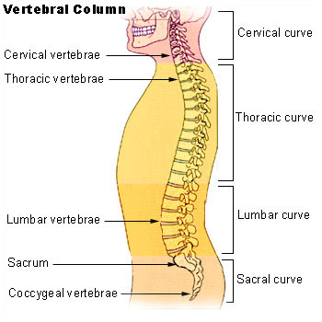

Slide 4
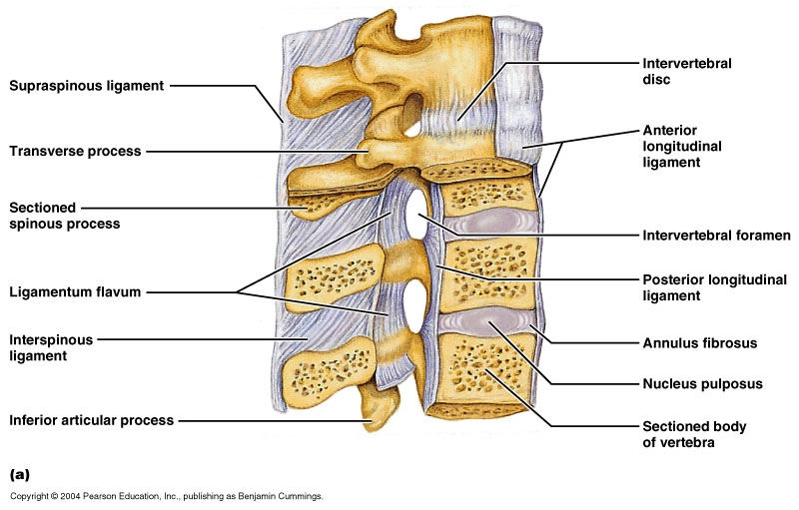
Structure of the Vertebral Column
It is formed of: I. Vertebrae,
& II. Inter-vertebral discs.
I. Vertebrae : Their number is 33 vertebrae.

Slide 5
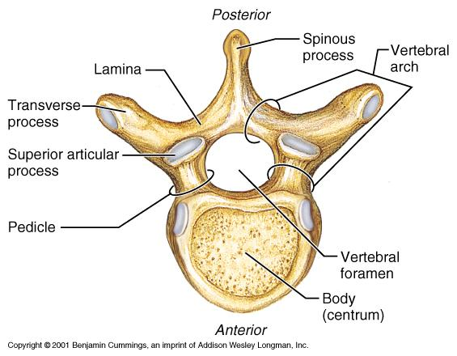
Structure (or Parts) of the Vertebra
Structure (or Parts) of the Vertebra
The vertebra is formed of two main parts; a body and an arch
with a foramen in-between of them called "vertebral foramen".
The vertebral foramina of the vertebrae together form the
vertebral canal, enclosing the spinal cord.
· The arch carries many processes, including:-
1. One spine, directed posteriorly.
2. Two transverse processes.
3. Two superior articular processes.
4. Two inferior articular processes.

Slide 6

The arch itself is divided into 2 halves by the attachment of the spine.
Each half is then subdivided by the transverse process into 2 parts:-
Anterior part, attached to the body of the vertebra, called pedicle.
Posterior part, in-between the transverse process and spine, called lamina.

Slide 7
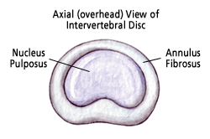
II. Inter-vertebral disc
· Structure:- It is a fibro-cartilage, found between the bodies
of the vertebrae (so it represents a secondary cartilaginous joint).
Each disc is formed of two portions:
- Nucleus pulposus: is the central gelatinous part.
- Annulus fibrosus: is the peripheral part. It is formed of fibro-cartilaginous tissue, of which collagen fibers are arranged in
concentric manner. It is attached to the anterior and posterior
ligaments of the vertebral column.

Slide 8
Function of the intervertebral disc
The discs act as a buffer between the vertebrae to neutralize the shocks applied to the vertebral column.
They represent about 20% (or 1/5th) of the total length of the vertebral column.
(N.B.: There is no inter-vertebral disc between the first and the second cervical vertebrae) or in sacrum or coccyx.

Slide 9
Classification of Vertebrae
The vertebrae are arranged into 5 regions, as follows:
"7" cervical vertebrae.
"12" thoracic vertebrae.
"5" lumbar vertebrae.
"5" sacral vertebrae, fused together to form one bone called; "sacrum".
"4" coccygeal vertebrae, fused together to form "one bone called; "coccyx"(tailbone).

Slide 10
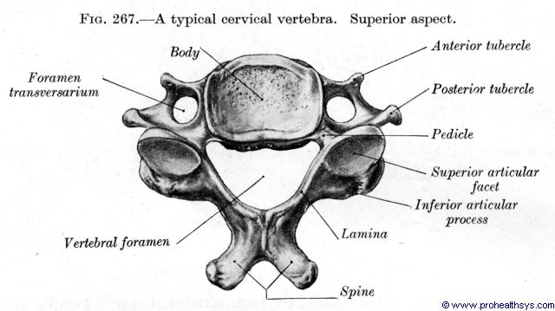
Cervical Vertebrae
Characters of typical cervical vertebrae (3rd to 6th), include:
1. They are the smallest and lightest vertebrae.
2. Body of vertebra is small in size and the transverse diameter is larger than the antero-posterior one.
3. Vertebral foramen is wide and triangular.
4. Spine is short and bifid.
5. Transverse processes are bifid and each one show a foramen called foramen transversarium, for passage of vertebral vessels and
sympathetic nerve fibers.
6. Facet on the superior articular
process is directed superiorly and posteriorly,
while that of the inferior articular
process is directed inferiorly and
anteriorly.
N.B.: Once you see these foramina, the
vertebra is then a cervical in type

Slide 11
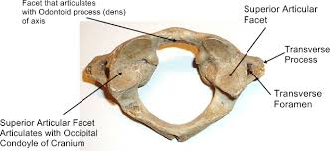
Atypical Cervical Vertebrae
1st Cervical Vertebra (called atlas):
Has no body and no spine. The upper surface contains large oval depression for articulations with the occipital condyles of skull. The joints between it and skull, called atlanto-occipital joints allow us to express 'yes'

Slide 12
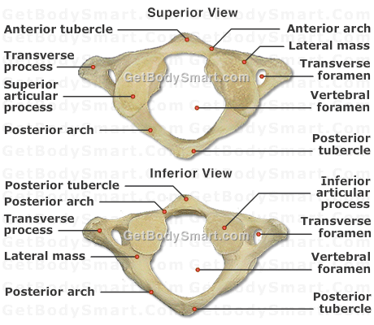

Slide 13
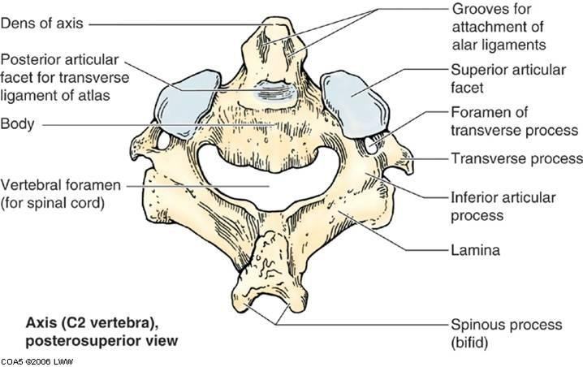
2nd Cervical Vertebra (called axis):
Has dens (called odontoid process). This process represents the body of 1st vertebra, fused with the body of 2nd vertebra. It acts as a pivot for rotation of the skull and the first vertebra. The joints between it and the 1st cervical vertebra called atlanto-axial joints allow us to express 'no'.

Slide 14
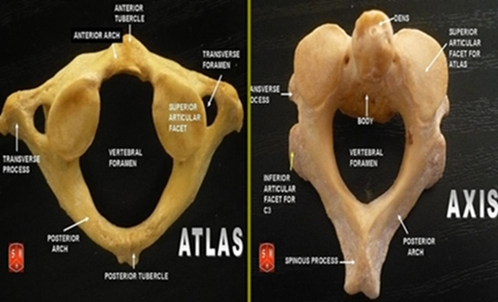

Slide 15
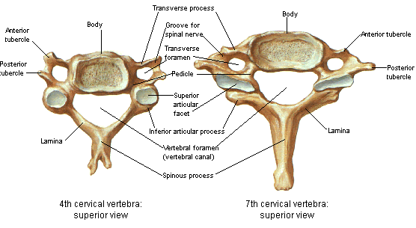
7th Cervical Vertebra: It resembles the typical vertebra, except it has long tapering spinous process.

Slide 16
Thank you

