Slide 1
Cranial Nerves
Assistant Professor
Dr. Duraid H Abid Alkadem
M.B.Ch.B (TUCOM)
MRCS ENT (RCSEd, UK),
DOHNS (RCSEd, UK),
MRES Anatomy ( Liverpool, UK)

Slide 2
The cranial nerves
12 in number
Are part of the peripheral nervous system
All exit the cranial cavity through foramina or fissures
All originate from the brain except cranial nerve 11( Accessory nerve)
Contain sensory, motor or both components

Slide 3
Cranial nerves
Like spinal nerves, cranial nerves are bundles of sensory or motor fibers that innervate muscles or glands; carry impulses from sensory receptors, or show a combination of these fiber types.
They are called cranial nerves because they emerge through foramina or fissures in the cranium and are covered by tubular sheaths derived from the cranial meninges.
There are twelve pairs of cranial nerves, which are numbered I to XII, from rostral to caudal, according to their attachment to the brain and penetration of the cranial dura. Their names reflect their general distribution or function.

Slide 4
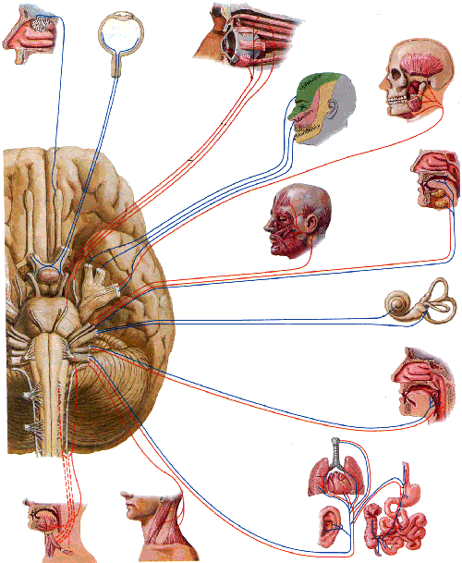
Names of cranial nerves
Ⅰ Olfactory nerve
Ⅱ Optic nerve
Ⅲ Oculomotor nerve
Ⅳ Trochlear nerve
Ⅴ Trigeminal nerve
Ⅵ Abducent nerve
Ⅶ Facial nerve
Ⅷ Vestibulocochlear nerve
Ⅸ Glossopharyngeal nerve
Ⅹ Vagus nerve
Ⅺ Accessory nerve
Ⅻ Hypoglossal nerve

Slide 5
Classification of cranial nerves
Sensory cranial nerves: contain only afferent (sensory) fibers
  ⅠOlfactory nerve
  ⅡOptic nerve
  Ⅷ Vestibulocochlear nerve
Motor cranial nerves: contain only efferent (motor) fibers
  Ⅲ Oculomotor nerve
  Ⅳ Trochlear nerve
  ⅥAbducent nerve
  Ⅺ Accessory nerve
  Ⅻ Hypoglossal nerve
Mixed nerves: contain both sensory and motor fibers---
  ⅤTrigeminal nerve,
  Ⅶ Facial nerve,
  ⅨGlossopharyngeal nerve
  ⅩVagus nerve

Slide 6
Sensory vs Motor vs Both
Cranial Nerve TYPE
1 Olfactory (I) Some
2 Optic (II) Say
3 Oculomotor (III) Marry
4 Trochlear (IV) Money
5 Trigeminal (V) But
6 Abducens (VI) My
7 Facial (VII) Brother
8 Vestibulocochlear (VIII) Says
9 Glossopharyngeal (IX) Better
10 Vagus (X) Brains
11 Accessory (XI) Matter
12 Hypoglossal (XII) Most

Slide 7
Brief overview of cranial nerve functional components
The 12 cranial nerves participate in a total of seven neural functions. Each of these seven functions is designated by a three letter acronym.
The first letter is either G (General) or S (Special).
  General refers to primitive and/or external structures of the body.
  Special refers to senses unique to the head (taste, olfaction, hearing, vision, and balance) and to muscles of branchial arch derivatives.
The second letter is either S (Somatic) or V (Visceral).
  Somatic refers to non-visceral structures including skin, muscles, tendons, joints, retina (vision), basilar membrane (hearing), and utricle/saccula (balance).
  Visceral refers to organs of the body cavity, smooth muscle, vessels, and glands.
The third letter is either A (Afferent) or E (Efferent).
  Afferent refers to flow of neural information toward the brain (sensation)
  Efferent refers to flow of neural information toward the periphery (motor).
Knowledge of the functional components and the deficits that follow damage to each provides the basis of the thorough neurological exam.

Slide 8
Functional components
General somatic afferent fibers (GSA): transmit exteroceptive and proprioceptive impulses from head and face to somatic sensory nuclei
Special somatic afferent fibers (SSA): transmit sensory impulses from special sense organs of vision, equilibrium and hearing to the brain
General visceral afferent fibers (GVA): transmit interoceptive impulses from the viscera to the visceral sensory nuclei
Special visceral afferent fibers (SVA): transmit sensory impulses from special sense organs of smell and taste to the brain

Slide 9
Functional components
General somatic efferent fibers (GSE): innervate skeletal muscles of eye and tongue
Special visceral efferent fibers (SVE): transmit motor impulses from the brain to skeletal muscles derived from pharyngeal arches of embryo. These include the muscles of mastication, facial expression and swallowing
General visceral efferent fibers (GVE): transmit motor impulses from the general visceral motor nuclei and relayed in parasympathetic ganglions. The postganglionic fibers supply cardiac muscles，smooth muscles and glands

Slide 10
Functional Component | Abbreviation | General function | Cranial nerve
General Somatic Afferent | GSA | Touch, Pain and Temperature | 5,7 &10
General Visceral Afferent | GVA | Sensory from Viscera | 9 & 10
Special Afferent | SA | Smell, Taste, Vision, Hearing and Balance | 1,2,7,8,9 & 10

Slide 11
Functional component | Abbreviation | General function | Cranial nerves
General Somatic Efferent | GSE | Motor Innervations to skeletal (voluntary) muscles | 3,4 6 & 12
General Visceral Efferent | GVE | Motor innervations to smooth muscle, heart muscle and glands | 3,7,9 &10
Brachial Efferent (SVE) | BE | Motor innervation to skeletal muscles from pharyngeal arch | 5,7,9,10 &11

Slide 12
Sensory cranial nerves
N. | Location of cell body and axon categories | Cranial exit | Terminal nuclei | Main action
Ⅰ | Olfactory cells (SVA) | Cribrifom foramina | Olfactory bulb | Smell
Ⅱ | Ganglion cells (SSA) | Optic canal | Lateral geniculate body | Vision
Ⅷ | Vestibular ganglion(SSA) | Internal acoustic meatus | Vestibular nuclei | Equilibrium
 | Cochlear ganglion (SSA) |  | Cochlear nuclei | Hearing

Slide 13
Motor cranial nerves
N. | Nucleus of origin and axon categories | Cranial exit | Main action
Ⅲ | Nucleus of oculomotor (GSE) | Superior orbital fissure | Motor to superior, inferior and medial recti; inferior oblique; levator palpebrae superioris
 | Accessory nucleus of oculomotor (GVE) |  | Parasympathetic to sphincter pupillea and ciliary muscle
Ⅳ | Nucleus of trochlear nerve (GSE) | Superior orbital fissure | Motor to superior obliquus
Ⅵ | Nucleus of abducent nerve (GSE) | Superior orbital fissure | Motor to lateral rectus
Ⅺ | Nucleus of accessory nerve (SVE) | Jugular foramen | Motor to sternocleidomastoid and trapezius
Ⅻ | Nucleus of hypoglossal nerve( GSE) | Hypoglossal canal | Motor to muscles of tongue

Slide 14
OLFACTORY NERVE

Slide 15
INTRODUCTION
Oldest sensory modality
1st Cranial nerve.
Sensory
Detects odor & influence social/sexual behavior.

Slide 16
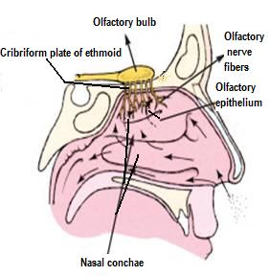
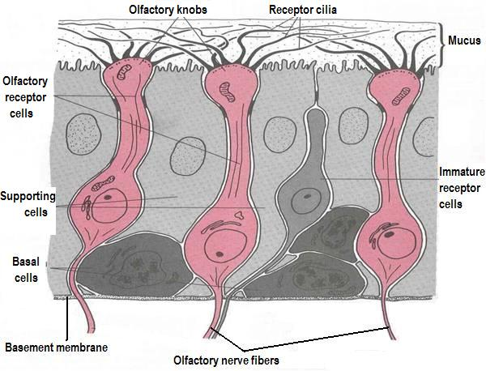
Olfactory Nerve
The receptors located in an area, covering about 5 cubic centimeters, in the superior part of the nose.
There are about 10 million to 20 million receptor cells for smell.
Each receptor is a specialized, ciliated neuron.
Their axons form numerous small fasciculi, the olfactory nerves, that pass through tiny openings in the cribriform plate of the ethmoid bone to reach the cranial cavity.

Slide 17
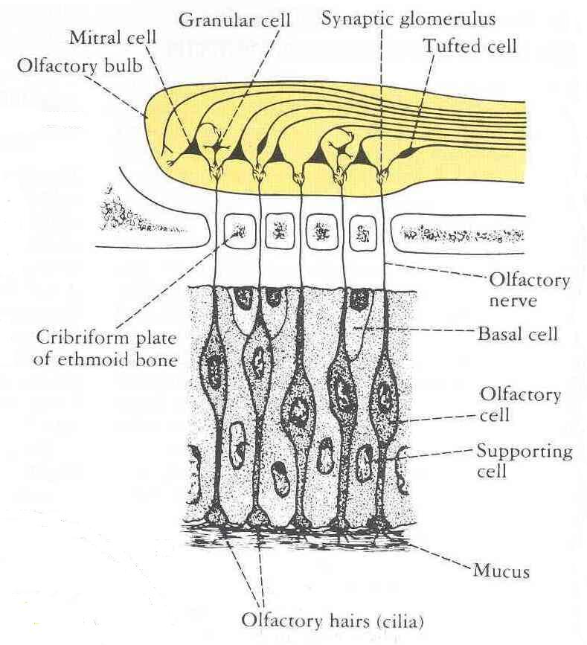
Olfactory Pathway
In the cranial cavity, the olfactory neurons synapse with neurons in the olfactory bulb.
The olfactory bulbs (right and left) are contain interneurons and large mitral cells.
The axons of the mitral cells form the olfactory tract, which passes backward on the basal surface of frontal lobe.

Slide 18
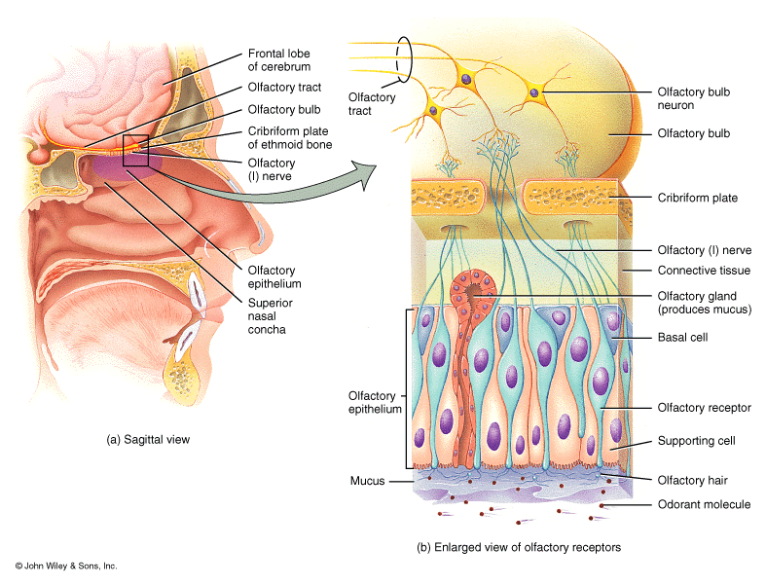
OLFACTORY EPITHELIUM
Located in upper part of nasal cavity
3 cell types-
  Basal cells
  Supporting cell
  Olfactory receptor cells
Olfactory receptor cells:
Bipolar cells with peripheral and central processes

Slide 19
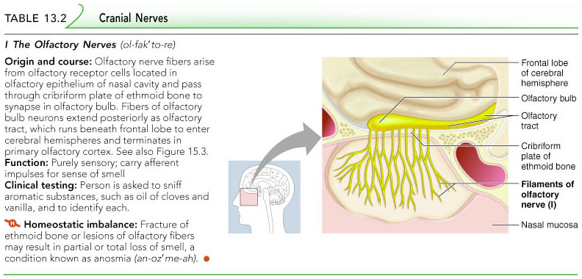

Slide 20
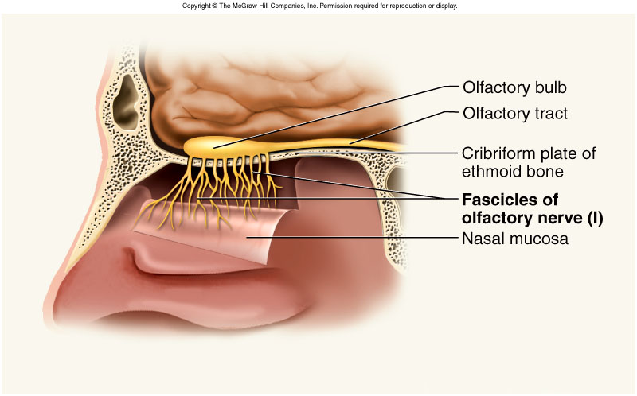
OLFACTORY NERVE
Unmylinated axons
Pass through cribriform plate
Enter the olfactory bulb
Synapse with mitral cells.

Slide 21
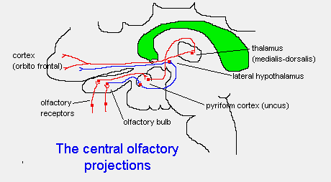

Slide 22
Clinical Anatomy
Damage to the olfactory nerves lead to anosmia
  The delicate olfactory nerves are prone to damage by head injury (e.g., whiplash) where the head is shaken in an anteroposterior direction. Here, the brain tends to move forward/backward, thus damaging the neurons entering vertically through the cribriform plate.
  Tumors of meninges may invade the olfactory nerves

Slide 23
OPTIC NERVE

Slide 24
INTRODUCTION
2nd cranial nerve
Sensory
Starts from optic disc, extends to optic chiasma
Backwawards continuation of retinal nerve fibers( in the ganglionic layer of retina)
Morphologically & embryologically comparable to sensory tract; it is myelinated and the sheaths are formed by oligodendrocytes

Slide 25
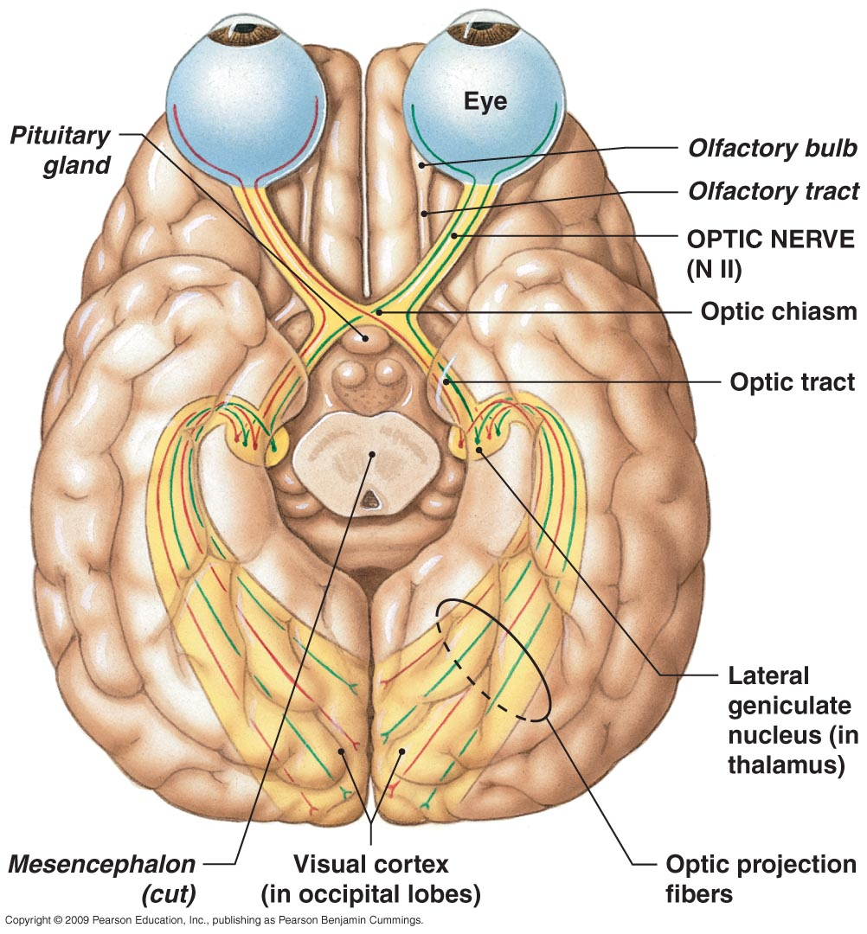
Optic nerve
Figure 14–20 The Optic Nerve.

Slide 26
Optic nerve
It leaves the orbital cavity through the optic canal and unites with opposite side to form optic chiasma

Slide 27
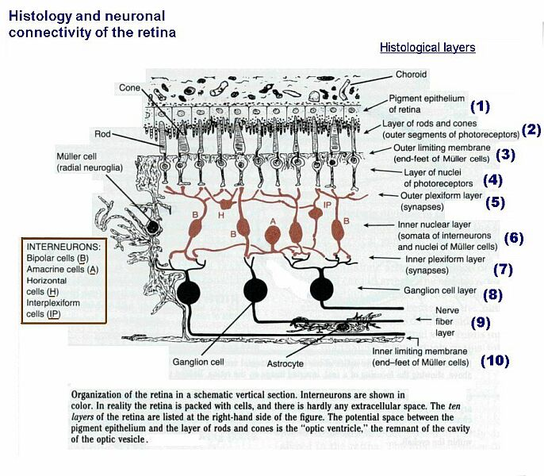

Slide 28
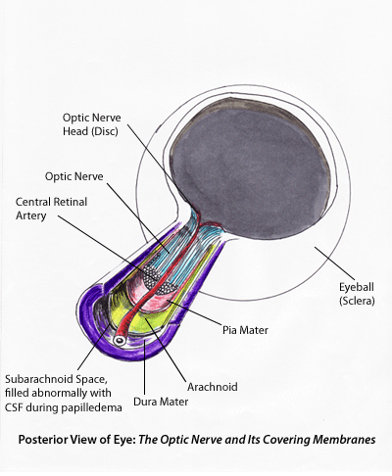

Slide 29
INTRAORBITAL PART
Extends from back of eyeball to optic foramina.
Surrounded by the 4 recti muscles near the optic foramina.
Some fibers of superior rectus closely adherent to nerve sheath.
Pierced by central retinal artery/vein.

Slide 30
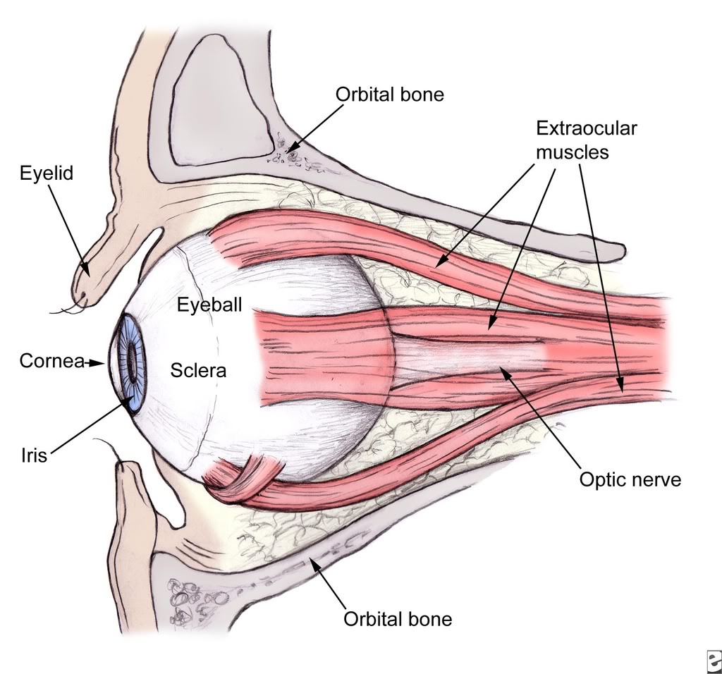

Slide 31
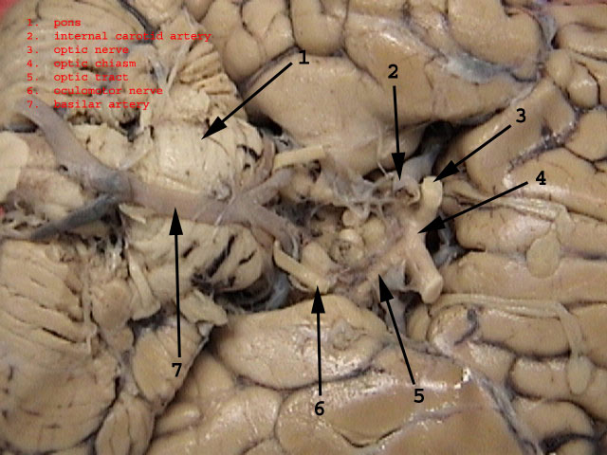

Slide 32
OPTIC CHIASMA
Situated at the junction of the anterior wall and floor of the third ventricle
Crossroad
Flat & Quadrangular in shape
Partial Decussation

Slide 33
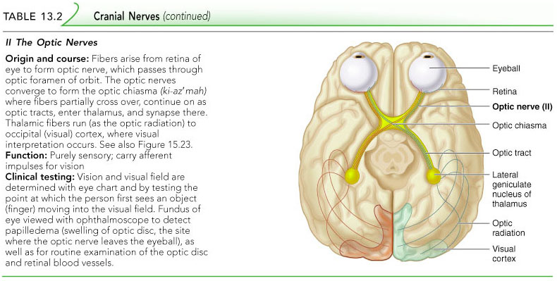
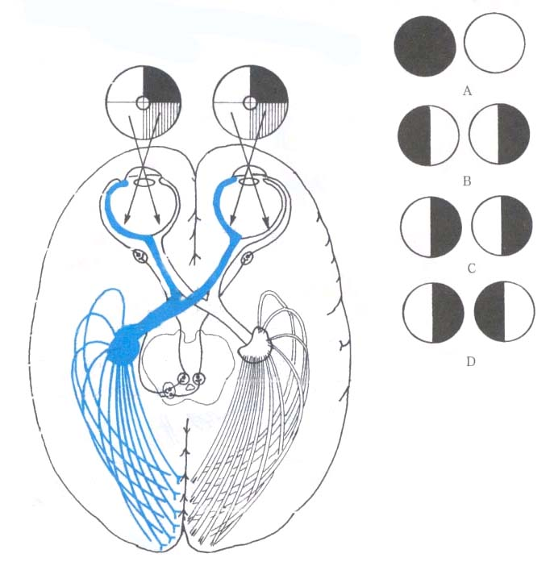

Slide 34
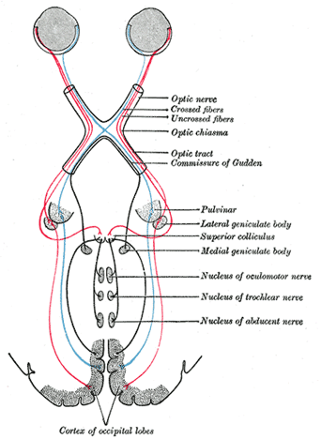

Slide 35
OPTIC TRACTS
Cylindrical bundles of nerve fibers
Ipsilateral temporal fibers & contralateral nasal fibers
Runs outward & backwards
Terminate in the lateral geniculate bodies.
Pupillary reflex fibers pass to superior colliculi.

Slide 36
LATERAL GENICULATE BODIES
Oval structures at posterior termination of optic tract
Consists of six layers of neurons (gray matter) alternating with white matter (formed by optic fibers).
Second order neurons relay station.

Slide 37
OPTIC RADIATION:-
  Extends from LGB to Visual Cortex
VISUAL CORTEX:-
  Medial aspect of occipital lobe above & below calcarine fissure-
    Visual cortex (area 17)
    Visual association area (area 18 & area 19)

Slide 38
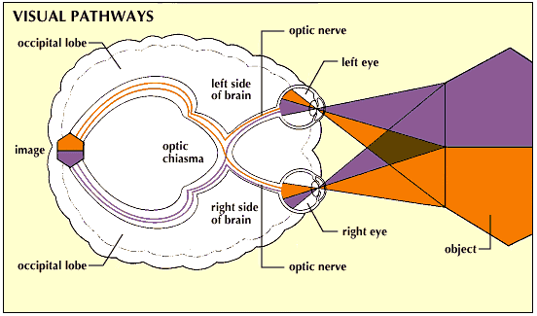
LESIONS OF VISUAL PATHWAY

Slide 39
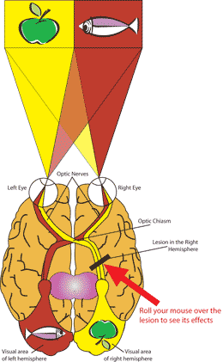

Slide 40
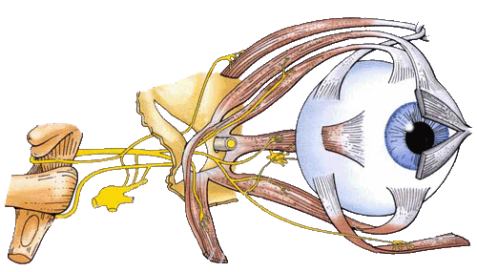
Oculomotor nerve
Fibers extend from the ventral midbrain, pass through the superior orbital fissure, and go to the extrinsic eye muscles
Components
  General somatic efferent fibers (GSE)
  General visceral efferent fibers (GVE)
2 nuclei
Main action－supplies
  Superior, inferior and medial recti; inferior obliquus; levator palpebrae superioris
  Sphincter pupillea and ciliary muscle
Ciliary ganglion: lies between optic nerve and
lateral rectus
Oculomotor nerve

Slide 41
Cranial Nerve III: Oculomotor
Functions in raising the eyelid, directing the eyeball, constricting the pupil, and controlling lens shape
The latter 2 functions are parasympathetically controlled
Parasympathetic cell bodies are in the ciliary ganglia

Slide 42
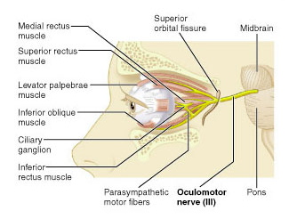
Oculomotor

Slide 43
Summary of Oculomotor N.
Oculomotor Nerves (III)
  Primary function
    Motor (eye movements)
  Origin
    Mesencephalon
  Pathway
    Superior orbital fissures of sphenoid
  Destination
    Somatic motor:
      superior, inferior, and medial rectus muscles
      inferior oblique muscle
      levator palpebrae superioris muscle
    Visceral motor:
      intrinsic eye muscles

Slide 44
The intrinsic eye muscles are innervated by the autonomic systems and include the iris sphincter and the ciliary muscle (innervated by the parasympathetic component of cranial nerve III), and the radial pupillodilator muscles (innervated by the ascending cervical sympathetic system with its long course from spinal .

Slide 45
Cranial Nerves
Oculomotor Nerve Structures
  Oculomotor nerve
    Controls four of six eye-movement muscles
    Delivers autonomic fibers to ciliary ganglion:
      ciliary ganglion: controls intrinsic muscles of iris and lens

Slide 46
Cranial Nerve IV: Trochlear
Fibers emerge from the dorsal midbrain and enter the orbits via the superior orbital fissures; innervate the superior oblique muscle
Primarily a motor nerve that directs the eyeball
It is the most slender cranial nerve and the only one to leave the posterior surface of brainstem

Slide 47
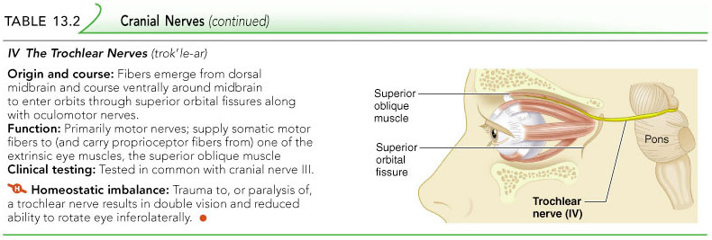
Trochlear

Slide 48
Trochlear Nerve
The Trochlear Nerves (IV)
  Primary function
    Motor (eye movements)
  Origin
    Mesencephalon
  Pathway
    Superior orbital fissure of sphenoid
  Destination
    Superior oblique muscle

Slide 49
Cranial Nerve VI: Abducens
Fibers leave the pons and enter the orbit via the superior orbital fissure
Primarily a motor nerve innervating the lateral rectus muscle (abducts the eye; thus the name abducens)

Slide 50
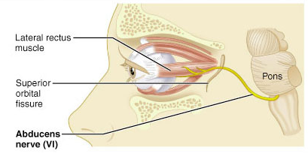
Abducens

Slide 51
Abducens Nerves
The Abducens Nerves (VI)
  Primary function
    Motor (eye movements)
  Origin
    Pons
  Pathway
    Superior orbital fissures of sphenoid
  Destination
    Lateral rectus muscle

Slide 52
Cranial Nerves v
The Trigeminal Nerves (V)
  Primary function
    Mixed (sensory and motor) to face
  Origin
    Ophthalmic branch (sensory):
      orbital structures
      nasal cavity
      skin of forehead, upper eyelid, and eyebrow
      part of nose

Slide 53
Cranial Nerves v
The Trigeminal Nerves (V)
  Origin
    Maxillary branch (sensory):
      lower eyelid
      upper lip, gums, and teeth
      cheek and nose
      palate and part of pharynx
    Mandibular branch (sensory):
      lower gums, teeth, and lips
      palate and part of tongue
    Mandibular branch (motor):
      motor nuclei of pons

Slide 54
Cranial Nerves(V)
The Trigeminal Nerves (V)
  Pathway
    Ophthalmic branch:
      superior orbital fissure
    Maxillary branch:
      foramen rotundum
    Mandibular branch:
      foramen ovale

Slide 55
Cranial Nerves(V)
The Trigeminal Nerves (V)
  Destination
    Sensory nerves:
      sensory nuclei in pons
    Motor nerves of mandibular branch:
      muscles of mastication

Slide 56
Cranial Nerves(V)
Trigeminal Nerve Structures
  Trigeminal nerves
    Largest cranial nerves
    With three major branches
  Semilunar ganglion
    Contains cell bodies of sensory neurons

Slide 57
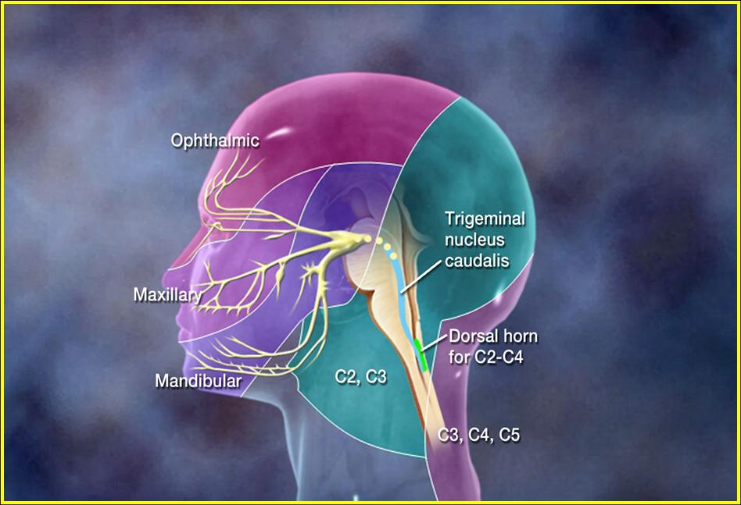

Slide 58
Trigeminal ganglion
The trigeminal ganglion (or Gasserian ganglion, or semilunar ganglion, or Gasser's ganglion) is a sensory ganglion of the trigeminal nerve (CN V) that occupies a cavity (Meckel's cave) in the dura mater, covering the trigeminal impression near the apex of the petrous part of the temporal bone.
It is somewhat crescentic in shape, with its convexity directed forward: Medially, it is in relation with the internal carotid artery and the posterior part of the cavernous sinus.
The motor root runs in front of and medial to the sensory root, and passes beneath the ganglion; it leaves the skull through the foramen ovale, and, immediately below this foramen, joins the mandibular nerve.
The greater superficial petrosal nerve lies also underneath the ganglion.

Slide 59
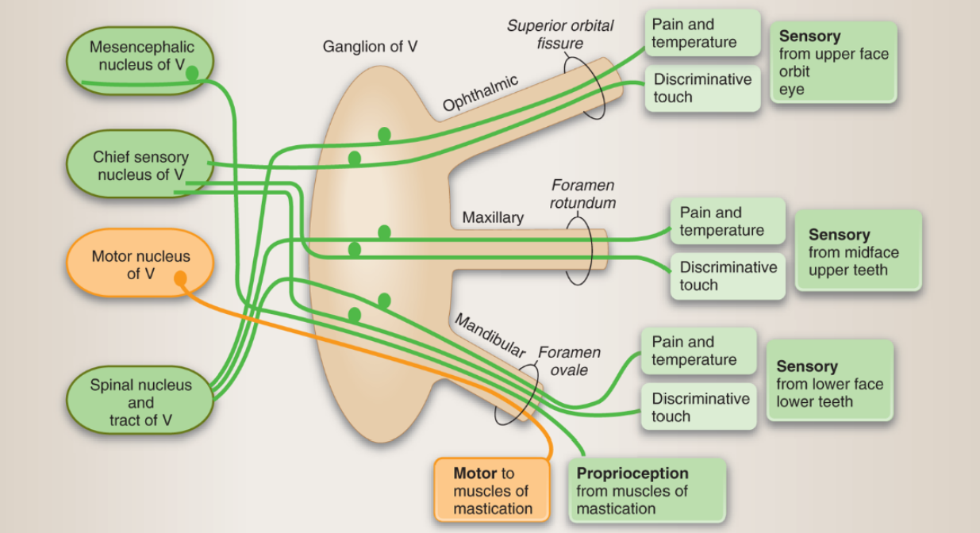

Slide 60
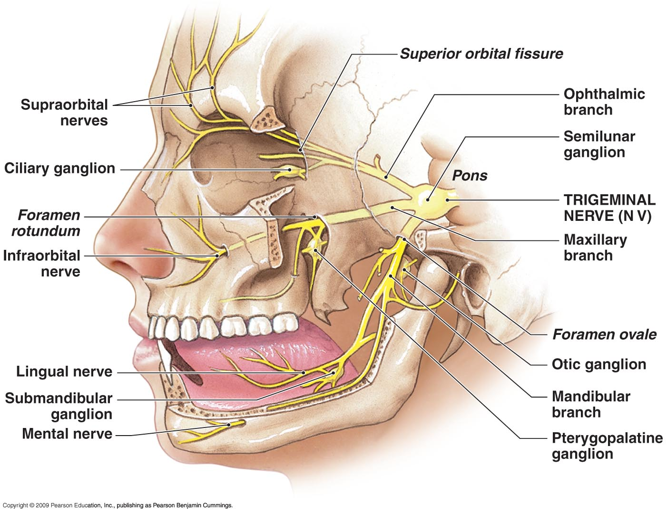
Cranial Nerves
Figure 14–22 The Trigeminal Nerve.

Slide 61
