Slide 1
The external ear
Assistant Professor
Dr. Duraid H Abid Alkadem
M.B.Ch.B (TUCOM)
MRCS ENT (RCSEd, UK),
DOHNS (RCSEd, UK),
MRES Anatomy ( Liverpool, UK)

Slide 2
Divisions of the Ear
Peripheral Mechanism
Central Mechanism
Outer Ear | Middle Ear | Inner Ear | VIII Cranial Nerve | Brain

Slide 3
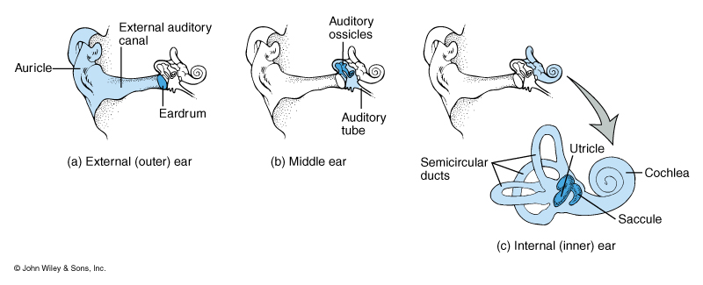
Three Parts of the Ear

Slide 4
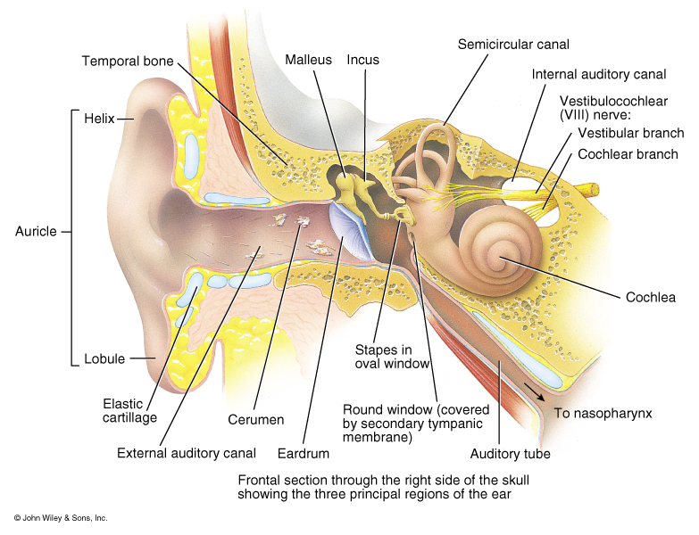
Overview of the anatomy of the external ear, middle ear and internal ear

Slide 5
External ear

Slide 6
Outer Ear
Pinna
Preauricular Tags
Preauricular Pits
EAM
Cerumen
Pinna
External
Auditory
Meatus

Slide 7
Major structures of The outer ear
Pinna or auricle
External auditory meatus or external ear canal
Tympanic membrane or eardrum
Notes:
Structures of the outer ear include the Auricle or Pinna, the external auditory meatus or external ear canal, and for some, the tympanic membrane or ear drum.
Some people consider the eardrum part of the middle ear, some consider it part of the outer ear. I think it’s the boundary between both, but we will consider it in our discussion of the outer ear.

Slide 8
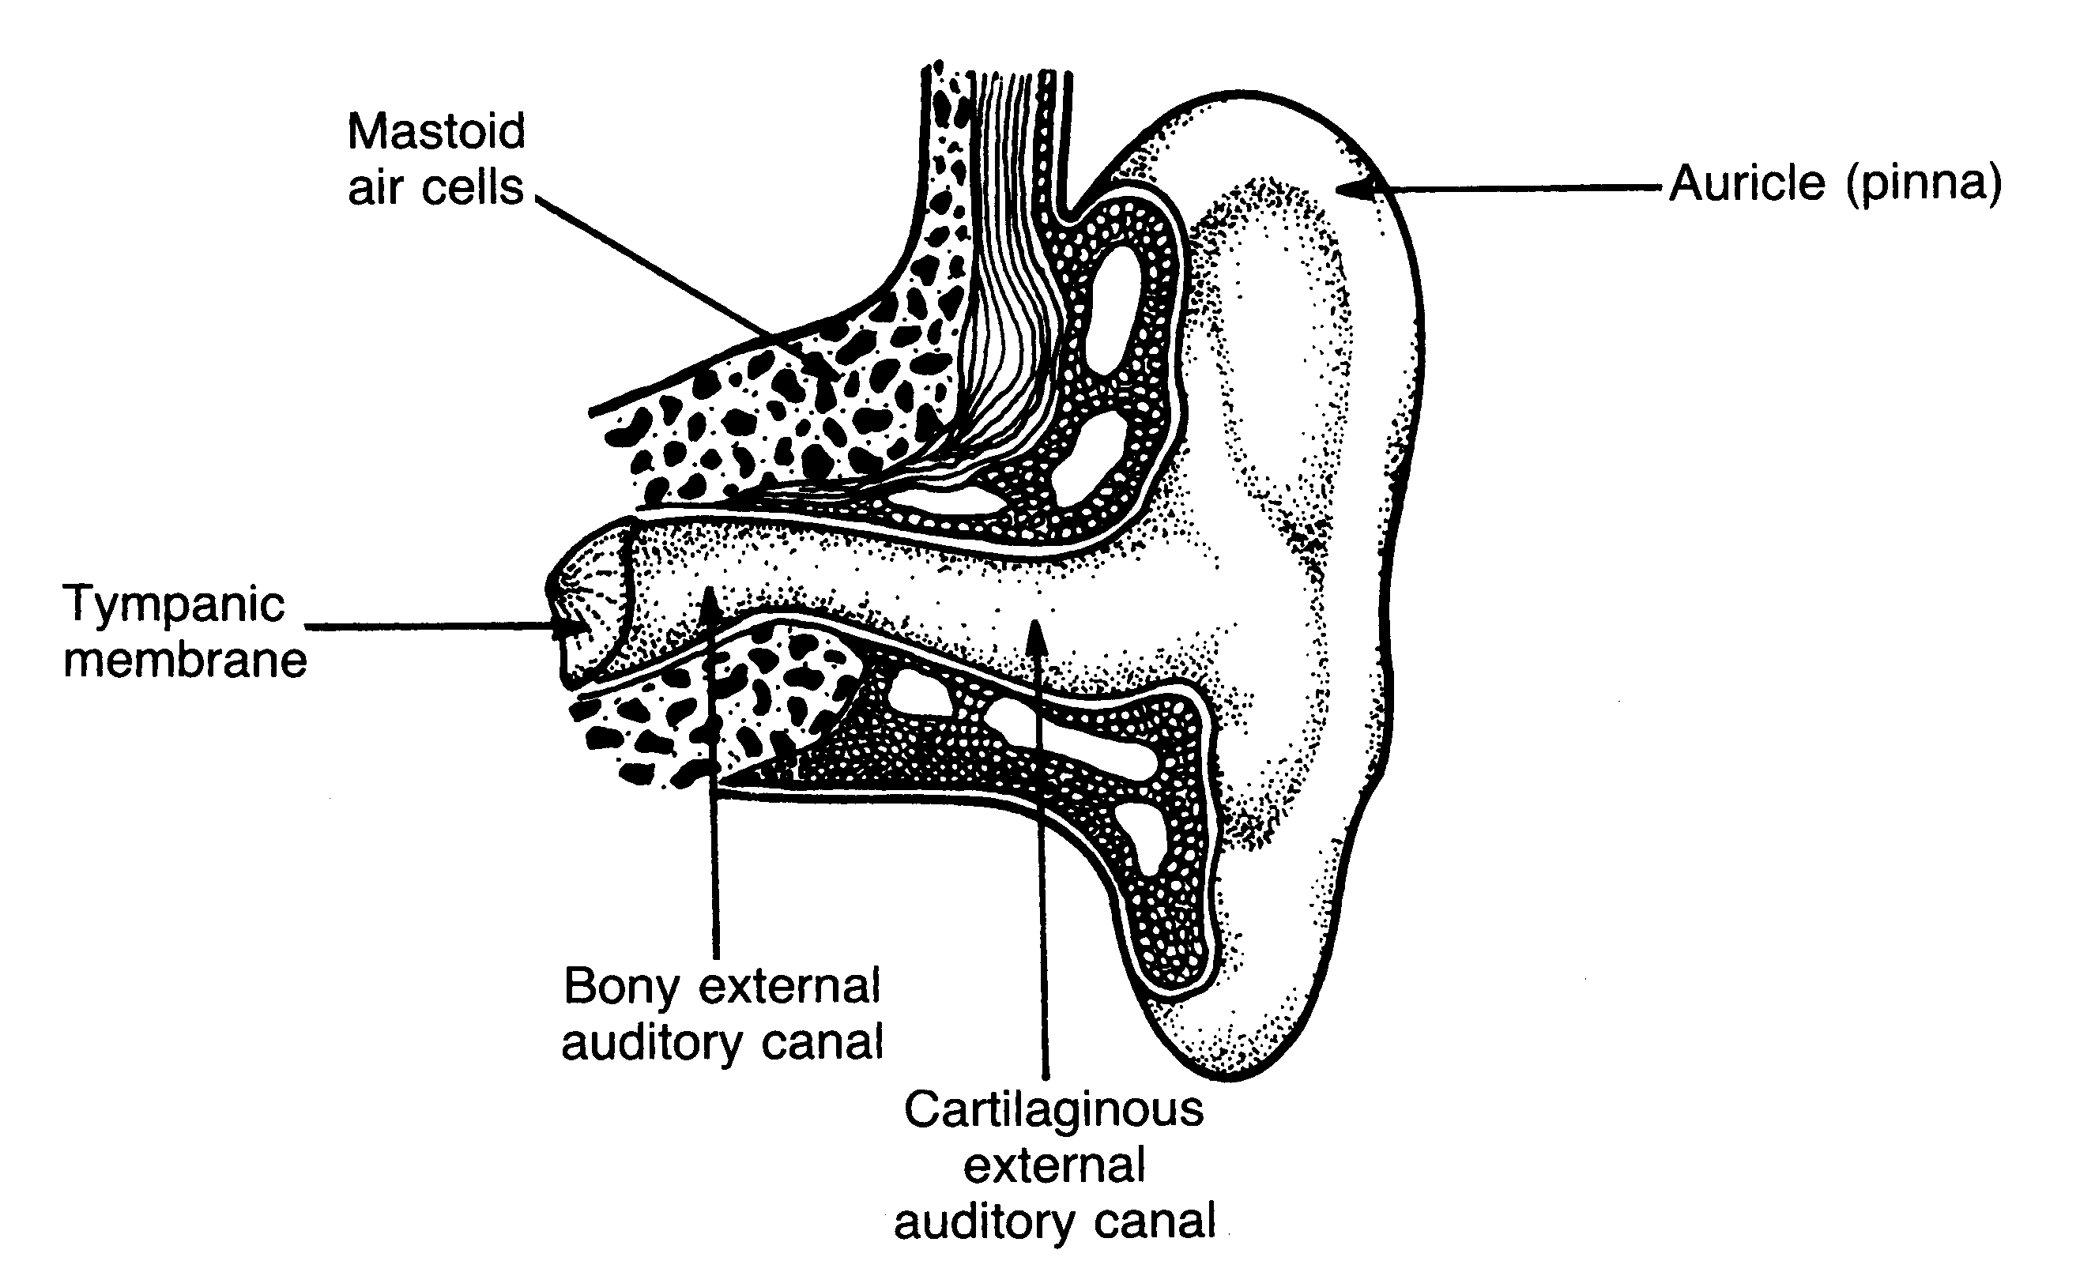
The outer ear
Cross section of the external ear
Notes:
Show figure 9.2--cross section of the external ear.

Slide 9
Function of Outer Ear
Collects sound
Localization
Resonator
Protection
Sensitive (earlobe)

Slide 10
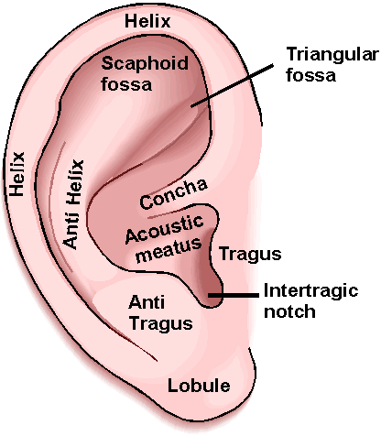
Pinna
The visible portion that is commonly referred to as "the ear"
Helps localize sound sources
Directs sound into the ear
Each individual's pinna creates a distinctive imprint on the acoustic wave traveling into the auditory canal

Slide 11
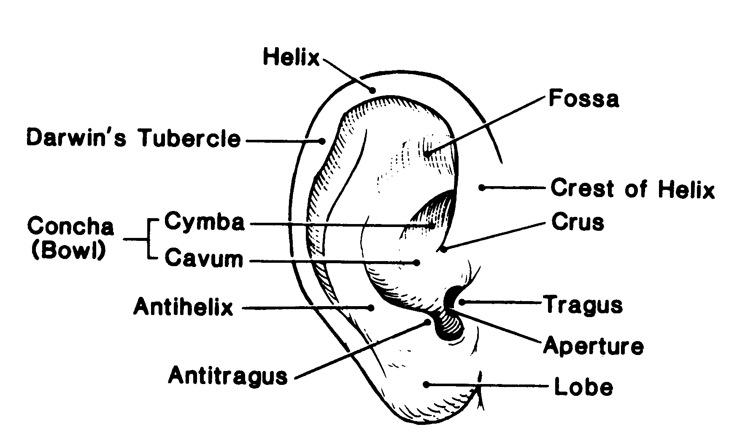
The pinna
Notes:
concha--divided into 2 parts cymba concha and cavum concha.
Use Fig 1.1 to show these. The concha aids in the ability to localize sources of sound and to funnel the sound to the external canal. It also has some resonant effects.

Slide 12
The external meatus
About 25 mm long, extends from the concha to the tympanic membrane. Its lateral part is cartilaginous and continuous with the auricle; the longer medial part is bony. The cartilaginous part of the meatus is slightly concave anteriorly,
A speculum may be inserted more readily when the auricle is pulled backward and upward. The meatus is lined by the skin of the auricle, which presents hairs, and sebaceous and ceruminous glands.

Slide 13
The external auditory canal
Structures
Sebaceous glands
Hair follicles
Osseocartilaginous junction
2.5 cm long
S-shaped
Outer 1/3 is cartilaginous
Inner 2/3 is bone
Notes:
tube formed in the side of the head, beginning at the concha and extending inward at a slight upward angle for about (2.5 cm) 1 inch in an adult. The canal is elliptical, averaging about 9 mm in height and 6.5 mm in width (adult).
S-shaped pathway (protective function) and slight downward tilt
Children’s canals tend to be less s-shaped and more horizontal---has implications for them
The canal is lined entirely in skin.
The outer portion (about 1/3 the length) passes thru cartilage.
The skin in this area supports several sets of glands, including the sebaceous glands which secrete sebum, an oily fatty substance.
The product of these secretions is cerumen, or earwax.
Talk about the purpose of cerumen (lubrication, protection, antimicrobial), movement, and problems with aging.
Hair follicles--protection.
Inner 2/3 of canal is bony--passes thru the tympanic portion of the temporal bone. No glands or hair here.
The cartilaginous portion and bony portion meet at the osseocartilaginous junction.
The condyle (protrusion of the mandible) comes to rest right below this junction (when the jaw is closed).
If bite is off, the condyle will put pressure on this junction and cause significant pain.

Slide 14
External Auditory Meatus
Extends from the pinna to the tympanic membrane
  About 26 mm in length and 7 mm in diameter in adult ear.
  Size and shape vary among individuals.
Protects the eardrum
Resonator
  Provides about 10 decibels (dB) of gain to the eardrum at around 3,300 Hertz (Hz).
The net effect of the head, pinna, and ear canal is that sounds in the 2,000 to 4,000 Hz region are amplified by 10 to 15 dB.
  Sensitivity to sounds greatest in this frequency region
  Noises in this range are the most hazardous to hearing

Slide 15
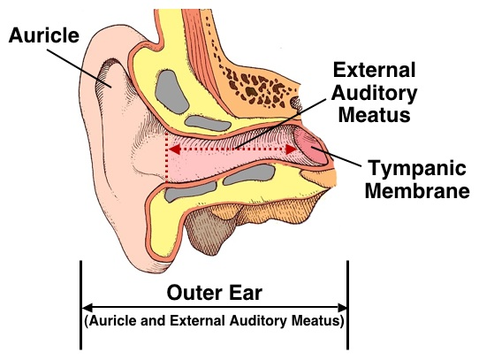
External Auditory Meatus

Slide 16
Outer ear
Tissues: elastic cartilage covered with skin
A. Meatus acusticus externus besides the hair follicles and fat glands contains:
Glandulae ceruminosae – modified sweat glands on the lateral wall of the canal.
Сerumеn (ear wax) combination of wax and fat glands secret and desquamated epithelial cells.

Slide 17
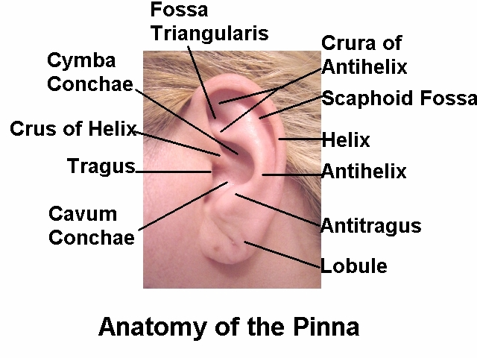

Slide 18
Earwax (Сerumеn )
Is a yellowish waxy substance secreted in the ear canal.
Function
1. It protects the skin of the human ear canal.
2. assists in cleaning and lubrication.
3. provides some protection from bacteria, fungi, insects and water.
Excess or compacted cerumen can press against the eardrum and/or occlude (block) the external auditory canal or hearing aids, potentially causing hearing loss(conductive hearing loss).

Slide 19
Sensory Innervation and Blood Supply.
Nerve supply
The external ear is supplied by the auriculotemporal (fifth cranial) nerve (and probably by contributions from cranial nerves VII, IX, and X) and the great auricular nerve.
Blood supply.
The posterior auricular and superficial temporal arteries of the external carotid artery.

Slide 20
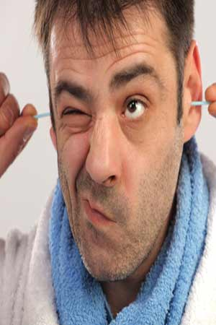
What do you say?

Slide 21
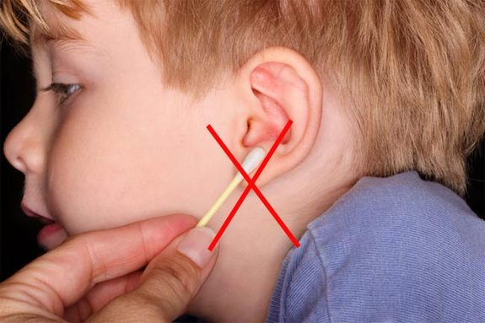
Now Hear This: Don't Remove Earwax

Slide 22
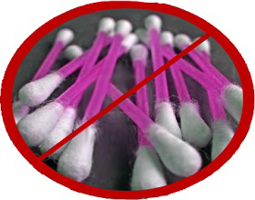

Slide 23
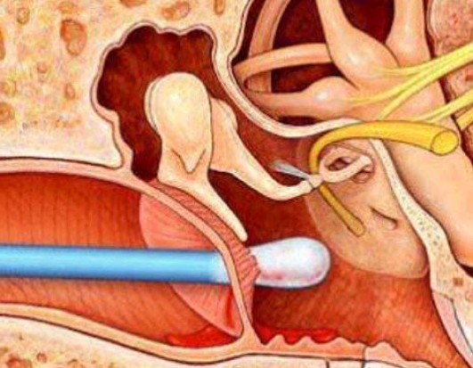
Why?

Slide 24
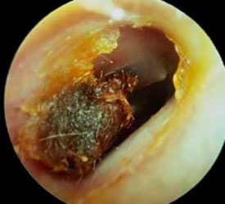
Clinical manifestation of wax impaction
Hearing loss.
Otalgia.
Stuffed or full feeling to ear
Vertigo.
Tinnitus
A feeling of itchiness in the ear
Discharge from the ear
Odor coming from the ear

Slide 25
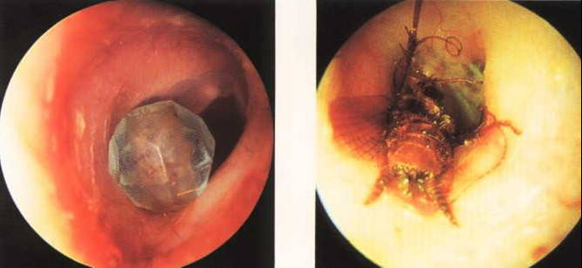
Bead
Bee
Foreign Bodies

Slide 26
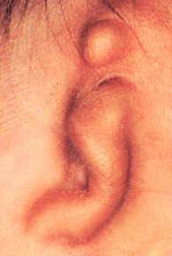
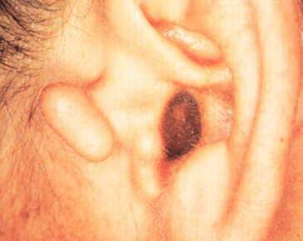
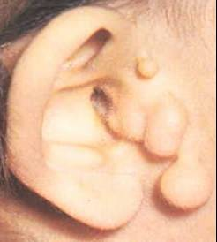
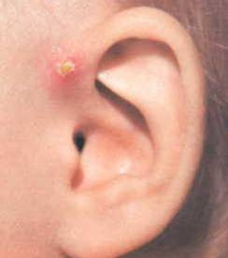
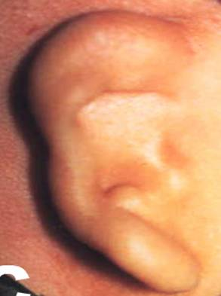
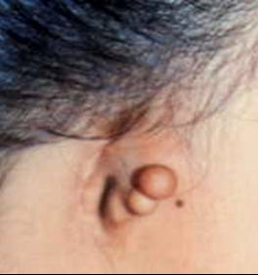
Accessory auricle
Aural atresia
Tags
Preauricular sinus
Absent external auditory canal
Aural atresia
Congenital aural anomalies due to defects of the 1st pharyngeal arch

Slide 27
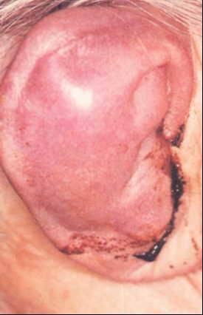
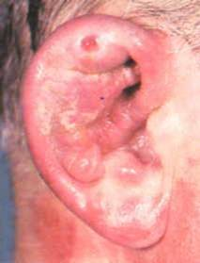
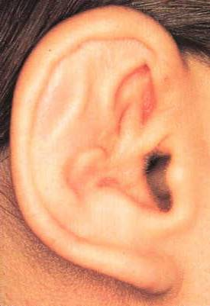
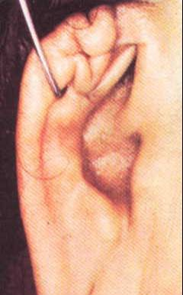
Hematoma ↓ Perichondritis ↓ Cauliflower auris ear

