Slide 1
Anatomy of Larynx
Assistant Professor
Dr. Duraid H Abid Alkadem
M.B.Ch.B (TUCOM)
MRCS ENT (RCSEd, UK),
DOHNS (RCSEd, UK),
MRES Anatomy ( Liverpool, UK)

Slide 2
General principles of development
The development of the larynx can be divided into prenatal and postnatal stages.
At birth, the larynx is located high in the neck between the C1 and C4 vertebrae, allowing concurrent breathing or vocalization and deglutition.
By age 2 years, the larynx descends inferiorly; by age 6 years, it reaches the adult position between C4 and C7 vertebrae. This new position provides a greater range of phonation (because of the wider supraglottic pharynx) at the expense of losing this separation of function, i.e., deglutition and breathing.

Slide 3
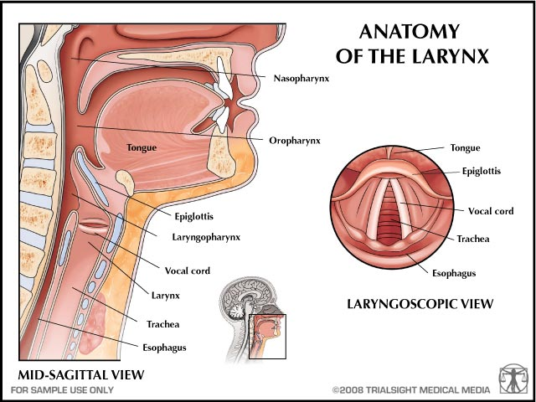
The larynx is the portion of the respiratory tract containing the vocal cords
A 2-inch-long, tube-shaped organ, opens into the laryngeal part of the pharynx above and is continuous with the trachea below
The larynx functions in:
  Deglutition (swallowing)
  Respiration (breathing)
  Phonation (voice production)

Slide 4
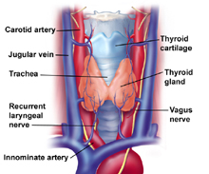
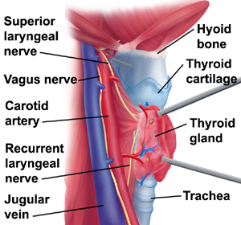
The Larynx: Relations
The larynx related to major critical structures:
  Carotid arteries , jugular veins, and vagus nerve
  Superior and inferior thyroid arteries
  Superior and recurrent laryngeal nerves

Slide 5
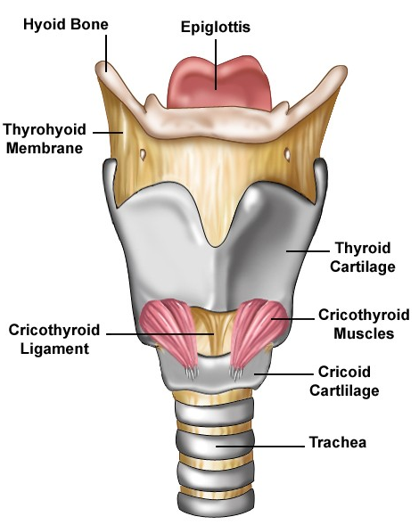
Structure
The larynx consists of four basic components:
  A cartilaginous skeleton
  Membranes and ligaments
  Intrinsic and extrinsic muscles
  Mucosal lining

Slide 6
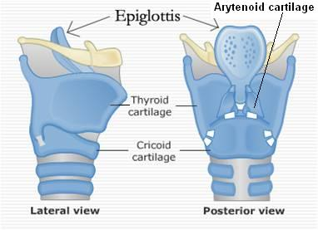
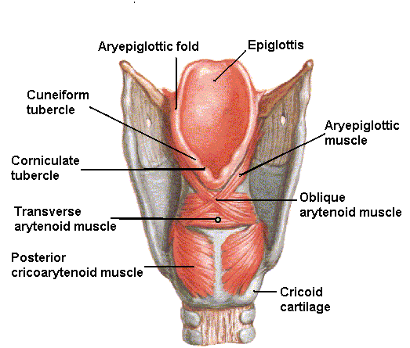
The Cartilages
The cartilaginous skeleton is comprised of :
  Single Cartilages:
    Thyroid
    Cricoid
    Epiglottis
  Paired Cartilages:
    Arytenoid
    Corniculate
    Cuneiform

Slide 7
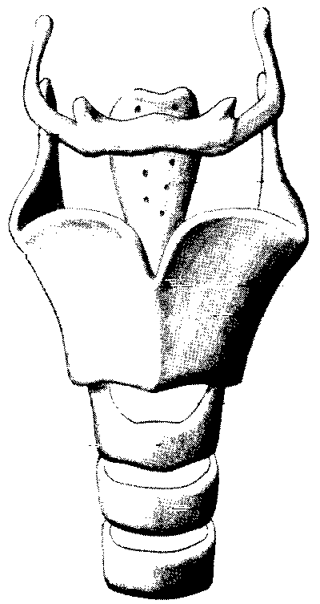
Laryngeal Cartilage's
3 Unpaired Cartilage's
-Epiglottis
-Thyroid
-Cricoid

Slide 8
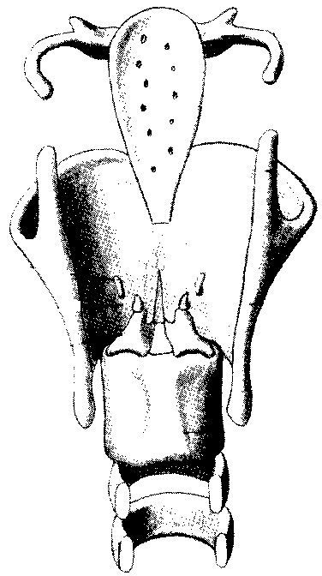
3 Paired Cartilage's
Cuneiform
-Corniculate
-Arytenoid

Slide 9
All the cartilages, except the epiglottis, are of hyaline type.
Epiglottis is formed of elastic cartilage
The cartilages are:
  Connected by joints, membranes & ligaments
  Moved by muscles

Slide 10
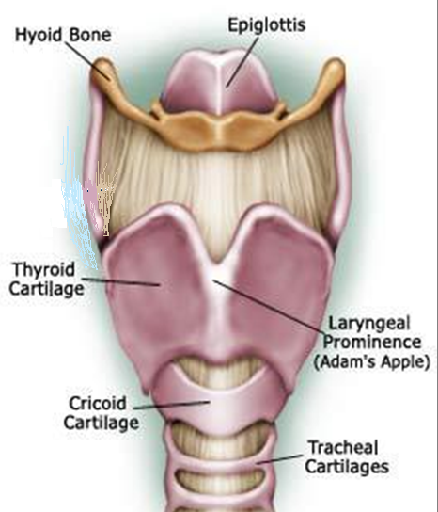
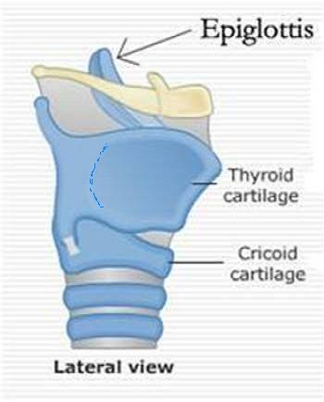
Thyroid Cartilage
Has two laminae, which meet in the midline and form a prominent angle, called laryngeal prominence (Adam’s apple) and the superior thyroid notch at the rostral margin of the
The posterior border of each lamina forms superior & inferior cornu (horns)
Outer surface of each lamina shows an oblique line which gives attachment to thyrohyoid, sternothyroid & inferior constrictor of the pharynx
The superior border gives attachment to the thyrohyoid membrane
superior cornu
Oblique line
inferior cornu

Slide 11
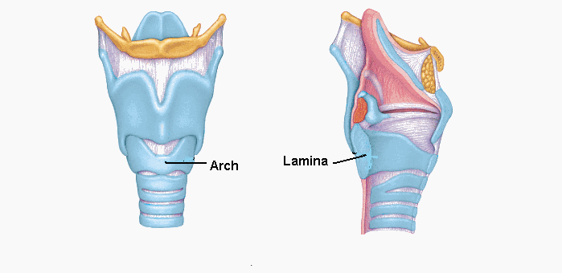
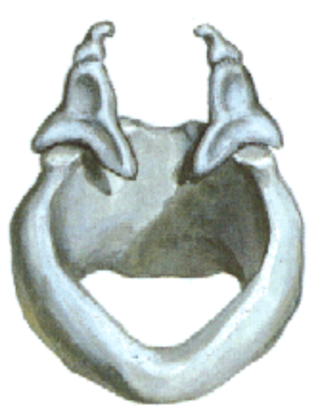
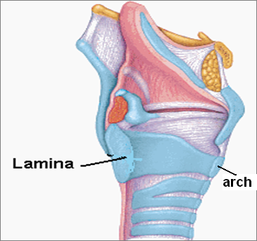
Cricoid Cartilage
Lies below the thyroid cartilage
Forms a complete ring
Has a narrow anterior arch & a broad posterior lamina
Has an articular facet on its:
  Lateral surface for articulation with inferior cornu of the thyroid cartilage (a synovial joint)
  Upper border for articulation with base of arytenoid cartilage (a synovial joint)

Slide 12
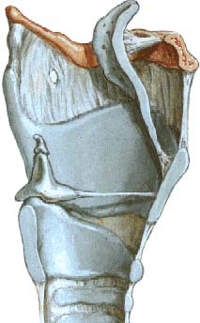
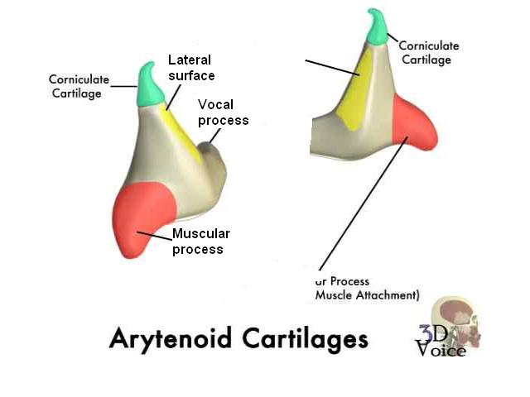
Arytenoid Cartilages
Small, pyramidal in shape
Situated at the back of the larynx
It Has:
A base articulating with the upper border of the cricoid cartilage
An apex supporting the corniculate cartilage
A vocal process projecting forward, gives attachment to the vocal ligament
A muscular process projecting laterally, gives attachment to muscles

Slide 13
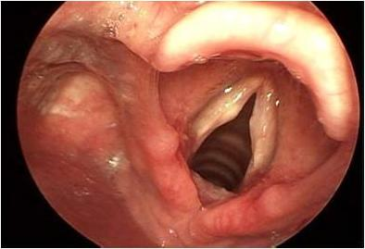
Corniculate & Cuneiform Cartilages
Corniculate Cartilages
Small nodules
Articulate with the apices of arytenoid cartilages
Cuneiform Cartilages
Small rod shaped, placed in each aryepiglottic fold, producing a small elevation
Do not articulate with any other cartilage
Serve as support for the ary-epiglottic fold
E
VF
CU
CO

Slide 14
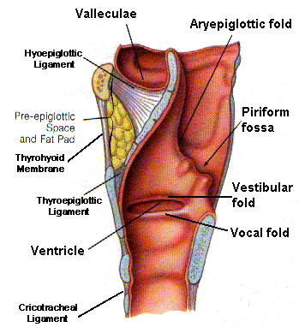
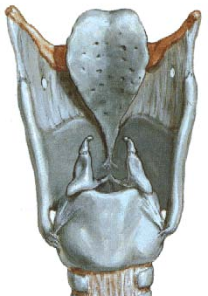
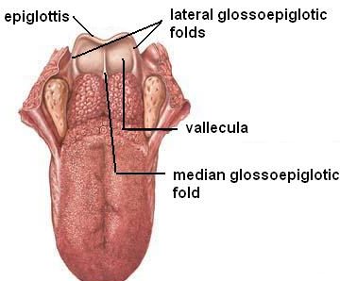
Epiglottis
Leaf shaped, situated behind the root of the tongue
Connected:
  In front to the body of hyoid bone by the hyoepiglottic ligament
  By its stalk to the back of thyroid cartilage by the thyroepiglottic ligament
Upper edge is free.
Laterally gives attachment to aryepiglottic fold
Anteriorly mucosa is reflected onto the tongue forming three glossoepiglottic folds & valleculae

Slide 15
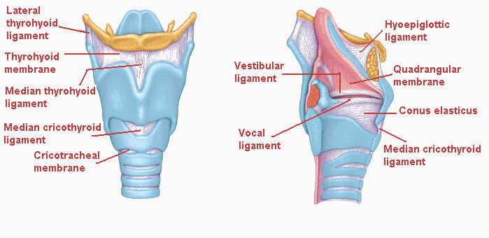
Membranes & Ligaments
Thyrohoid membrane, median & lateral thyrohoid ligaments
Median cricothyroid ligament
Cricotracheal membrane
Hyoepiglottic ligament
Thyroepiglottic ligament

Slide 16
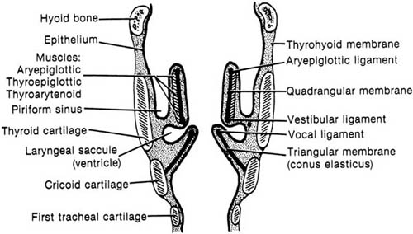
Quadrangular membrane:
Extends between the epiglottis and the arytenoid cartilages
Its lower free margin forms the vestibular ligament that lies within the vestibular fold
Cricothyroid membrane (conus elasticus):
Lower margin is attached to upper border of cricoid cartilage
Upper free margin forms vocal ligament that is attached anteriorly to deep surface of thyroid cartilage & posteriorly to the vocal process of arytenoid cartilage

Slide 17
Laryngeal Inlet
Faces backward and upward and opens into the laryngeal part of the pharynx
The opening is bounded:
  Anteriorly: by the upper margin of epiglottis
  Posteriorly & below by arytenoid cartilages
  Laterally by aryepiglottic folds
E
CU
CO
AEF
A

Slide 18
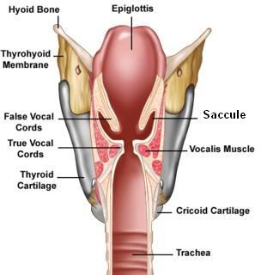
Laryngeal Cavity
Extends from laryngeal inlet to lower border of the cricoid cartilage
Narrow in the region of the vestibular folds (rima vestibuli)
Narrowest in the region of the vocal folds (rima glottidis)
Rima vestibuli
Rima glottidis

Slide 19
Laryngeal Cavity cont’d
Divided into three parts:
  Supraglottic part, the part above the vestibular folds, is called the vestibule
  The part between the vestibular & the vocal folds, is called the ventricle
  Infraglottic part, the part below the vocal folds
A
B
C

Slide 20
Vestibular Part:
Extends from the inlet to the vestibular fold
Below it becomes narrow as the vestibular folds project medially.
Each vestibular fold contains vestibular ligament, the lower free margin of the quadrangular membrane stretching from thyroid cartilage to the arytenoid cartilage
Lower Part:
Extends from vocal folds to lower border of cricoid cartilage
Walls formed by the inner surface of the cricothyroid ligament and the cricoid cartilage

Slide 21
Middle Part
Extend from vestibular folds to the vocal folds
Laterally a small recess between the vestibular fold & the vocal fold is called the sinus of the larynx, which may extend upwards between vestibular fold and the thyroid cartilage as saccule of the larynx

Slide 22
Mucous Membrane
The cavity is lined with ciliated columnar epithelium
The surface of vocal folds, because of exposure to continuous trauma during phonation, is covered with stratified squamous epithelium
Contains many mucous glands, more numerous in the saccule (for lubrication of vocal folds)
Muscles:
Divided into two groups:
Extrinsic muscles: divided into two groups
  Elevators of the larynx
  Depressors of the larynx
Intrinsic muscles: divided into two groups
  Muscles controlling the laryngeal inlet
  Muscles controlling the movements of the vocal cords

Slide 23
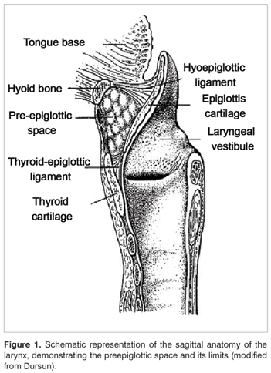
Pre-Epiglottic Space
Bound sup by hyo-epiglottic ligament, ant by thyrohyoid memb. & thyroid cartilage and posteriorly by epiglottis
Filled with fat and areolar tissue
Continuous with para-glottic space
Cx of laryngeal surface of epiglottis readily spread to PreEpiSpace

Slide 24
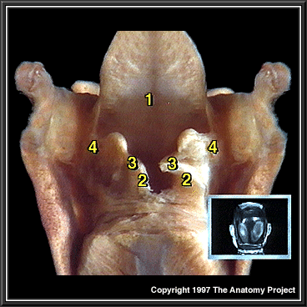
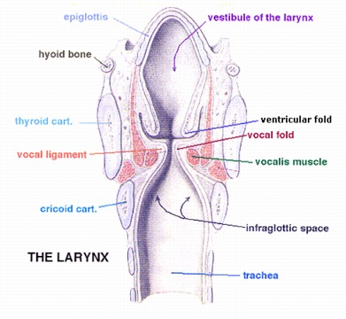
Para-glottic space

Slide 25
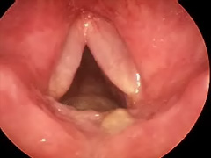
Reinke’s Space
Mucosa over the vocal ligament loosely attached to ligaments
Thus there is a submucosal space along most of the length of truer VC

Slide 26
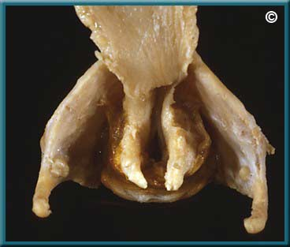
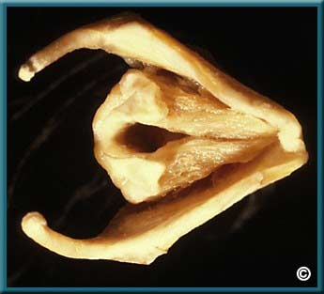

Slide 27
Extrinsic Laryngeal Muscles
Three Main Purposes:
1) Fixation (primary role)
2) Elevation (move larynx up)
3) Depression (move larynx down)
Two major groups: Suprahyoid & Infrahyoid
Anatomical position:
Suprahyoid- Attachment lies above hyoid bone.
Infrahyoid- Attachment lies below hyoid bone.

Slide 28
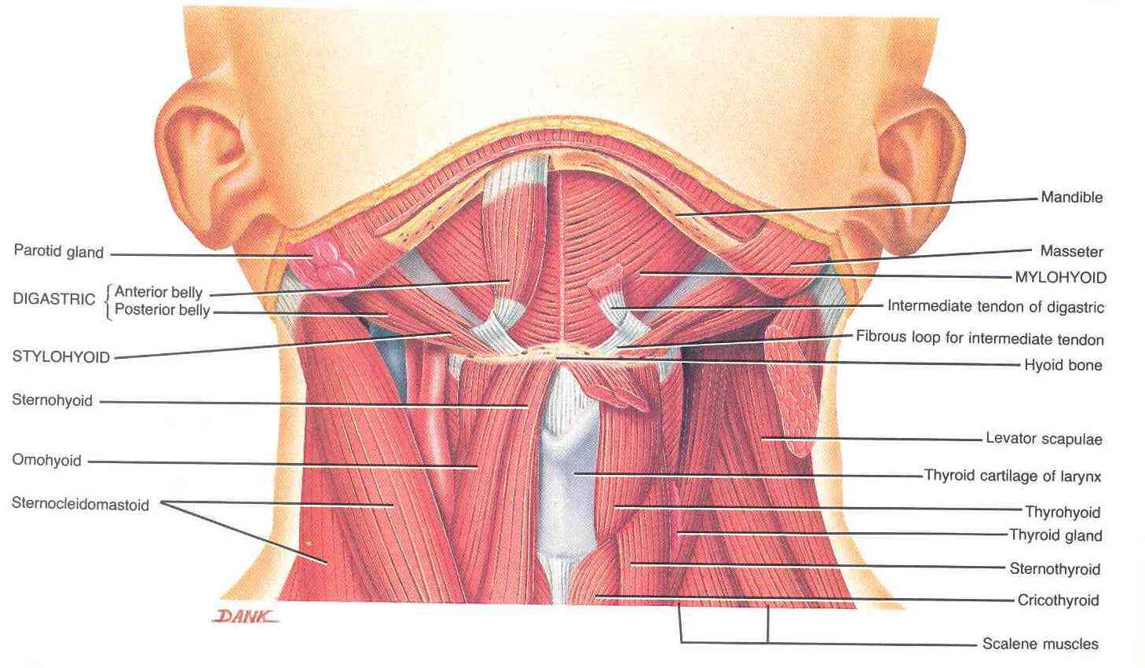
Elevators of the Larynx
The Suprahyoid Muscles
  Digastric
  Stylohyoid
  Mylohyoid
  Geniohyoid
The Longitudinal Muscles of the Pharynx
  Stylopharyngeus
  Salpingopharyngeus
  Palatopharyngeus
  Depressors of the larynx:
The Infrahyoid Muscles
  Sternohyoid
  Sternothyroid
  Omohyoid

Slide 29
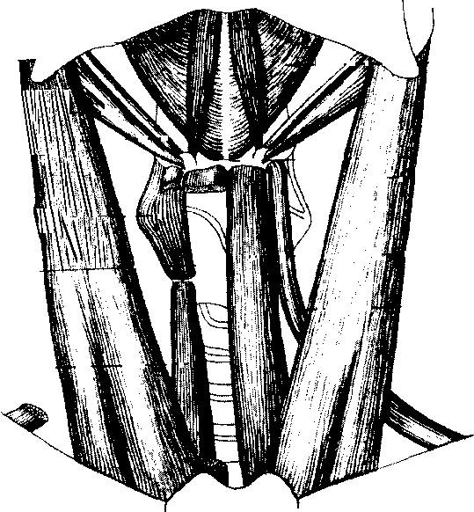
Extrinsic laryngeal Muscles
Mandible
Mastoid Tip
Mylohyoid
Hyoid Bone
Sternohyoid
Omohyoid
Sternum
Ant. Digastric
Post.
Digastric
Stylohyoid
Thyrohyoid
Sternothyroid

Slide 30
Intrinsic Laryngeal Muscles
Functions:
1) Abduction of vocal folds for respiration,
2) Fine discrete movements during voice production & closure of vocal folds and,
3) Protection of trachea,

Slide 31
More Specifically...
Change degree of abduction/ adduction
Change mass characteristics of folds
Change tension of folds
Change length characteristics of folds
React during swallowing- closure of folds
Assist in muscular mechanical advantage

Slide 32
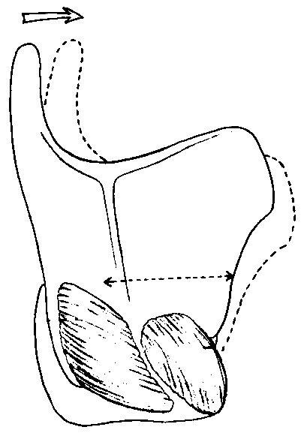
Intrinsic Muscles
Action of
Cricothyriod
Pars oblique
Pars recta
Cricothyroid: fan-shaped, 2 divisions, Lengthens & tenses vocal folds.

Slide 33
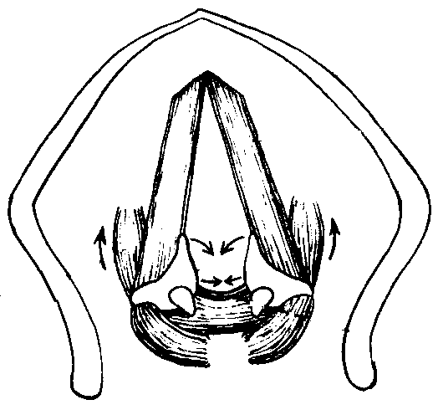
Intrinsic Muscles
Vocal
Ligament
Thyroarytenoid
Thyrovocalis
Thyromuscularis
Thyroarytenoid: muscle making up true vocal folds, 2 parts: thyrovocalis (bound to vocal ligament) & thyromuscularis (lateral to arytenoids).

Slide 34
Thyroarytenoid Functions
Decreases distance between the thyroid & arytenoid cartilage's,
Shortens folds,
Decreases tension
Decreases pitch of the voice,
Active contraction lowers pitch of voice.

Slide 35
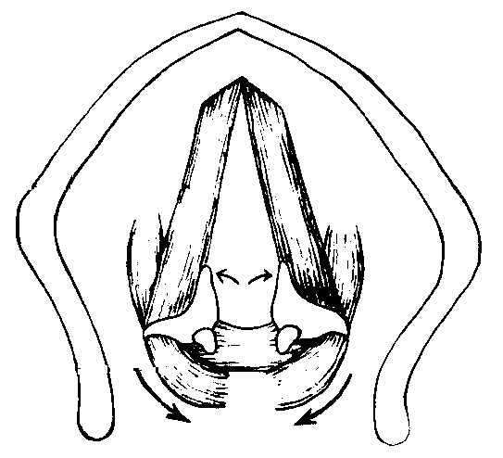
Intrinsic Muscles
Action of Post.
Cricoarytenoid
Posterior
Cricoarytenoid
Posterior Cricoarytenoid: Abducts the vocal folds, actively contracted at the end of phonation & any speech sound not requiring v.f. vibration.

Slide 36
Intrinsic Muscles
Action of Lat.
Cricoarytenoid
Lateral
Cricoarytenoid
Lateral Cricoarytenoid: lies on upper surface of cricoid cartilage, adducts vocal processes of arytenoids closing membranous portion of v.f.’s.

Slide 37
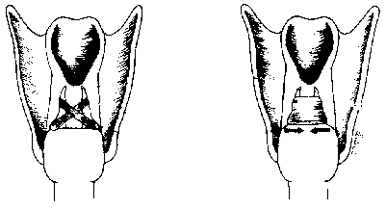
Intrinsic Muscles
Transverse
Interarytenoids
Oblique
Interarytenoids
Interarytenoids (transverse & oblique): Unpaired, 2 part muscle, adducts v.f.’s in cartilaginous portion by pulling arytenoid tips together.

Slide 38
The Glottis
Glottis
Glottis is an open space between vocal folds.
Size is dependent on what position the v.f.’s are in.
Not a muscle or cartilage.
Abduction- open v.f.’s; Adduction- closed v.f.’s

Slide 39
Ventricular Folds
False Folds,
Superior & lateral to true vocal folds,
Their role in phonation?
-No role in voicing
Consist of muscle, but doesn’t have innervation for discrete movements,

Slide 40
Neuroanatomy of Vocal Mechanism
Volitional control of laryngeal muscles: Resides in brain.
Connecting points in brain having a role in control of phonation: cortex, subcortical areas, midbrain & medulla.
Next slides will briefly review phonation neuroanatomy & neurophysiology.

Slide 41
Cortical Mechanisms of Phonatory Control
The cerebral cortex is responsible for conceptualization, planning, and execution of the speech act (phonation).
Three major areas of cortex responsible for vocalization:
a) Precentral & postcentral gyrus,
b) Anterior (Broca’s) area, and
c) Supplementary motor area.

Slide 42
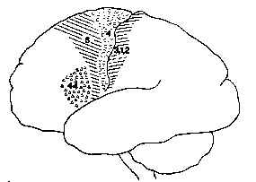
Cortical Areas Involved in Speech Movement Control
Primary Motor Cortex
Premotor & Supplementary
Cortex
Somatosensory
Cortex
Broca’s Area
1. Stimulation of these areas can initiate, stop or distort vocalization.
2. These behaviors occur in dominant & nondominant hemispheres.

Slide 43
What nerve innervates the intrinsic laryngeal muscles?
Intrinsic laryngeal muscles are innervated by branches of vagus (X) nerve
The vagus nerve splits into several branches:
1. Recurrent laryngeal nerve,
2. Superior laryngeal nerve,
3. Pharyngeal nerve.

Slide 44
Recurrent Laryngeal nerve of Vagus
Courses along laryngeal branch of inferior thyroid artery.
It passes under caudal border of inferior constrictor muscle.
Divides into a motor & sensory branch prior to entry into larynx.
Innervates int. muscles that control abduction/adduction of vocal folds

Slide 45
RLN & SLN
Inferior Recurrent Laryngeal Branch:
  Thyroarytenoid
  Lateral Cricoarytenoid
  Posterior Cricoarytenoid
  Interarytenoids
Superior Laryngeal Branch:
  Cricothyroid

Slide 46
SLN & RLN
Ensure ability of intrinsic muscles to move quickly & fine motor control
High conduction velocity
Rapid contractions

Slide 47
Muscles Controlling the Laryngeal Inlet
Oblique arytenoid
Aryepiglottic muscle

Slide 48
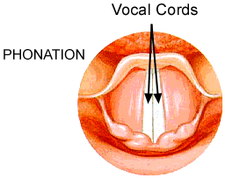
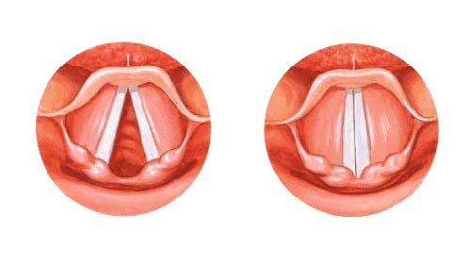
Movements of the Vocal Cords
Adduction
Abduction
Glottis (space between folds)
Folds closed (adducted) Folds open (abducted) (View from above)

Slide 49
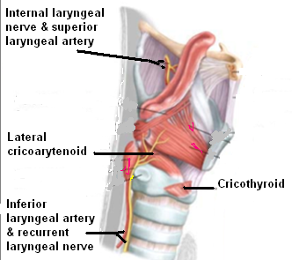
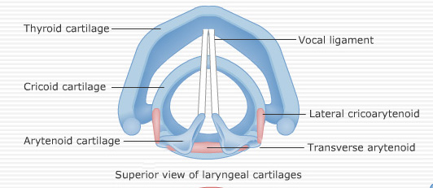
Adductors of the Vocal Cords
Lateral cricoarytenoid
Transverse arytenoid

Slide 50
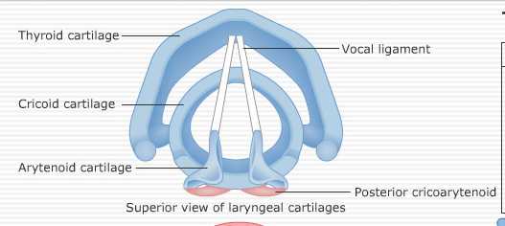
Abductor of the Vocal Cords
Posterior cricoarytenoid

Slide 51
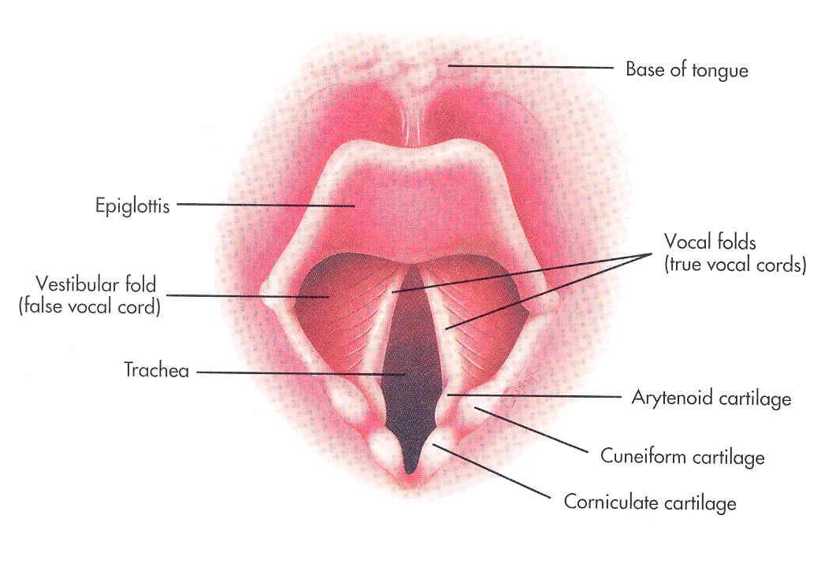
Sphincteric Function of the Larynx
There are two sphincters:
At the inlet: used only during swallowing
At the rima glottis: used in coughing and sneezing

Slide 52
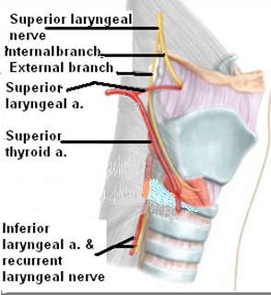
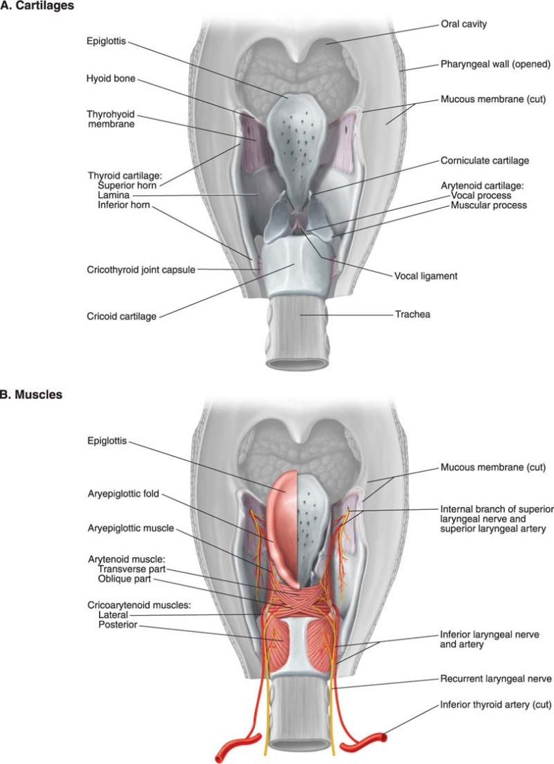
Blood Supply & Lymph Drainage
Arteries:
  Upper half: Superior laryngeal artery, branch of superior thyroid artery
  Lower half: Inferior laryngeal artery, branch of inferior thyroid artery
Veins:
  Accompany the corresponding arteries
Lymphatics:
  The lymph vessels drain into the deep cervical lymph nodes

Slide 53
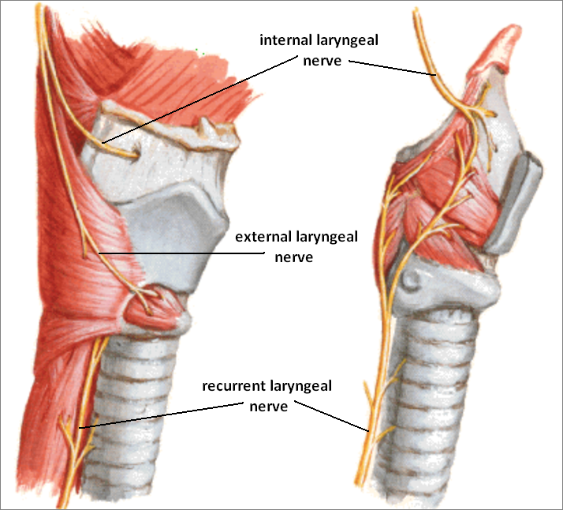
Nerve Supply
Sensory
  Above the vocal cords: Internal laryngeal nerve, branch of the superior laryngeal branch of the vagus nerve
  Below the vocal cords: Recurrent laryngeal nerve, branch of the vagus nerve
Motor
  All intrinsic muscles, except cricothyroid, supplied by the recurrent laryngeal nerve
  The cricothyroid muscle is supplied by the external laryngeal nerve, a branch of the superior laryngeal branch of vagus nerve

Slide 54
What is voice?
The acoustic result of the interaction between:
  muscle groups
  cartilage's and
  the aerodynamic system.
Three major subsystem to be concerned about:
  Respiratory
  Phonatory
  Supraglottal

Slide 55
Production of Voice
The production of voice has three components:
The generation of sound: Sound production originates from the larynx as a fundamental tone by the intermittent release of expired air between the adducted vocal cords resulting in their vibration.
The resonance of sound: This tone is modified by various resonating chambers (resonators) i.e. pharynx, mouth and paranasal sinuses.
The articulation of voice (speech production) : Finally converted to speech by the action of the mouth, nose, nasal cavity and throat, where the tongue, palate, cheek and lips are involved in articulation
Parameters of Voice
Quality, Loudness, and Pitch
Quality :depends on symmetrical vibration at the midline of the glottis
Loudness : is influenced by subglottic pressure, glottic resistance, transglottic air flow, and amplitude of vibration
Pitch : depends on the alterations in length and tension of vocal folds

Slide 56
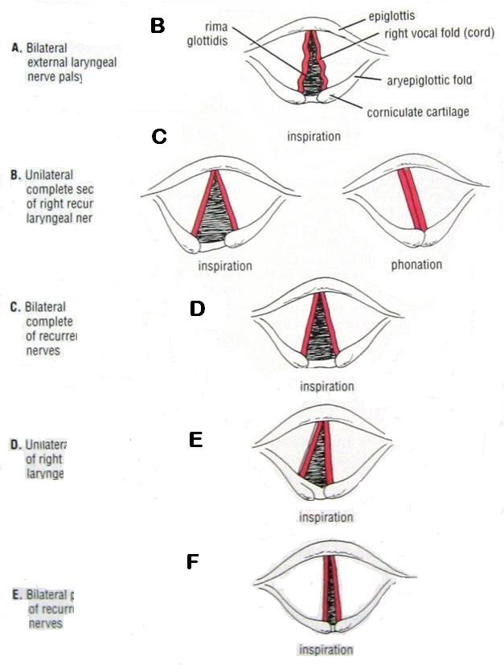
Clinical Notes
Laryngitis
Edema of laryngeal mucosa
Laryngeal nerve lesions:
External laryngeal nerve
  Unilateral
  Bilateral
Recurrent laryngeal nerve
  C. Unilateral complete (of right nerve)
  D. Bilateral complete
  E. Unilateral partial (of right nerve)
  F. Bilateral partial
The position of vocal cords

Slide 57
What nerve innervates the intrinsic laryngeal muscles?
Intrinsic laryngeal muscles are innervated by branches of vagus (X) nerve
The vagus nerve splits into several branches:
1. Recurrent laryngeal nerve,
2. Superior laryngeal nerve,
3. Pharyngeal nerve.

