Slide 1
Anatomy of the middle ear
Assistant Professor
Dr. Duraid H Abid Alkadem
M.B.Ch.B (TUCOM)
MRCS ENT (RCSEd, UK),
DOHNS (RCSEd, UK),
MRES Anatomy ( Liverpool, UK)

Slide 2
The middle ear
The middle ear or tympanic cavity is an irregular, laterally compressed space within the temporal bone. It is filled with air, which is conveyed to it from the nasal part of the pharynx through the auditory tube. It contains a chain of movable bones, which connect its lateral to its medial wall, and serve to convey the vibrations communicated to the tympanic membrane across the cavity to the internal ear.

Slide 3
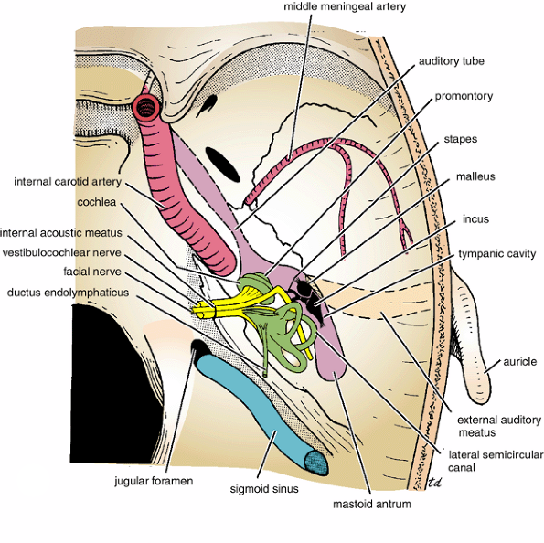
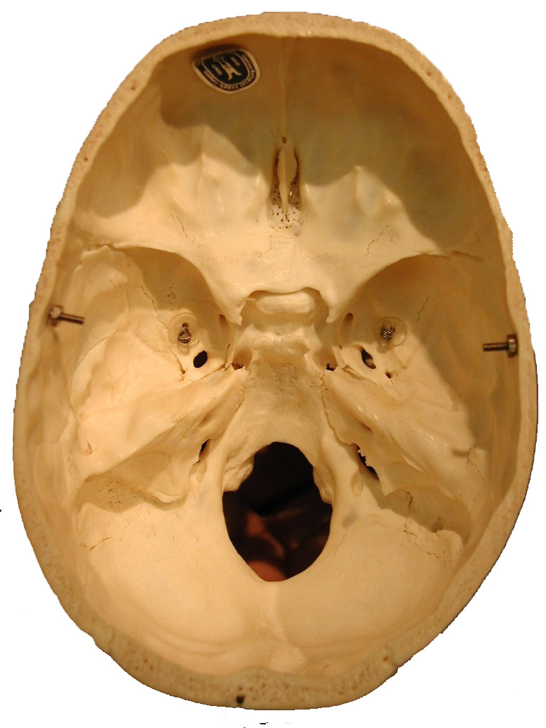

Slide 4
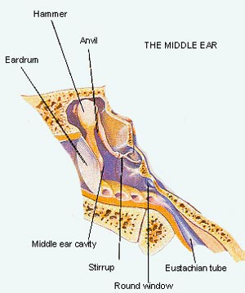
Middle Ear
Tympanic membrane
Middle Ear Cavity
Ossicles
Middle Ear Muscles
Mastoid
Eustachian Tube
Function Amplifier
Tympanic Cavity
Tympanic Membrane
Ossicles
Middle Ear Muscles
Eustachian Tube
Mastoid
Cholesteatoma
Temporal bone fractures
Otitis Media
Otosclerosis

Slide 5
Function of Middle Ear
Conduction
  Conduct sound from the outer ear to the inner ear
Protection
  Creates a barrier that protects the middle and inner areas from foreign objects
  Middle ear muscles may provide protection from loud sounds
Transducer
  Converts acoustic energy to mechanical energy
  Converts mechanical energy to hydraulic energy
Amplifier
  Transformer action of the middle ear
  only about 1/1000 of the acoustic energy in air would be transmitted to the inner-ear fluids (about 30 dB hearing loss)

Slide 6
The tympanic cavity consists of
1. The tympanic cavity proper, opposite the tympanic membrane.
2. The attic or epitympanic recess, above the level of the membrane; the latter contains the upper half of the malleus and the greater part of the incus.

Slide 7
Boundaries of tympanic cavity
The tympanic cavity is bounded
laterally by the tympanic membrane;
medially, by the lateral wall of the internal ear.
Posteriorly with the tympanic antrum and through it with the mastoid air cells,
Anteriorly with the auditory tube.

Slide 8
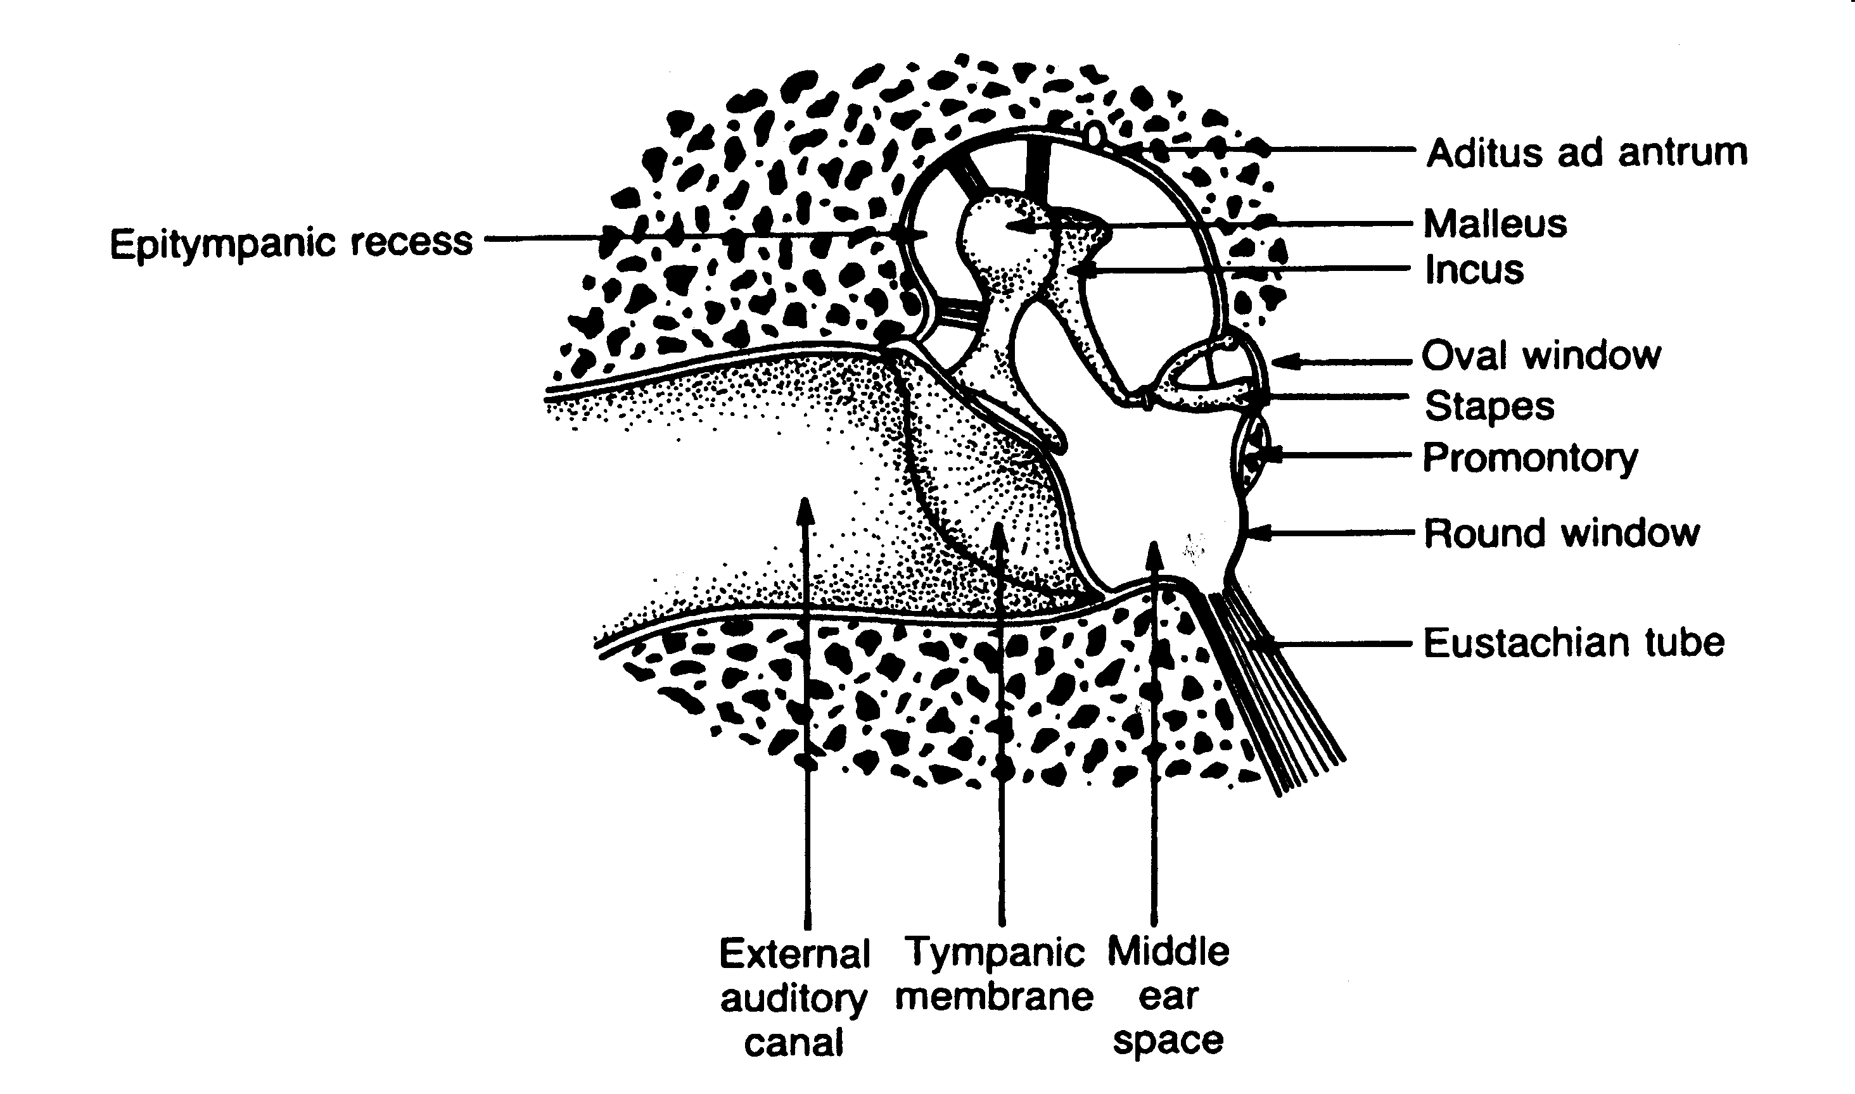
The middle ear
Important Structures:
Epitympanic recess
Tympanic cavity
Aditus ad antrum
Mastoid air cells
Ossicles
Notes:
The structures of the middle ear lie in a cavity within the petrous portion of the temporal bone. Altho most diagrams are 2 dimensional, you need to get a feel for the middle ear cavity as a volume.
Fig 10.1 middle ear in cross section--very simplified drawing
The volume is narrow--only 2mm to 4mm wide, but very high with the vertical dimension about 15 mm.
Total volume is 2cc--if you filled it with water, this is how much water you would use.
The cavity is divided into 2 parts--the attic or epitympanic recess, which is the portion extending upward beyond the superior border of the eardrum.
Tympanic cavity or middle ear space--which is the portion lying medially to the eardrum.
The epitympanic recess is largely occupied by the head of the malleus and the bulk of the incus, two of the middle ear ossicles.
The tympanic antrum communicates with the mastoid air cells. Has implications regarding pathways for infection.

Slide 9
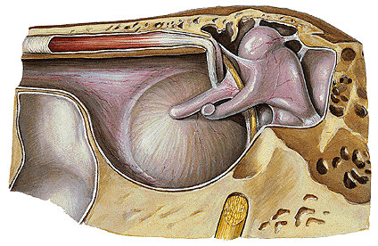
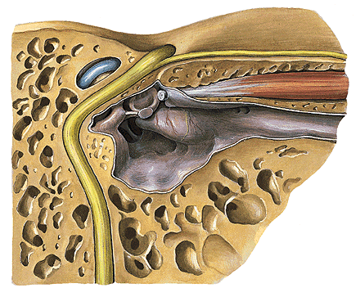
Tympanic cavity
Volume – 1.5 ml
Form – flatten drum
Structure – six walls:
  - Lateral
  - Medial
  - Anterior
  - Posterior
  - Superior
  - Inferior

Slide 10
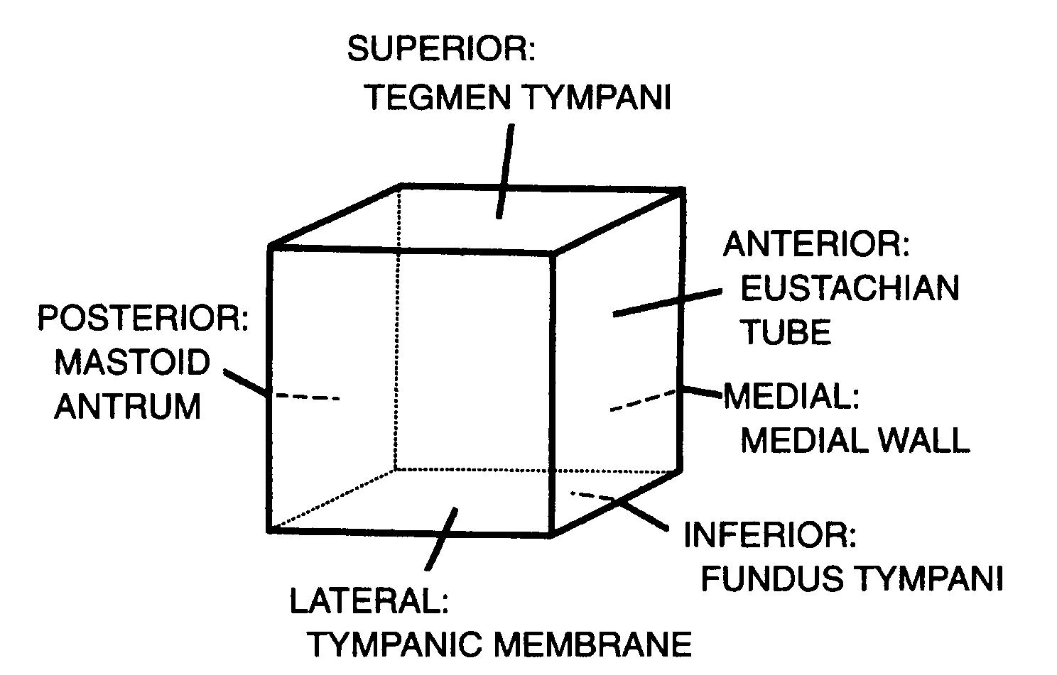
The middle ear
Schematic view of the middle ear boundaries and landmarks
Notes:
Many authors view the middle ear cavity as a box--to get a perspective regarding where the middle ear structures are found.
Fig 1-2 shows the names of the six faces of the box.
• superior face (ceiling)
• inferior face (floor)
• posterior face (left side wall)
• anterior face (right side wall)
• lateral face (front wall)
• medial face (back wall)
Let’s talk about some structures associated with these faces.

Slide 11
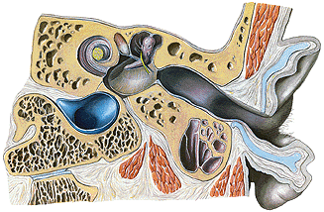
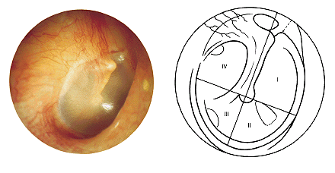
Lateral wall

Slide 12
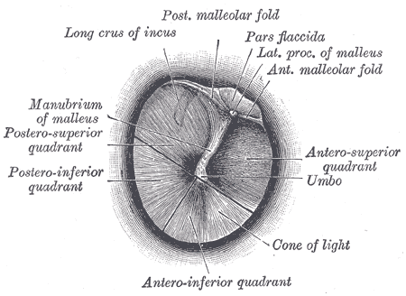
Tympanic Membrane
Separates outer ear from middle ear
Barrier from foreign objects
Cone-shaped in appearance
  about 17.5 mm in diameter
Vibrates in response to sound waves.
The membrane movement is incredibly small
  as little as one-billionth of a centimeter

Slide 13
Tympanic membrane
Two parts:
Pars flaccida – upper, thin, loose
Pars tensa – lower, tense
Three layers:
1. Outer, cutaneous – continuation of the canal skin. No hairs and glands.
2. Middle, fibrous – elastic fibers.
3. Inner, mucous – tympanic cavity lining

Slide 14
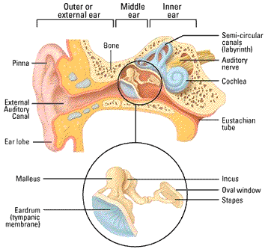
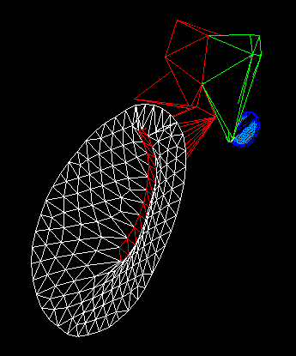
Middle Ear
Sound waves change to mechanical energy in the middle ear
½” chamber

Slide 15
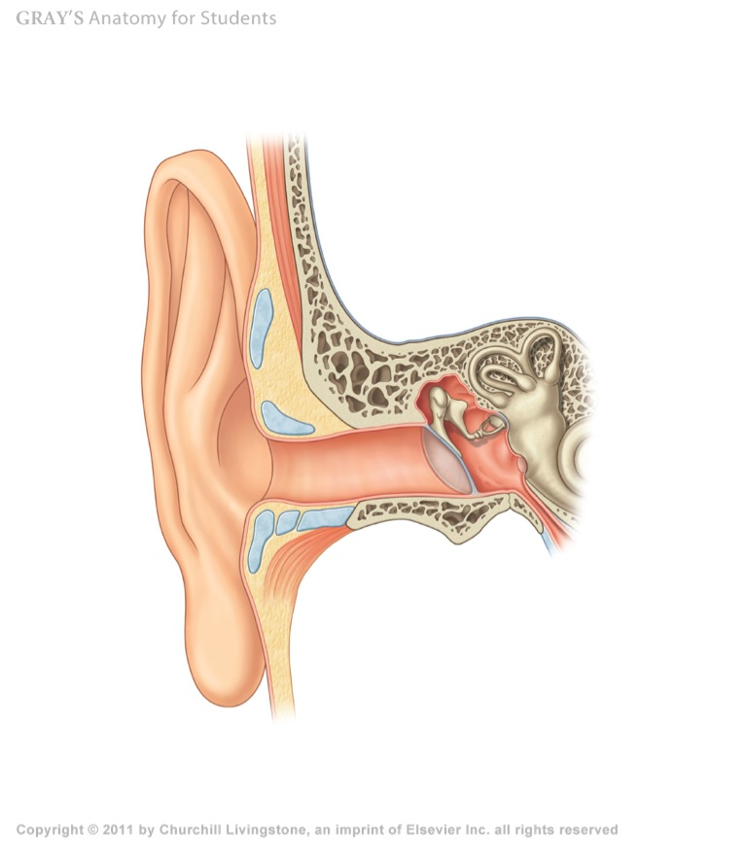
about 17 mm in diameter
it is obliquely directed making an angle of 55 with the floor of the meatus

Slide 16
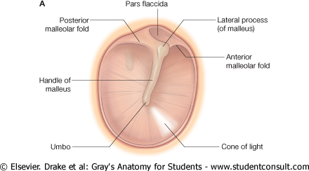
posterior
anterior

Slide 17
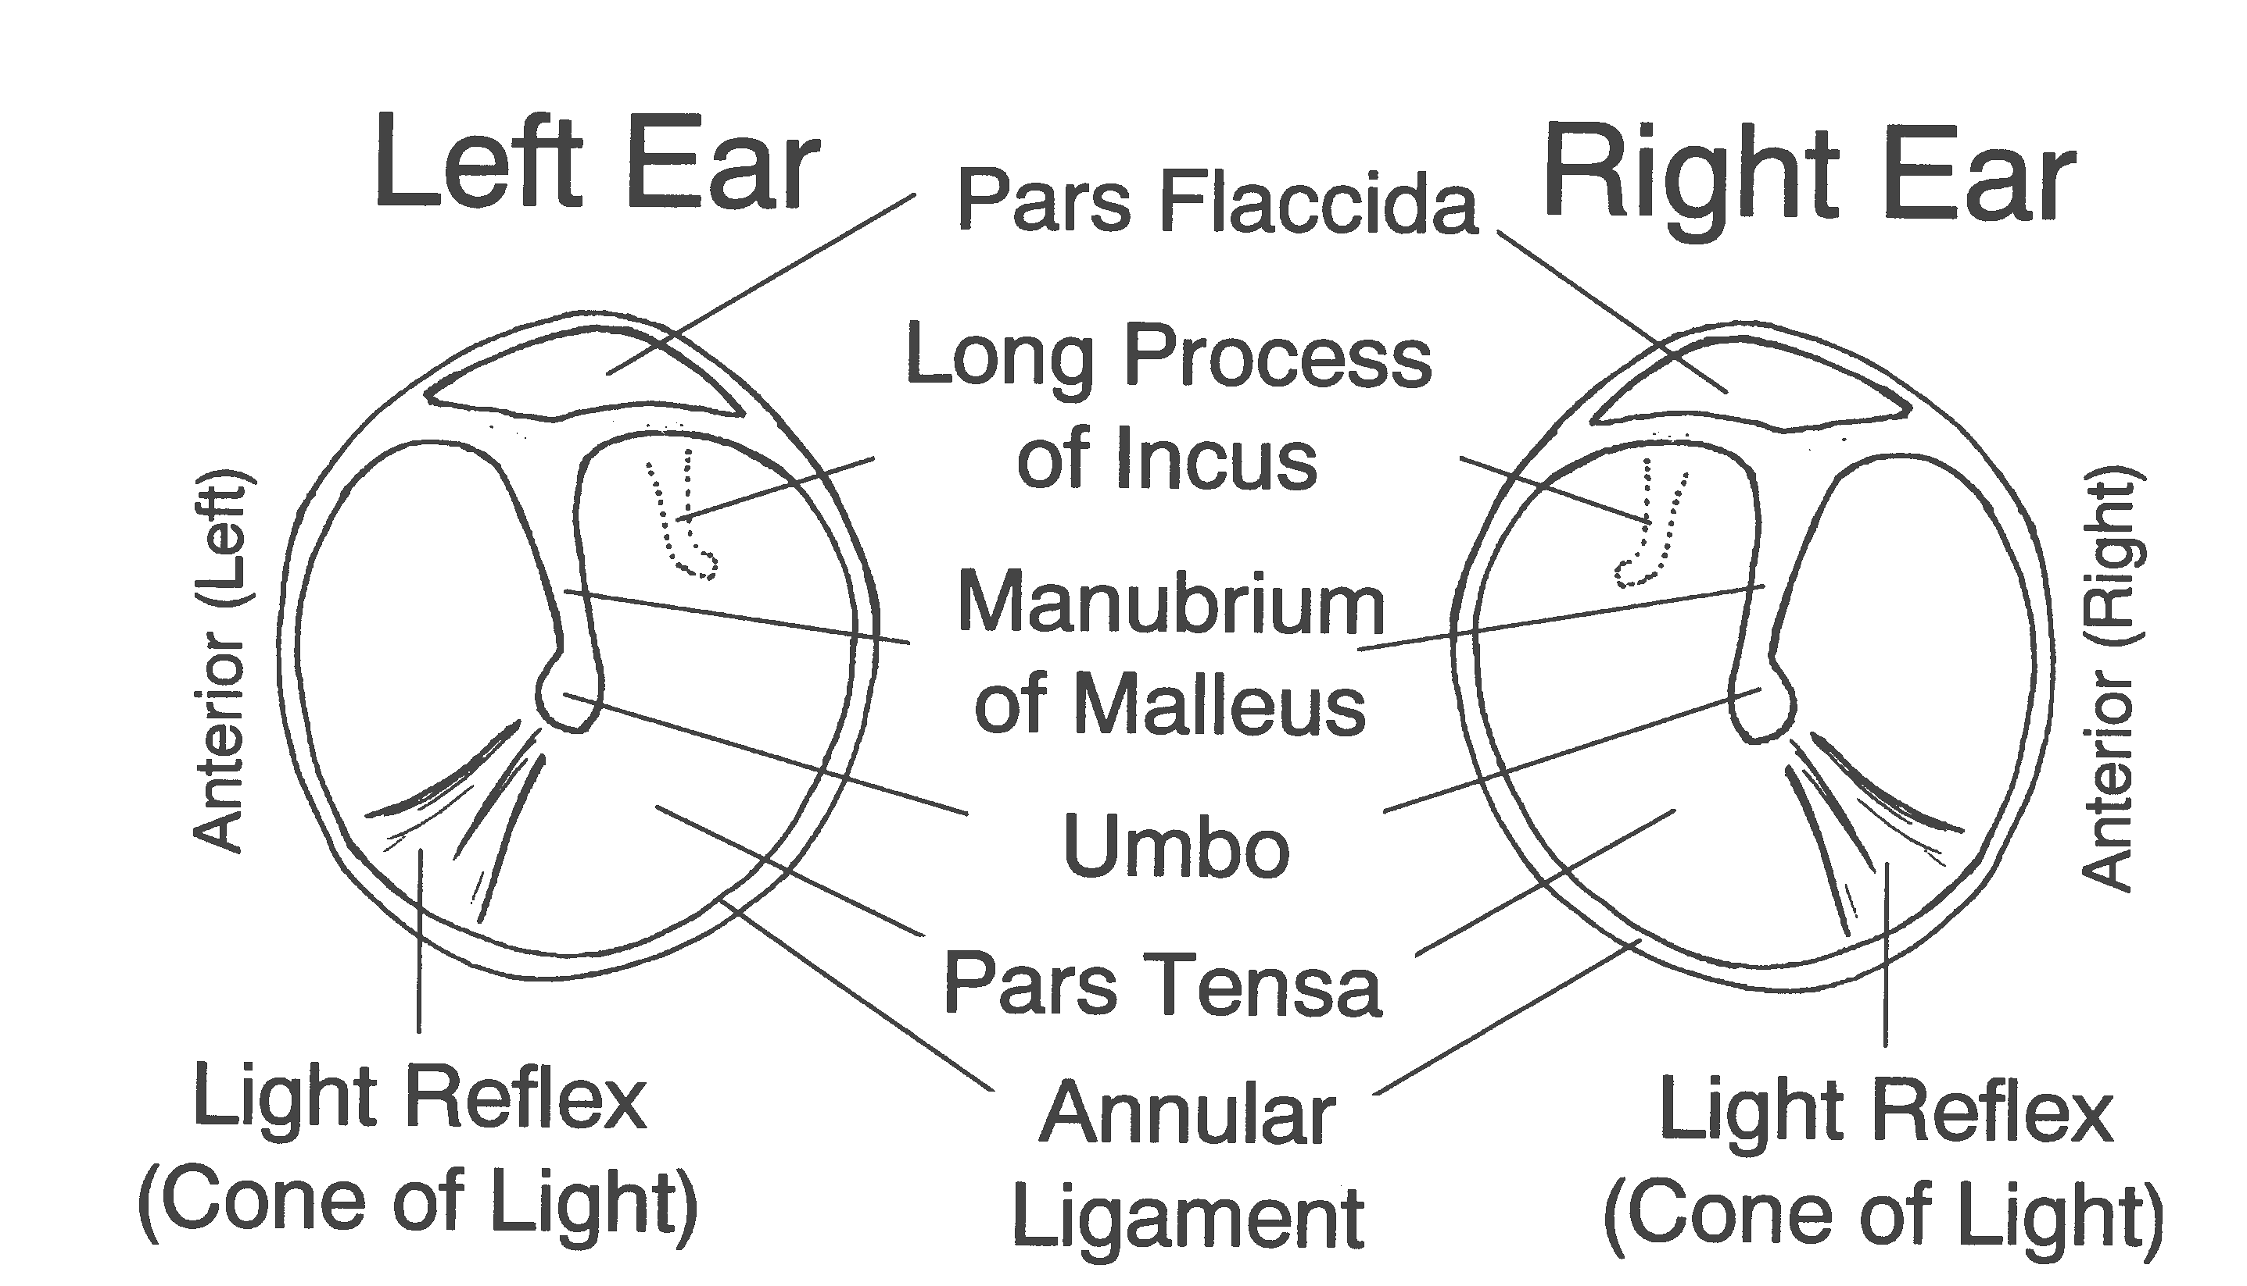
The tympanic membrane
Major landmarks of the tympanic membrane
Notes:
Tympanic Membrane:
The external meatus ends at the TM, which is tilted at an angle of about 55o to the canal.
Fig 2-8 major landmarks of the TM--looking otoscopically.
The TM is firmly attached to the tympanic sulcus, a groove in the temporal bone, by a ring of fibrocartilaginous connective tissue called the tympanic annulus
The eardrum is smooth and translucent.
Average thickness is about 0.074 mm
Concave outward rather than flat with the meatus.
The dimple or peak of the concavity is called the umbo.
The eardrum has four layers.
The most lateral layer is continuous with the skin of the ear canal.
The most medial layer is continuous with the mucous membrane of the middle ear.
Sandwiched between them are two fibrous layers--which provides a lot of strength to the tm.
The fibrous layers are unevenly distributed. The density is greatest towards the periphery and in the center. A small triangular area contains very few fibers, so results in rather flaccid region of the membrane. Hence referred to as pars flaccida
the remainder of the eardrum is held rather tense and is known as the pars tensa.
The TM is connected to the malleus, which is the first of the 3 middle ear bones at the manubrium
Cone of light--define. Radiates from the umbo. Hallmark of a healthy TM

Slide 18
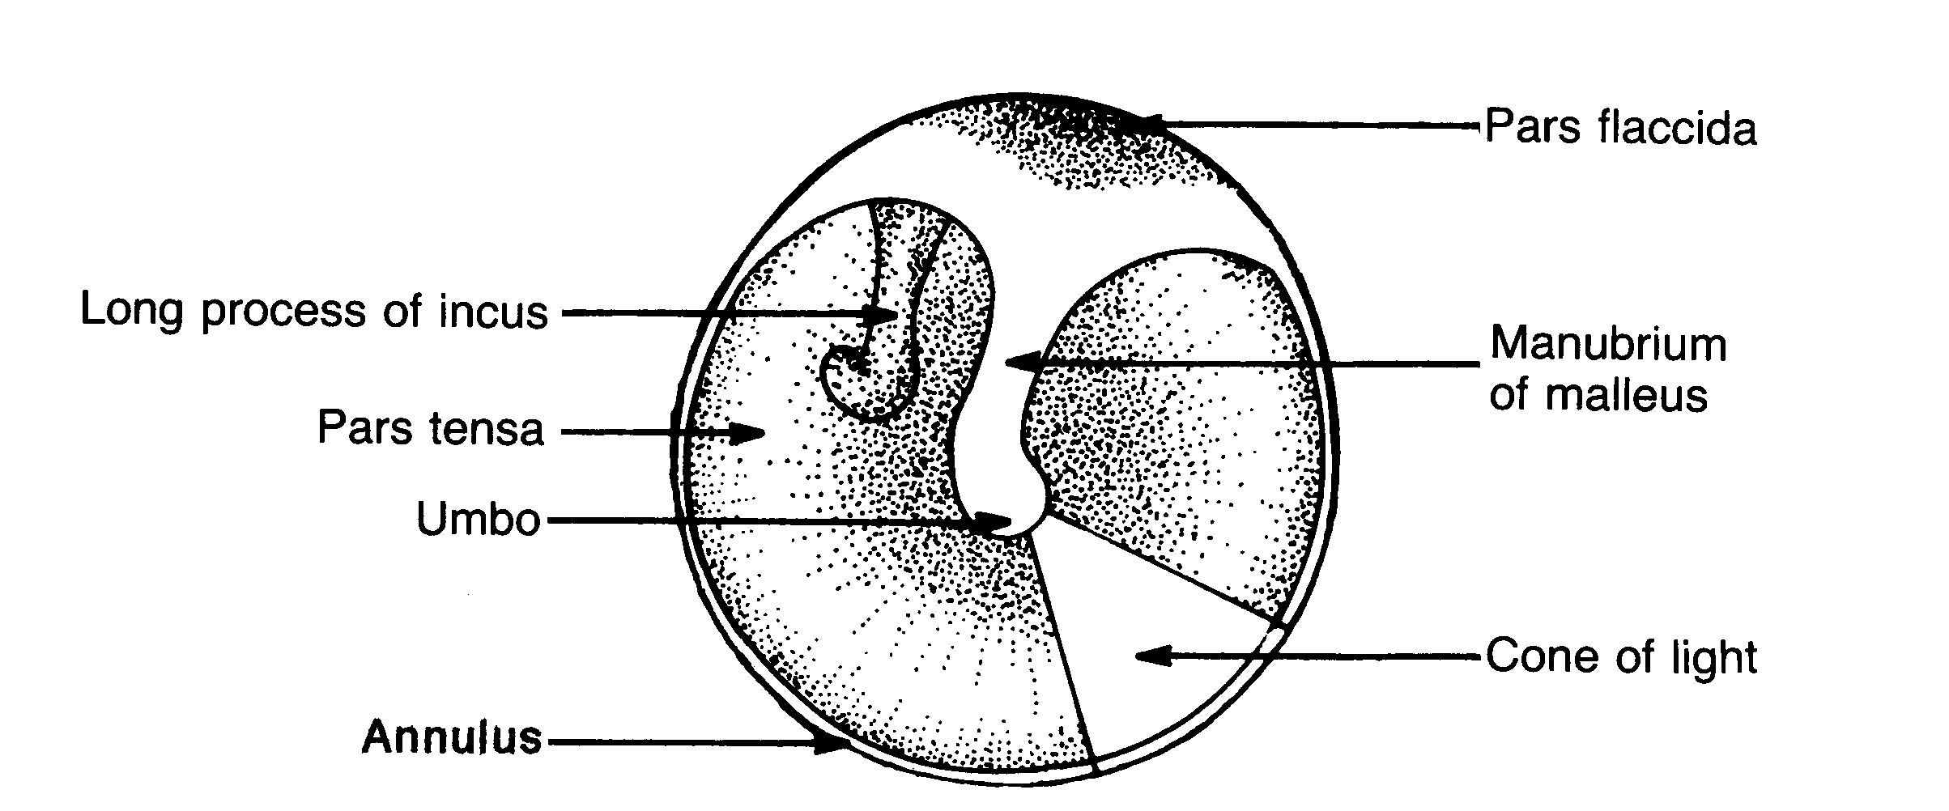
The tympanic membrane
A healthy right tympanic membrane
Notes:
Fig 9.3 a right TM
Identify major landmarks again.

Slide 19
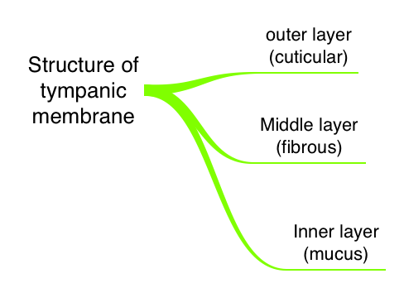

Slide 20
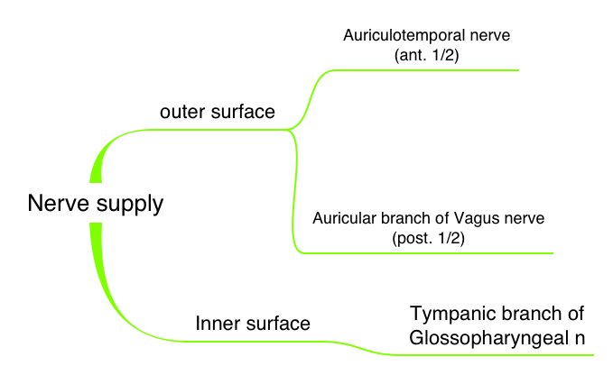

Slide 21
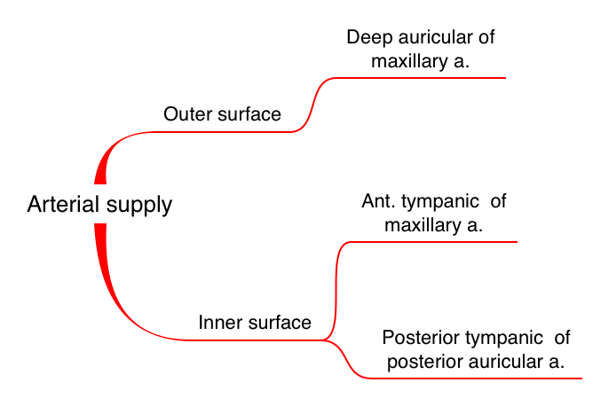

Slide 22
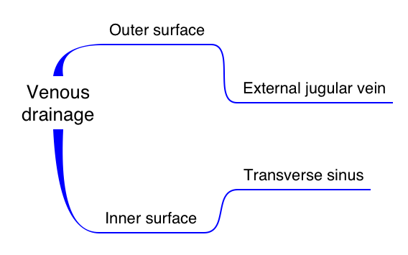

Slide 23
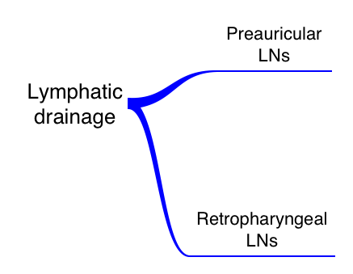

Slide 24
Lateral (membranous)
wall

Slide 25
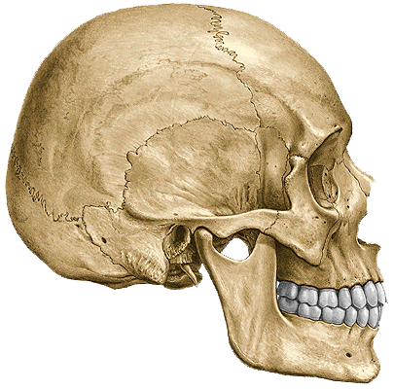
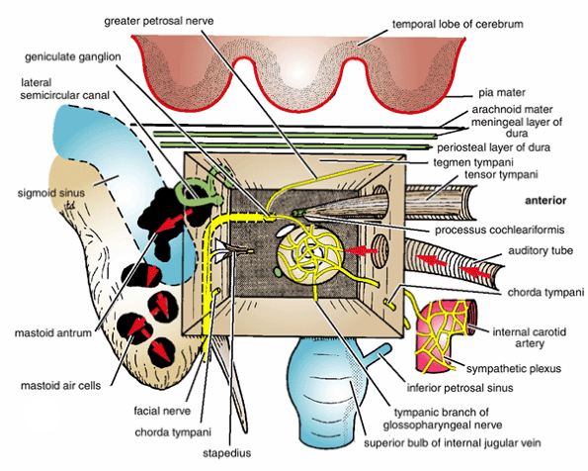
Posterior
Anterior

Slide 26
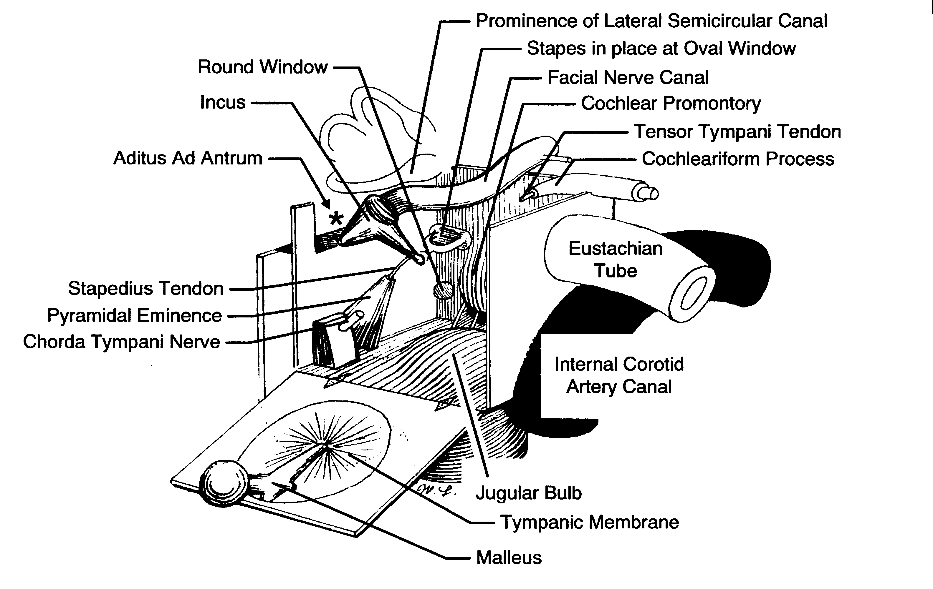
The lateral wall
Eardrum
Notes:
• the lateral face---most of the lateral wall is formed by the eardrum.

Slide 27
The lateral wall of the middle ear is partly bony and partly membranous. The central portion of the lateral wall is formed by the tympanic membrane, while above and below the tympanic membrane there is bone, forming the outer lateral walls of the epitympanum (attic) and hypotympanum respectively. The lateral wall of the epitympanum (attic) also includes that part of the tympanic membrane lying above the anterior and posterior malleolar folds - this portion of the ear drum is also known as pars flaccida. This portion of the tympanic membrane lacks the middle fibrous layer, hence the name. The lateral attic wall (bony portion) is wedge shaped, its lower portion is also called the outer attic wall (scutum)

Slide 28
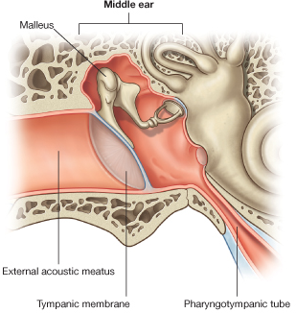
Epitympanic recess
Tympanic cavity proper

Slide 29
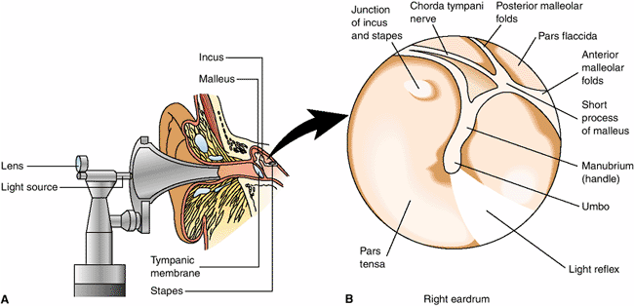

Slide 30
Openings of the lateral wall
posterior canaliculus for the chorda tympani nerve. This opening is situated at the junction between the lateral and posterior walls of the tympanic cavity. It also contains a branch from the stylomastoid artery.
petrotympanic (Glaserian) fissure. 2 mm long. It receives the anterior malleolar ligament. It also transmits the anterior tympanic branch of the maxillary artery to the tympani cavity.
canal of Hugier. It lies medial to the Glaserian fissure. The chorda tympani nerve enters through this.

Slide 31
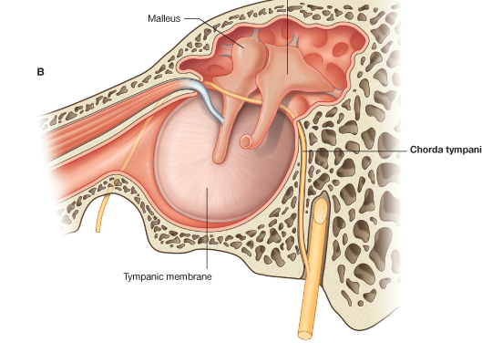

Slide 32
Anterior (carotid)
wall

Slide 33
It is formed by thin plate separate the cavity from internal carotid artery and its surrounding sympathetic plexus.
There are 2 openings or canal
1. The lower and large eustachian tube.
2. The upper and smaller is the tensor tympani muscle.

Slide 34
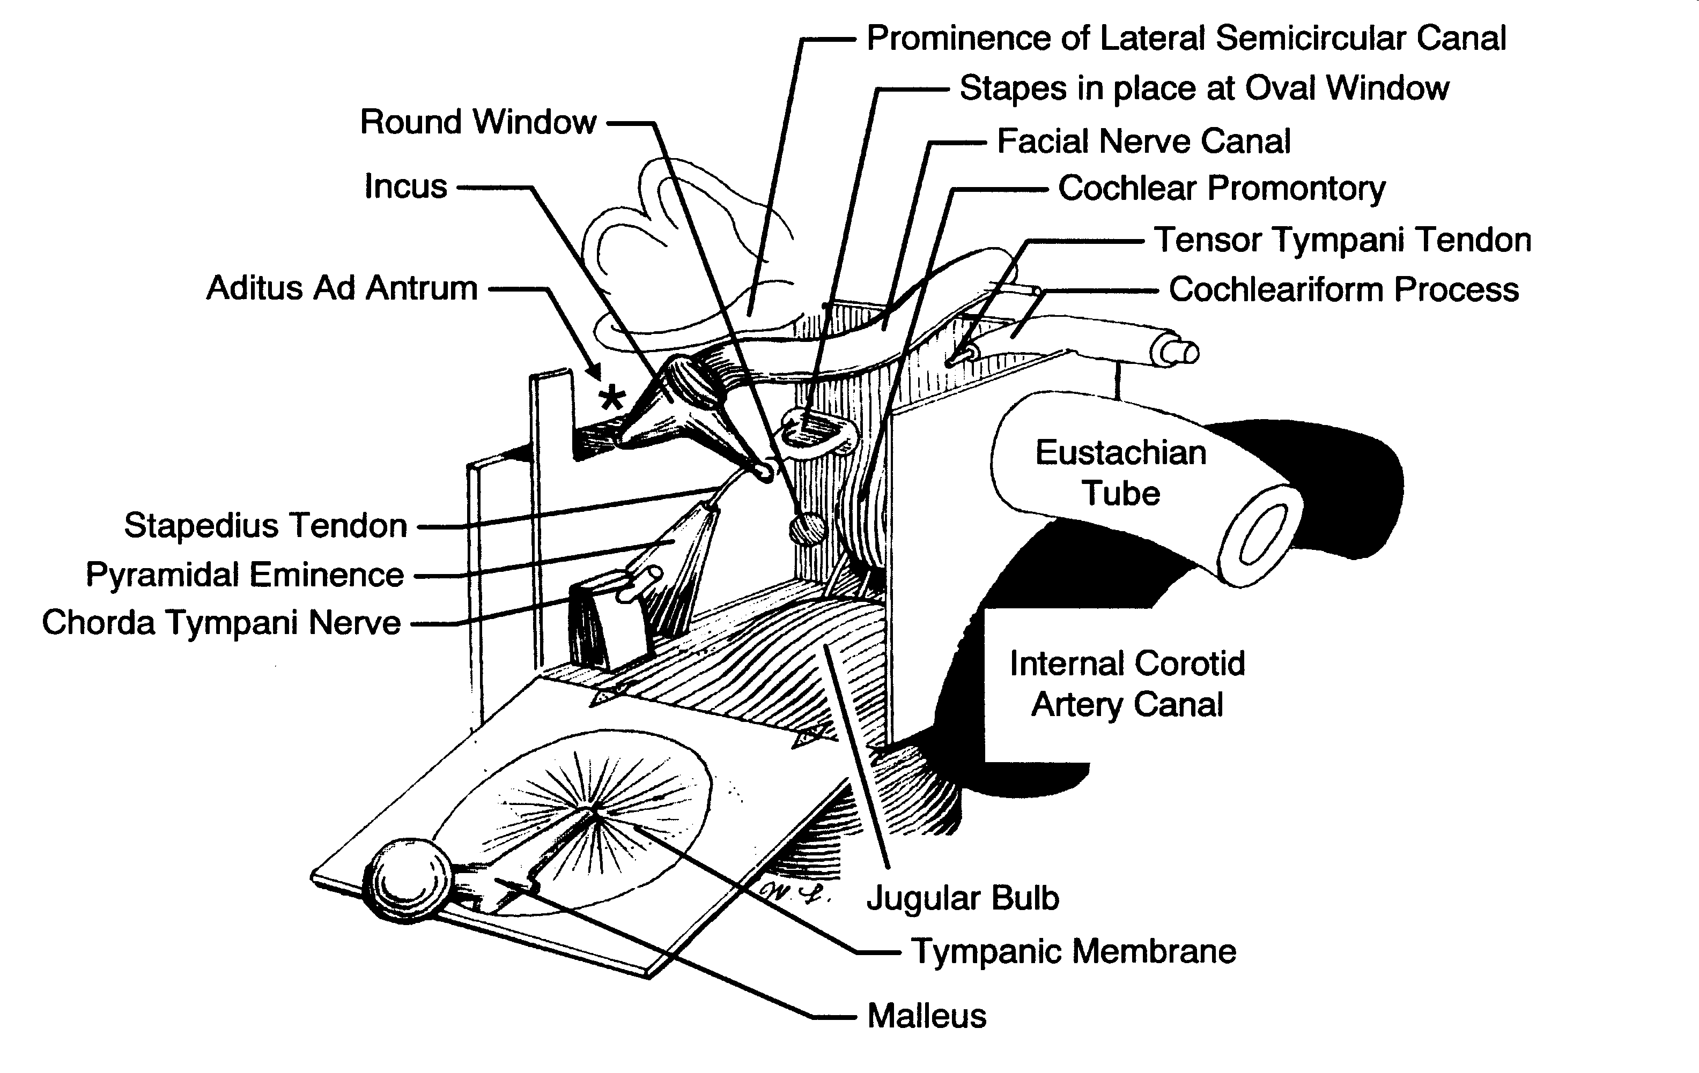
The anterior wall
Carotid wall
Eustachian tube
Notes:
the anterior face---sometimes call the carotid wall. The internal carotid artery runs behind this wall. Major auditory landmark is the eustachian tube.

Slide 35
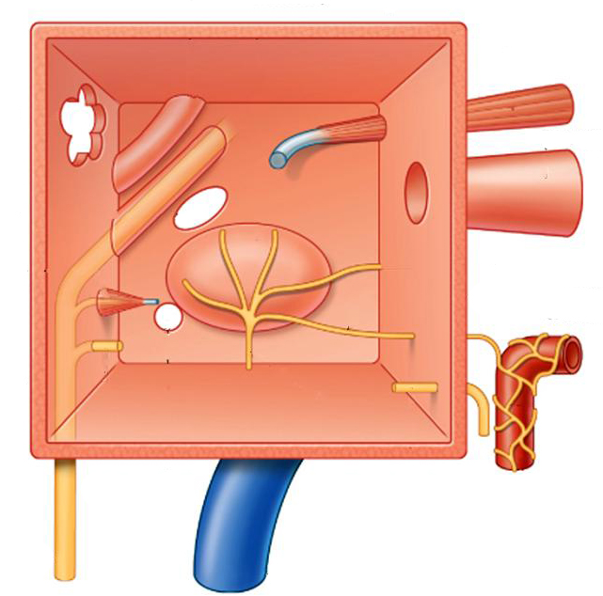
Canal for
Tensor tympani
Bony part of
Auditory tube
Internal carotid artery

Slide 36
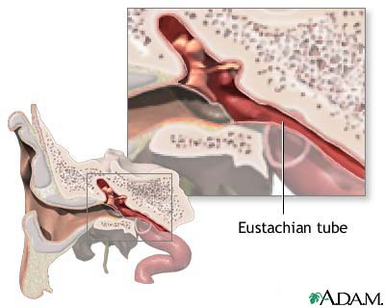
Auditory (Eustachian) tube
Connects tympanic cavity with pharynx
Two openings:
ostium pharyngeum tubae
ostium tympanicum tubae.
Two parts:
bony
cartilagenous
Function:
Equalizes pressure on both sides of tympanic membrane for optimal hearing.

Slide 37
Eustachian Tube
The auditory tube (tuba auditiva; Eustachian tube) is the channel through which the tympanic cavity communicates with the nasal part of the pharynx. Its length is about 36 mm., and its direction is downward, forward, and medially, forming an angle of about 45 degrees with the sagittal plane and one of from 30 to 40 degrees with the horizontal plane. It is formed partly of bone ( 12 mm. in length), partly of cartilage (about 24 mm. in length) and fibrous tissue

Slide 38
Eustachian Tube
The eustachian tube connects the front wall of the middle ear with the nasopharynx
The eustachian tube also operates like a valve, which opens during swallowing and yawning
  This equalizes the pressure on either side of the eardrum, which is necessary for optimal hearing.
  Without this function, a difference between the static pressure in the middle ear and the outside pressure may develop, causing the eardrum to displace inward or outward
    This reduces the efficiency of the middle ear and less acoustic energy will be transmitted to the inner ear.
    . Contraction of the tensor veli palatini and the salpingopharyngeus outside of the tympanic cavity (middle ear) dilate and open the auditory tube

Slide 39
Roof (tegmental) wall

Slide 40
The Tegmental Wall or Roof (paries tegmentalis) is formed by a thin plate of bone, the tegmen tympani, which separates the cranial and tympanic cavities

Slide 41
Tegmen tympani

Slide 42
Floor (Jugular)
wall

Slide 43
Inferior wall
The Jugular Wall or Floor (paries jugularis) is narrow, and consists of a thin plate of bone (fundus tympani) which separates the tympanic cavity from the jugular fossa. If presents, near the labyrinthic wall, a small aperture for the passage of the tympanic branch of the glossopharyngeal nerve.

Slide 44
Tympanic branch of XI
Internal jugular vein

Slide 45
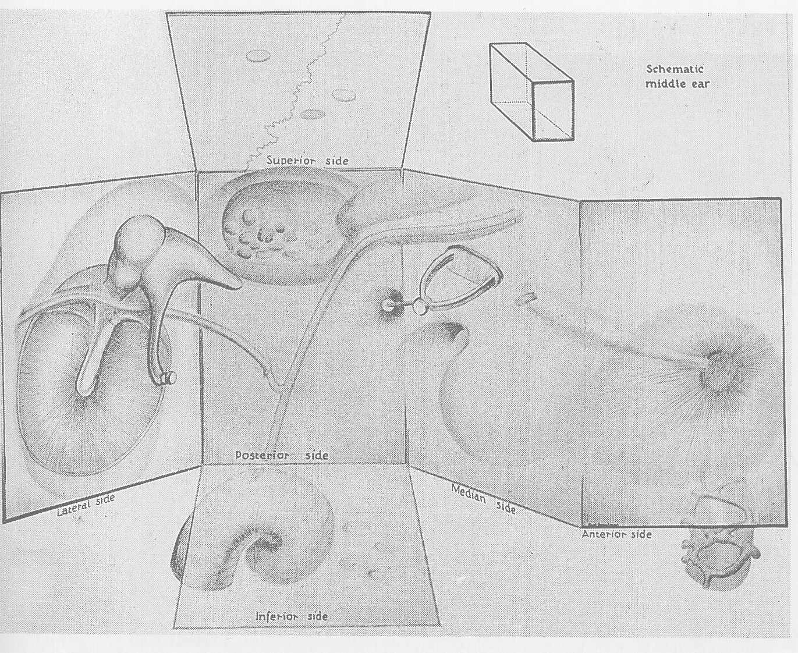
The inferior surface
Tympanic plate
Jugular fossa
Notes:
the inferior face---formed by the tympanic plate of the temporal bone which separates the cavity from the jugular fossa (large groove than accommodates the jugular vein).

Slide 46
Medial (Labyrinthine)
wall

Slide 47
Medial wall
cochlea/inner ear
important landmarks
  oval window (fenestra vestibuli)
    a kidney shaped opening into the vestibule of the inner ear
    occupied by the footplate of the stapes
    are of tympanic membrane is 17x the oval window.
      as the area increases, pressure increases
      amplitude of sound wave increased at oval window
      On the medial side is the perilymph of scala vestibuli of inner ear.
  round window (fenestra cochleae)
    a circular opening into the basal turn of the cochlea which is covered by a thin membrane (secondary tympanic memb.)
    On the medial side is the perilymph of scala tympani
  promontary
    a rounded prominence caused by the 1st turn of the bony labyrinth of the inner ear.
    Above and behind the promontory is the prominence of the facial nerve canal.

Slide 48
Promontory
Prominence of
Facial n. canal
Fenestra vestibuli
Fenestra chocleae
Sinus tympani
Tympanic plexus of ns.

Slide 49

The medial wall
Oval window
Footplate of the stapes
Round window
Promontory
Notes:
• the medial face---on the other side is the cochlea or inner ear. Important landmarks
- the oval window--a kidney shape opening into the vestibule of the inner ear. Occupied by the footplate of the stapes
- the round window--a circular opening into the basal turn of the cochlea which is covered by a thin membrane
- promontory--a rounded prominence projecting into the middle ear cavity. Caused by the first turn of the bony labyrinth of the inner ear

Slide 50
Posterior(mastoid)
wall

Slide 51
The entrance to the antrum is a large irregular aperture, which leads backward from the epitympanic recess into a considerable air space, named the tympanic or mastoid antrum.
On the medial wall of the entrance to the antrum is a rounded eminence, situated above and behind the prominence of the facial canal; it corresponds with the position of the ampullated ends of the superior and lateral semicircular.
The pyramidal eminence is situated immediately behind the fenestra vestibuli, and in front of the vertical portion of the facial canal; it is hollow, and contains the Stapedius muscle.
The cavity in the pyramidal eminence is prolonged downward and backward in front of the facial canal, and communicates with it by a minute aperture which transmits a twig from the facial nerve to the Stapedius muscle.
The fossa incudis is a small depression in the lower and back part of the epitympanic recess; it lodges the short crus of the incus.

Slide 52
Aditus to
Mastoid antrum
Pyramid

Slide 53

The posterior face
Mastoid wall
Tympanic aditus
Pyramidal eminence
Chorda tympani nerve
Notes:
the posterior face---sometimes called the mastoid wall. Landmarks include the tympanic aditus which is the entrance to the tympanic antrum. The pyramidal eminence is here and contains the stapedius muscle. A major landmark is the chorda tympani nerve runs along this wall. The chorda tympani is a branch of the facial nerve that courses thru the middle ear.

Slide 54
CONTENTS OF TYMPANIC CAVITY

Slide 55
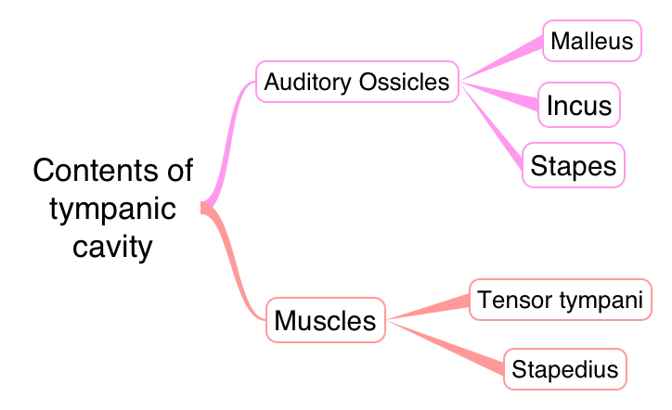

Slide 56
Auditory Ossicles

Slide 57
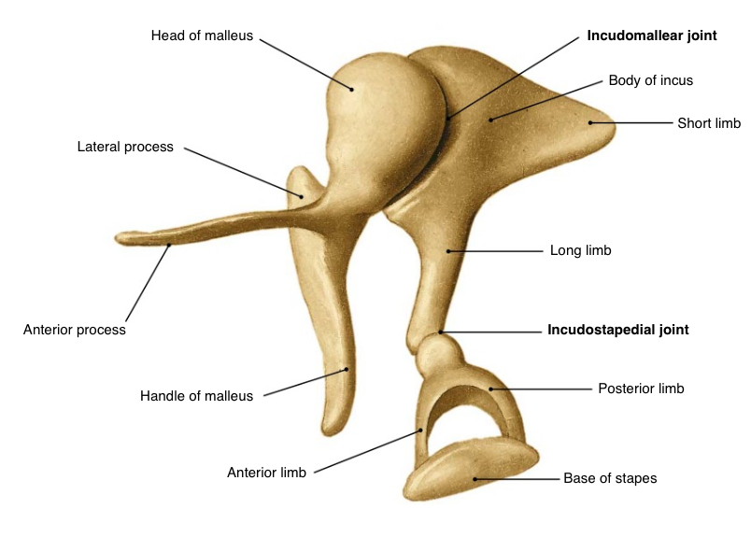
Lateral
Malleus
Incus
Anterior
Stapes
Posterior
Medial

Slide 59

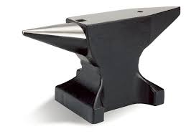
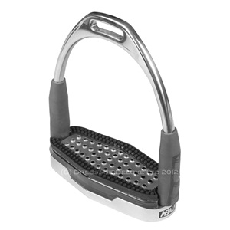
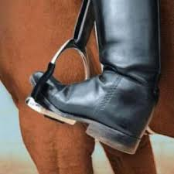
The ossicles
Malleus (hammer)
Incus (anvil)
Stapes (stirrup)
Notes:
The ossicles: the three tiny bones that make up the ossicular chain transmit the sound-induces vibrations of the eardrum to the cochlea through the oval window.
The ossicles are the smallest bones in the body and are at their adult size at birth--they don’t grow.
The three bones include the malleus (hammer), incus (anvil) and stapes (stirrup). Instead of being attached to other bones the ossicles are suspended within the cavity by a series of ligaments and tendons. We’ll look at these later.

Slide 60
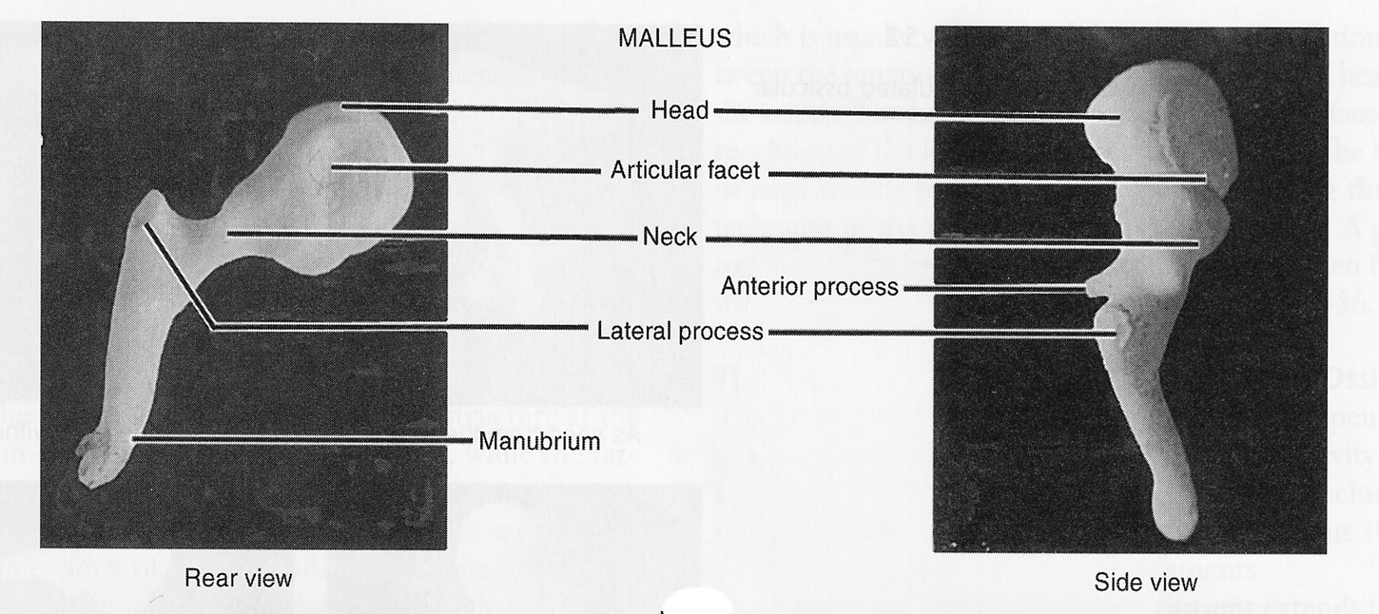
Malleus
- It is the largest ossicles. It has a head, neck, handle and anterior
and lateral processes.
- The head is situated superiorly in the epitympanic recess; and
articulates posteriorly with incus. The handle is attached to inner
surface of ear drum, while the anterior process is attached to the
anterior wall of tympanic cavity by a ligament.

Slide 61
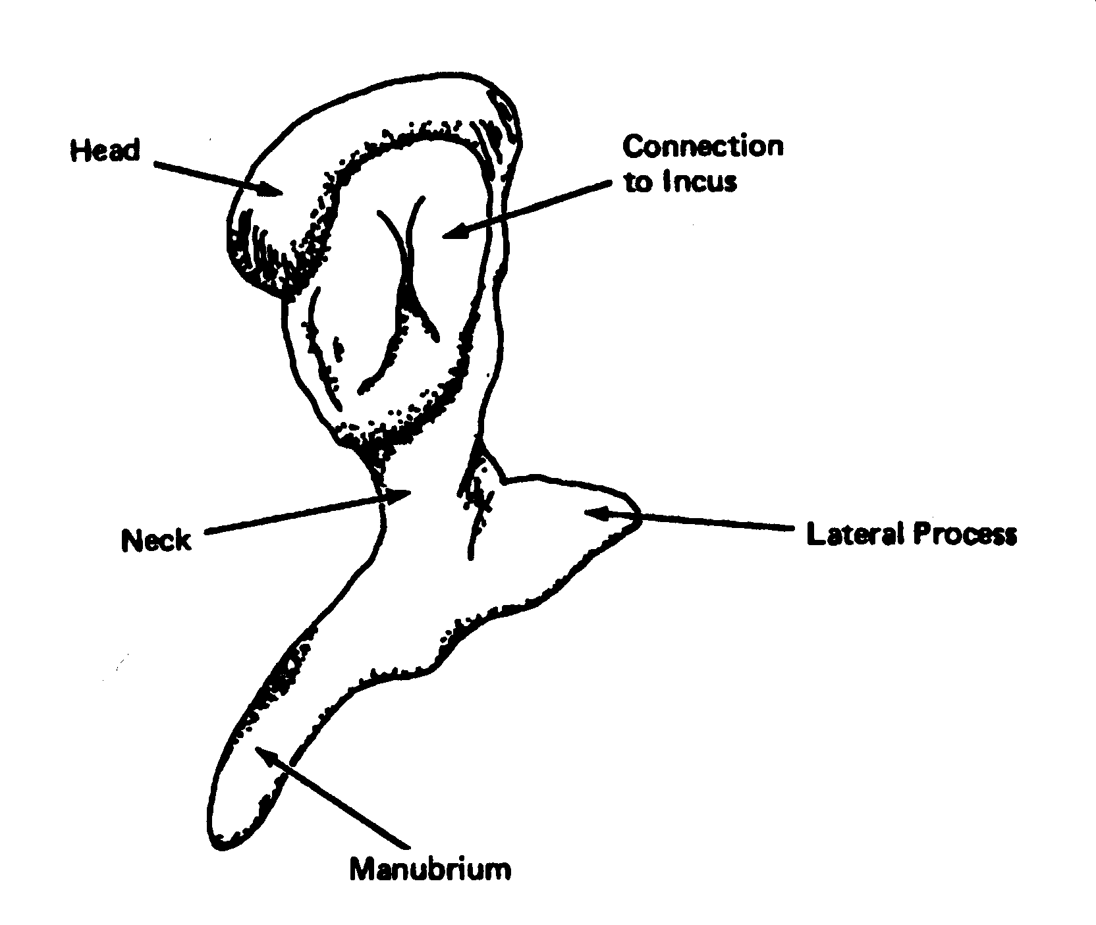
The malleus
Manubrium
Neck
Head
Lateral process
Notes:
• The malleus--Show fig 10.2 approximately 8-9 mm long. Landmarks include the manubrium (handle)--which in life is firmly embedded between the fibrous and mucous membrane layers of the tm. This is the most lateral attachment of the ossicular chain.
The neck is a narrowing between its manubrium and head.
The lateral process is what produces the bulge on the eardrum when we look otoscopically.
The head of the malleus connects with the body of the next middle ear ossicle--the incus.

Slide 62
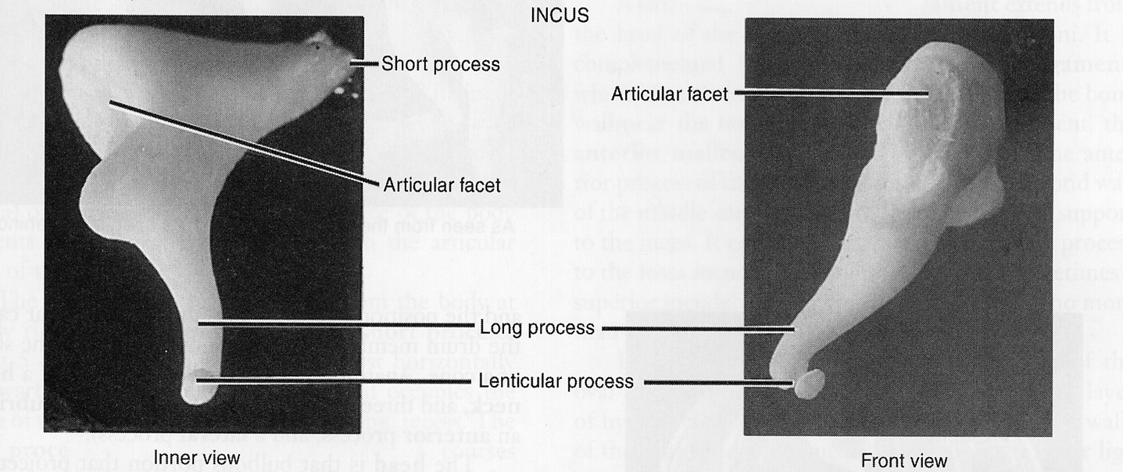
Incus:
- It has a large body and two processes.
- Head is compressed; and articulates with head of malleus.
- Long process is directed downwards parallel to the handle of malleus; and articulates with head of stapes.
- Short (posterior) process: is attached to the posterior wall of tympanic cavity by a ligament.

Slide 63
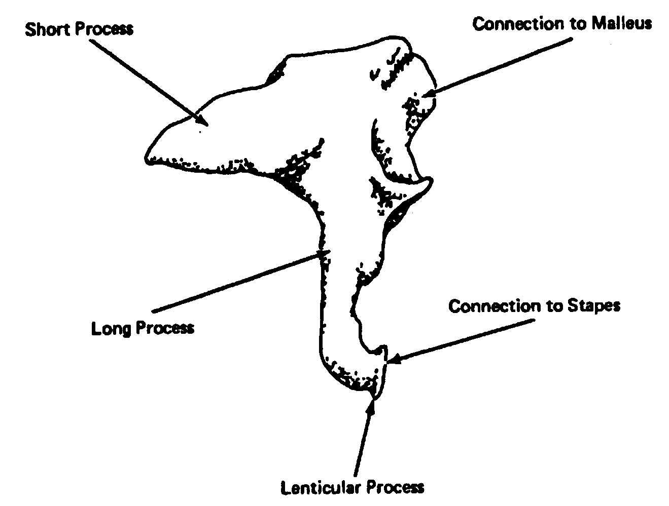
The incus
Short process
Long process
Lenticular process
Incudostapedial joint
Notes:
• The incus--show fig 10.3. About 7 mm long and is the middle bone.
Landmarks include the short process, the long process, and the lenticular process. This is the point of attachment with the stapes.
The connection is thru a true ball-and-socket kind of joint called the incudostapedial joint.

Slide 64
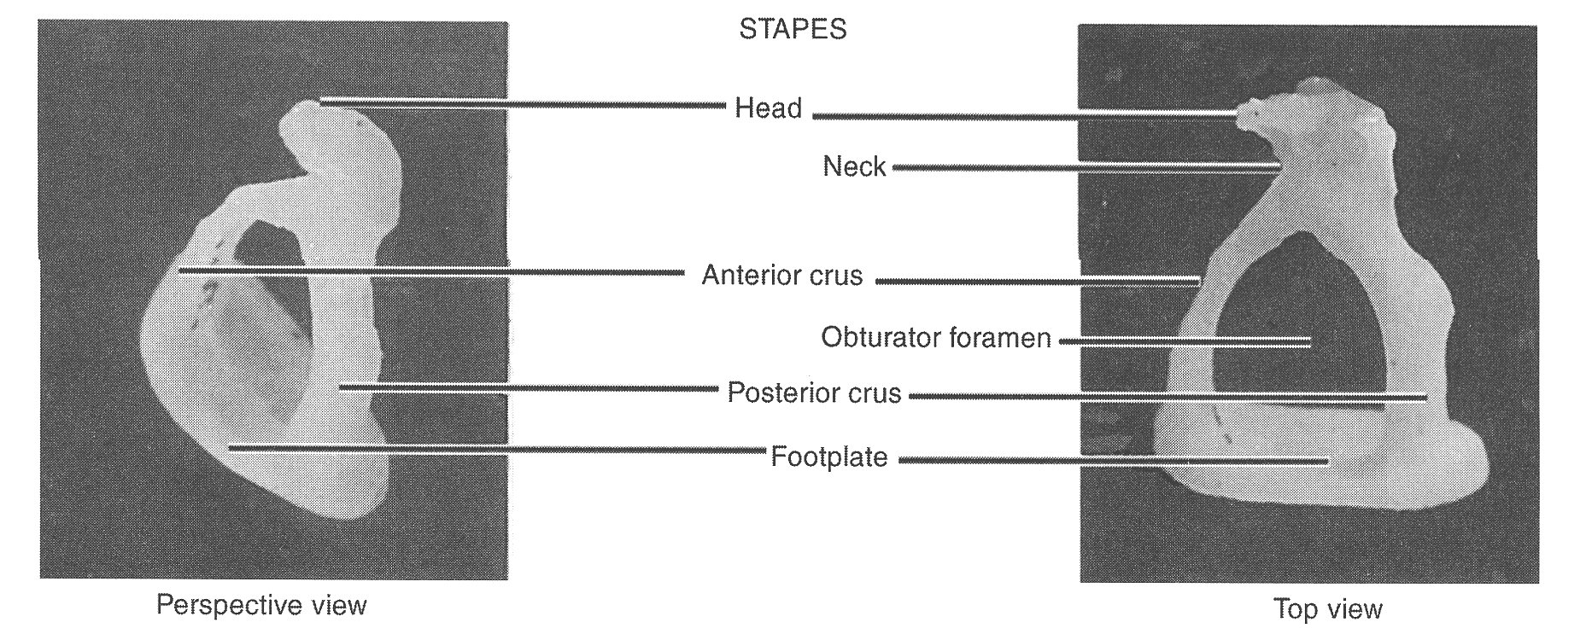
Stapes
It has a head, neck, base and two limbs.
- The small head articulates with long process of incus.
- Neck receives the insertion of stapedius.
- The base is attached to the margins of fenestra vestibuli by an annular ligament.

Slide 65
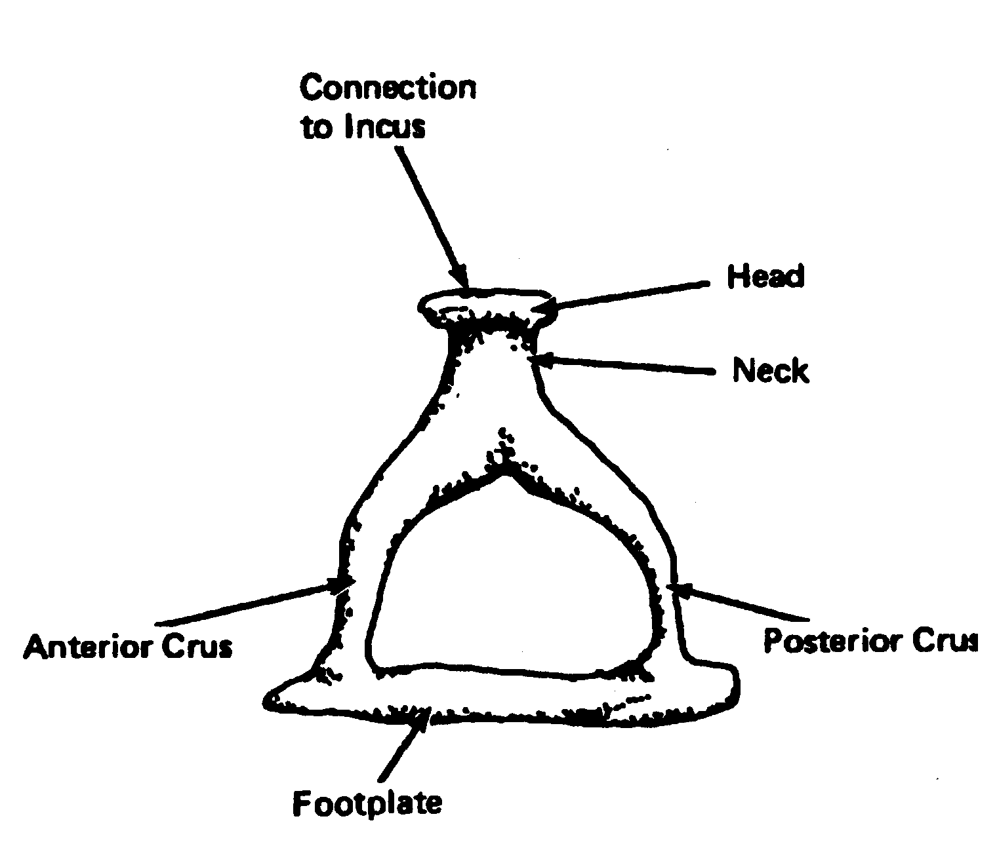
The stapes
Head
Neck
Anterior crus
Posterior crus
Footplate
Notes:
• the stapes---show fig 10.4 only about 3.5 mm long. This is THE smallest bone in the human body. Landmarks include the head, the neck, the anterior and posterior crus or crura, and the footplate. The footplate is embedded into the oval window by the annular ligament. This is the most medial attachment of the ossicular chain.

Slide 66
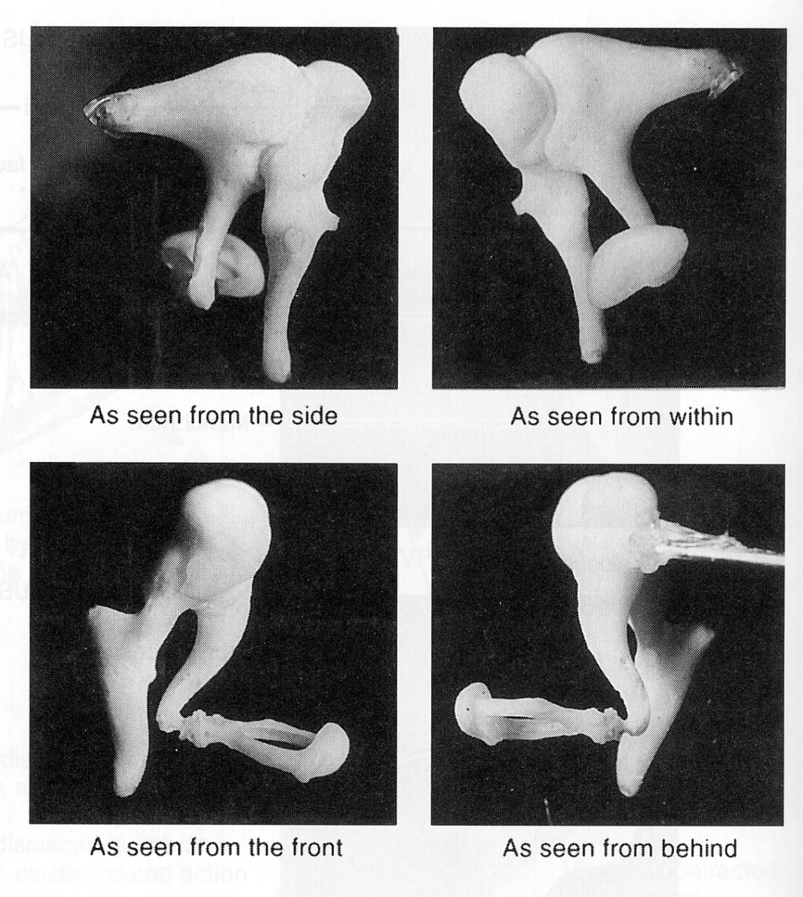
Articulated ossicular chain
Notes:
articulated ossicular chain--fig 6-52 showing various views of an articulated ossicular chain. Very much moves as a unit

Slide 67
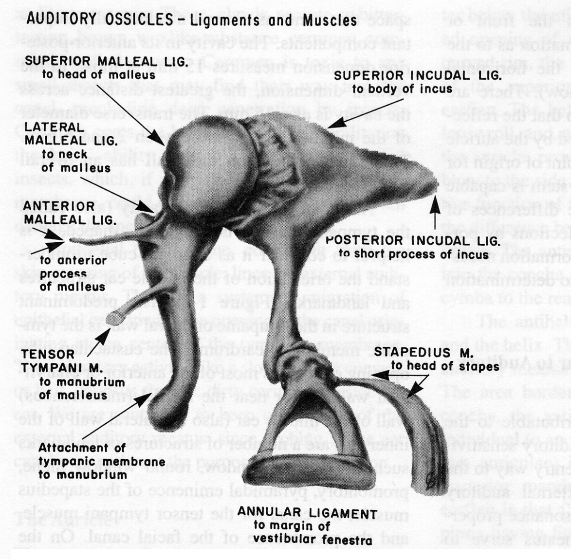
Ligaments of the ossicular chain
Superior malleal ligament
Anterior malleal ligament
Lateral malleal ligament
Posterior incudal ligament
Notes:
The ligaments that suspend the ossicular chain--show fig 1-3. The ossicles are suspended in the middle ear cavity by four ligaments.
• the superior malleal ligament---runs from the superior face of the cavity (tegmen tympani) to the head of the malleus
• the anterior malleal ligament--runs from the anterior face of the cavity to the anterior process of the malleus
• the lateral malleal ligament--runs from the bony wall to the neck of the malleus
• the posterior incudal ligament---runs from the mastoid (posterior wall) to the short process of the incus

Slide 68
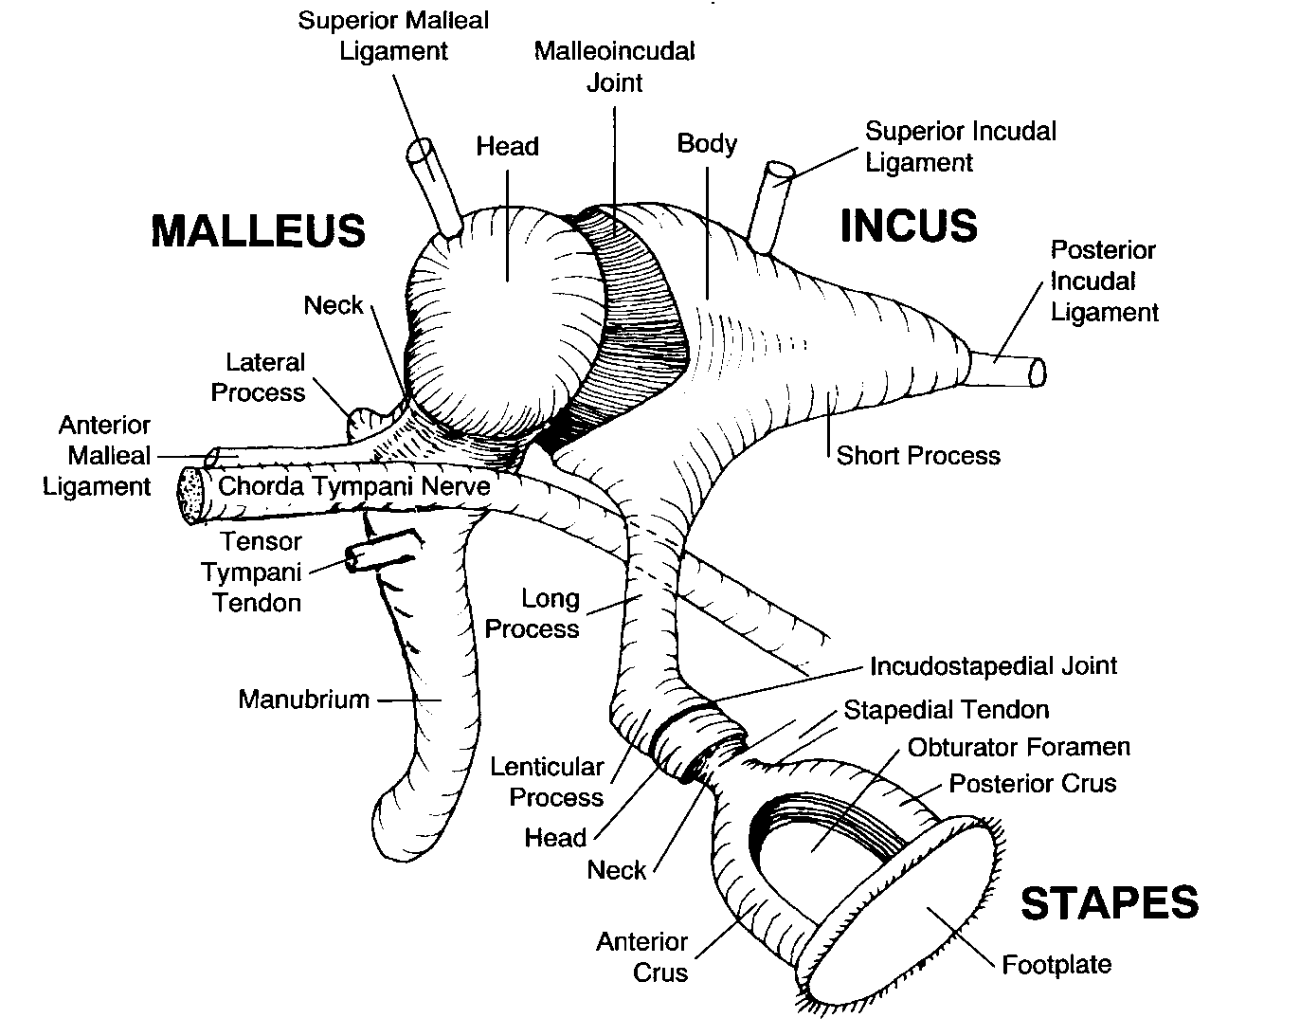
The ossicular chain in place
Notes:
Because of the way the ossicular chain is suspended by these series of ligaments, its inertia is very small and they are well balanced. As a result, once sound vibrations have ceased, the vibrations of the ossicles also terminate abruptly. If this were not the case, the ossicular chain would tend
to swing like a pendulum and would continue to vibrate after the sound had ceased.
Fig 2-10 the ossicular chain in place--review major landmarks

Slide 69
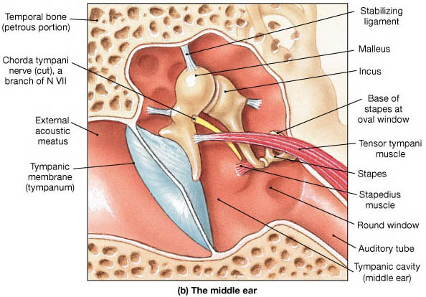
Muscles of tympanic cavity

Slide 70
1. Tensor tympani:
Origin: from the wall of cartilaginous auditory tube.
Insertion: into root of handle of malleus.
Nerve supply: Mandibular nerve, through the nerve to
medial pterygoid (the muscle is derived from the first
pharyngeal arch).
2. Stapedius muscle:
Origin: from the posterior wall of middle ear.
Insertion: into neck of stapes.
Nerve supply: Facial nerve (the muscle is derived
from the second pharyngeal arch).
Action: Both muscles dampen the noise of sounds
(such as sounds of mastication), as they dampen down
the vibrations of malleus and stapes.

Slide 71
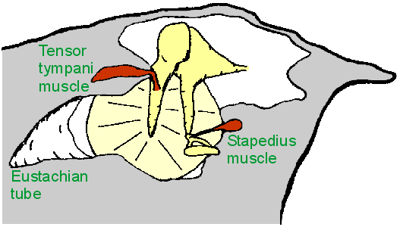
Middle Ear Muscles
Middle Ear Muscle Function:
  Help maintain ossicles in proper position
  Protect inner ear from excessive sound levels
    When ear exposed to sound levels above 70 dB, the muscles contract, decreasing amount of energy transferred to inner ear
  This protective reflex termed "acoustic reflex"

Slide 72
Blood supply of middle ear
Tympanic branch of the maxillary (tympanic membrane).
Stylomastoid branch of the posterior auricular (posterior cavity and mastoid).
Petrosal branch of the middle meningeal.
Branch of the ascending pharyngeal.
Tympanic branch of the internal carotid.
A branch from the artery of the pterygoid canal (follows the auditory tube).
Venous drainage
To the pterygoid plexus and the superior petrosal sinus.

Slide 73
Innervation of middle ear
The horizontal portion of the facial nerve traverses through the tympanic cavity on its labyrinthine wall in a bony canal just superior to the footplate of the stapes.
The chorda tympani, a recurrent branch of the facial nerve, is given off before the facial nerve exits the stylomastoid foramen. It enters the tympanic cavity (middle ear) after exiting a bony canal and passing medial to the neck of the malleus invested in the mucous membrane, then it emerges in the carotid wall. The chorda tympani innervates the submandibular and sublingual salivary glands and the anterior two thirds of the tongue (carrying taste information).

Slide 74
tympanic plexus
Sensory information about the tympanic canal (middle ear) is carried by multiple nerves that contribute to the tympanic plexus located on the promontory of the medial wall, as follows:
Tympanic branch of the glossopharyngeal (Jacobson nerve): This contributes to the tympanic plexus
Superior and inferior caroticotympanic nerves: These are branches from the sympathetic carotid plexus that join the tympanic branch of glossopharyngeal nerve to contribute to the tympanic plexus
Communication with a branch from the greater petrosal nerve
The tympanic plexus then supplies branches to the mucous membrane of the tympanic cavity (middle ear), the fenestra vestibuli and auditory tube, in addition to other regions.

Slide 75
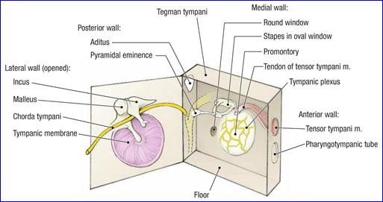
Tympanic plexus

