Slide 1
The Nose and Paranasal Sinuses
Assistant Professor
Dr. Duraid H Abid Alkadem
M.B.Ch.B (TUCOM)
MRCS ENT (RCSEd, UK),
DOHNS (RCSEd, UK),
MRES Anatomy ( Liverpool, UK)

Slide 2
Functions of the nasal cavity
(a) It is primarily meant for olfaction
(b) It forms the cephalic part of the respiratory passages and acts as air-conditioning chamber by adding humidity, and temperature to the inspired air.
(c) It protects the air passages by filtering foreign particles by the coarse hairs of the vestibule, and provides a mucociliary barrier which moves the entrapped particles backward to the nasopharynx, then they are ejected by sneezing or coughing.

Slide 3
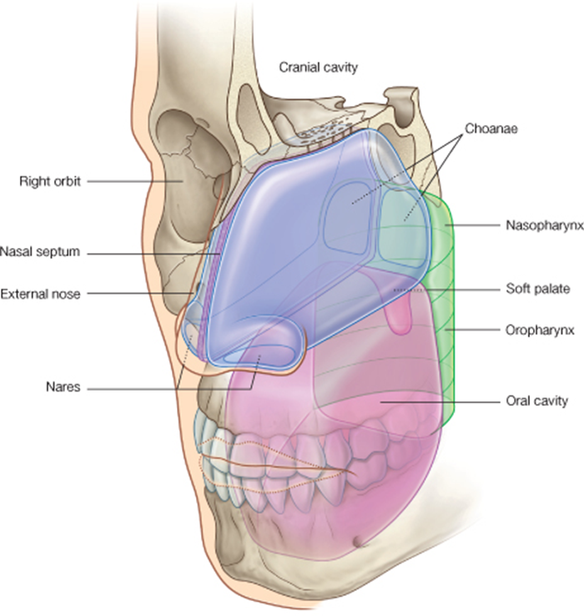
Nose
Divided into two regions :
The external nose
The internal nasal cavity

Slide 4
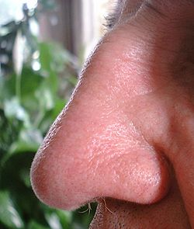
The external nose

Slide 5
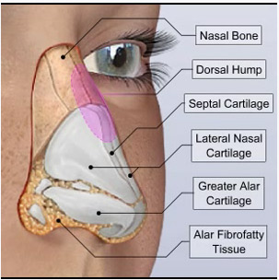
Nose and paranasal sinuses
Nose-
External nose- boney and cartilagenous part,
Bones- nasal bones & the frontal processes of the maxillae
Cartilages- superior & inferior nasal cartilages, septal cartilage and some small cartilages

Slide 6
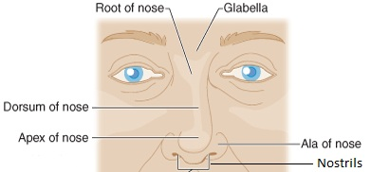
2 openings called nostrils separated by nasal septum
The lateral margin ala of nose rounded and mobile.

Slide 7
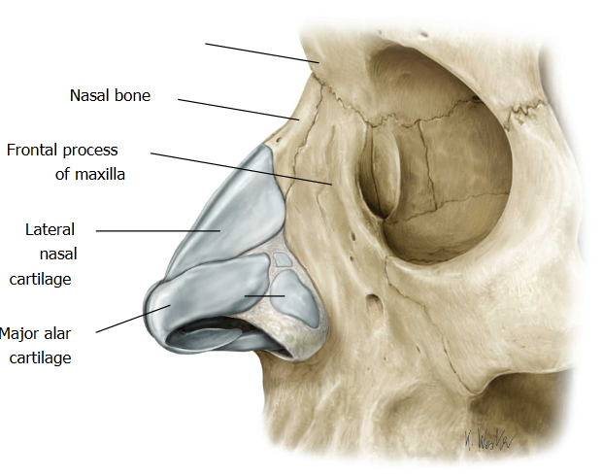
Frontal

Slide 8
Blood supply
branches of ophthalmic a.
and the maxillary a.
skin of the ala and lower part of the septum are by branches of facial artery.

Slide 9
Nerve supply
The infratrochlear and external nasal branches of the ophthalmic nerve (CN V).
Infraorbital branch of the maxillary nerve (CN V).

Slide 10
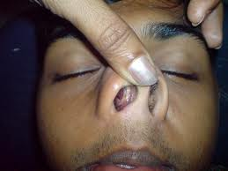
The nasal cavities

Slide 11
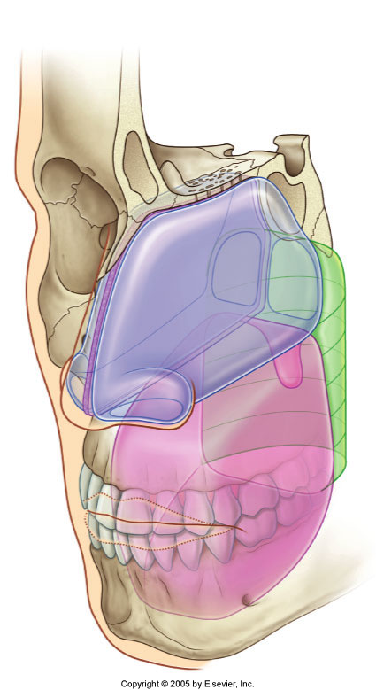
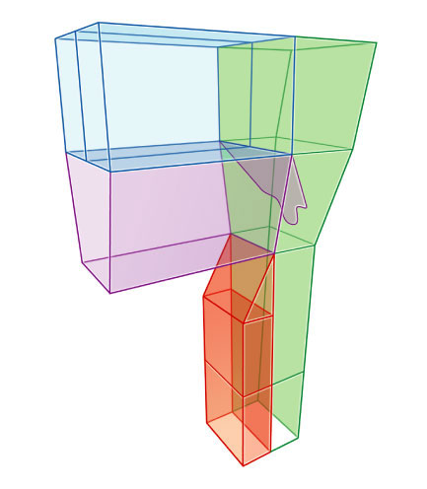
Nasal Cavity

Slide 12
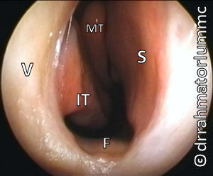
Nasal Endoscopy

Slide 13

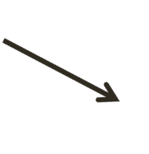
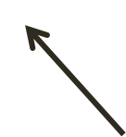
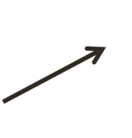
Nasal Cavity
Separated by a midline nasal septum
Each nasal cavity has a floor, roof, medial wall, and lateral wall
Lateral to the nasal cavities are the orbits

Slide 14
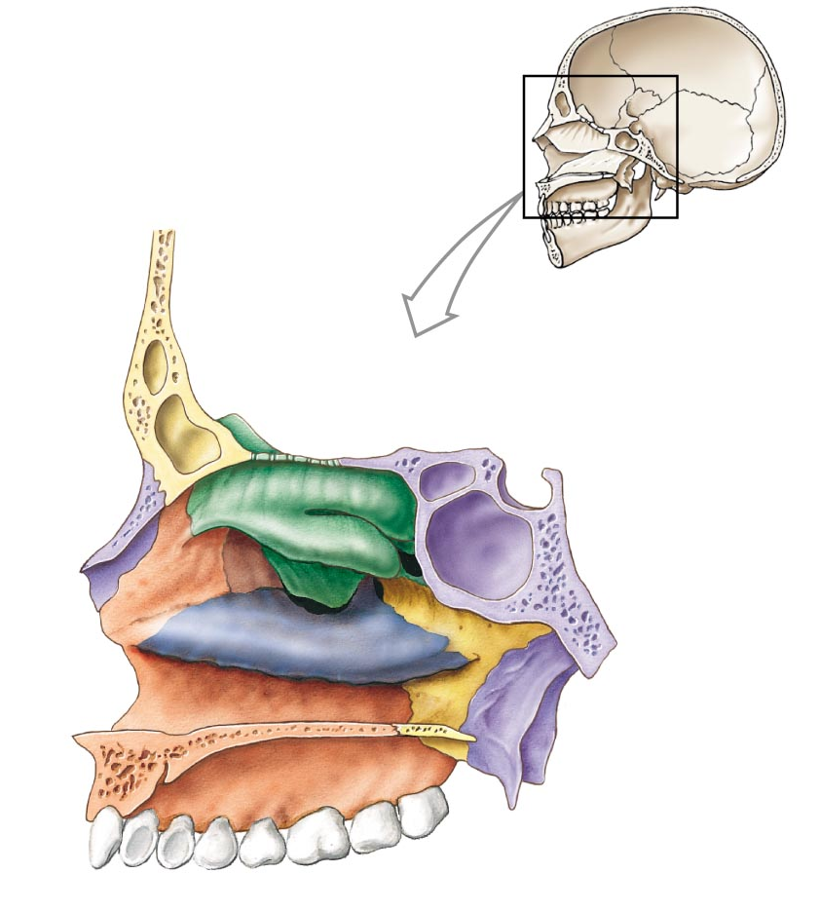
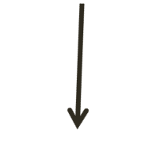
Nasal Cavity
from oral cavity below by the hard palate
from the cranial cavity above by parts of the frontal, ethmoid, and sphenoid bones.

Slide 15
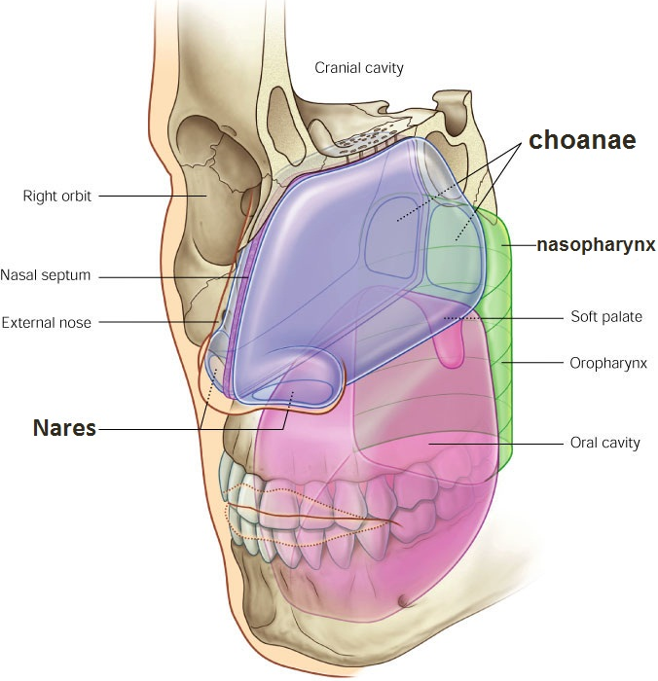
Nasal Cavity
The anterior apertures of the nasal cavities are nares, which open onto the inferior surface of the nose.
The posterior apertures are the choanae, which open into the nasopharynx.

Slide 16
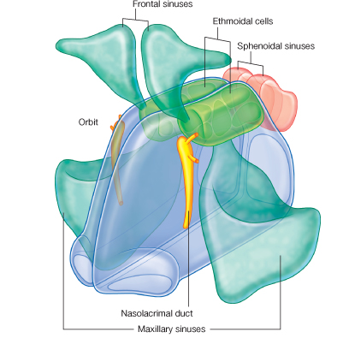
Sinuses
NLD

Slide 17
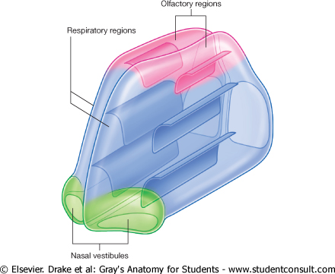
Nasal Cavity Regions
Each nasal cavity consists of three general regions
the nasal vestibule is a small dilated space just internal to the naris that is lined by skin and contains hair follicles;
the respiratory region is the largest part of the nasal cavity, has a rich neurovascular supply, and is lined by respiratory epithelium composed mainly of ciliated and mucous cells;
the olfactory region is small, is at the apex of each nasal cavity, is lined by olfactory epithelium, and contains the olfactory receptors.
In addition to housing receptors for the sense of smell (olfaction), the nasal cavities adjust the temperature and humidity of respired air, and trap and remove particulate matter from the airway.

Slide 18
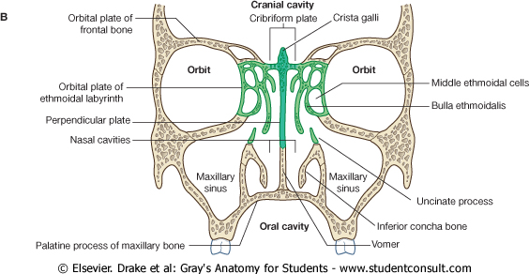
Ethmiod bone
Ethmoid bone
The single ethmoid bone is one of the most complex bones in the skull.
It contributes to the roof, lateral wall, and medial wall of both nasal cavities, and contains the ethmoidal cells (ethmoidal sinuses).

Slide 19
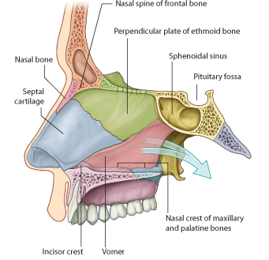
Boundaries of Nasal Cavity
Medial wall
nasal septum, which is oriented vertically in median sagittal plane and separates right and left nasal cavities
Septum of :
septal cartilage
vertical plate of the ethmoid
vomer.

Slide 20
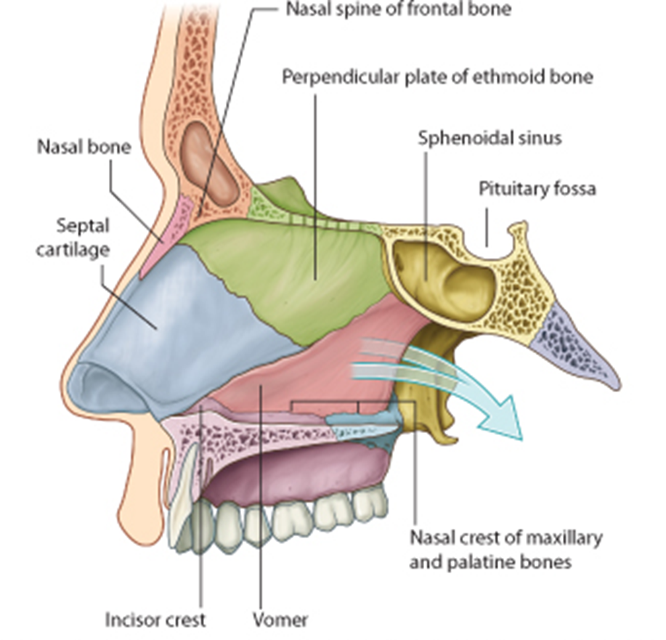
Nasal septum:
* Above: perpendicular plate of the ethmoid.
* Below and in front: septal cartilage.
* Below and behind: vomer.

Slide 21
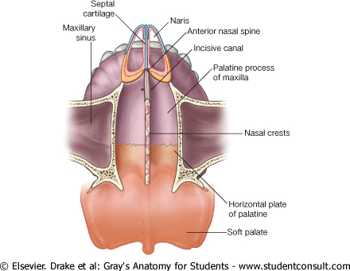
Floor of Nasal Cavity
It consists of:
palatine process of maxilla & horizontal plate of the palatine bone, which together form the hard palate.
The naris opens anteriorly into the floor.

Slide 22
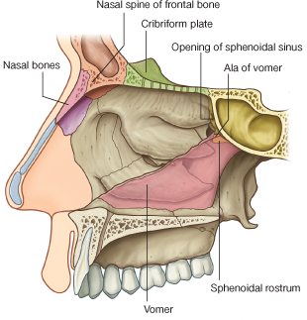
Roof of Nasal Cavity
narrow
Formed by :
cribriform plate of the ethmoid bone
nasal and frontal bones, and posteriorly sphenoid Bone.

Slide 23
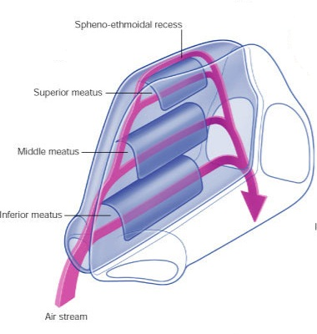
LATERAL WALL OF NASAL CAVITY
* It has 3 curved long projections called nasal conchae:
1) Superior concha.
2) Middle concha.
3) Inferior concha.
* The space below each of these conchae is called nasal meatus.

Slide 24
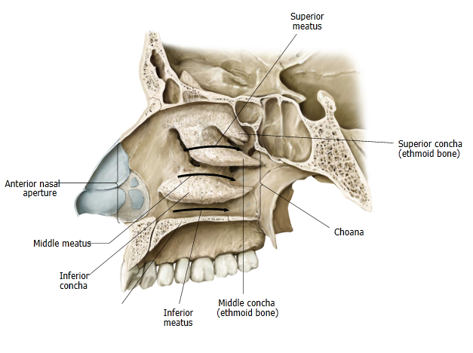

Slide 25
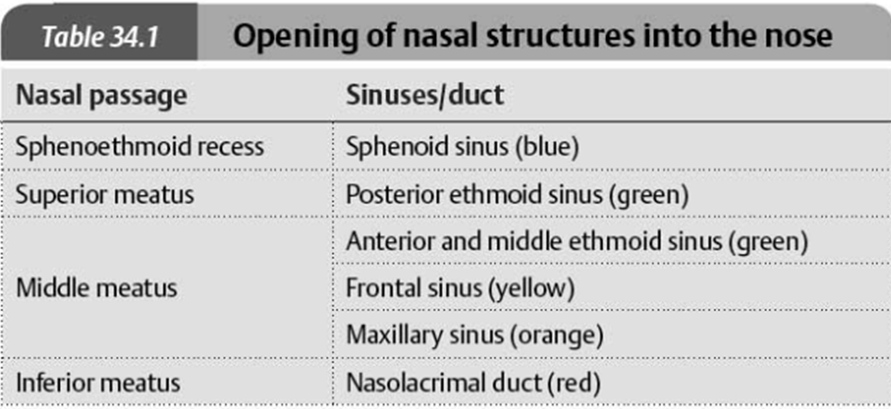

Slide 26
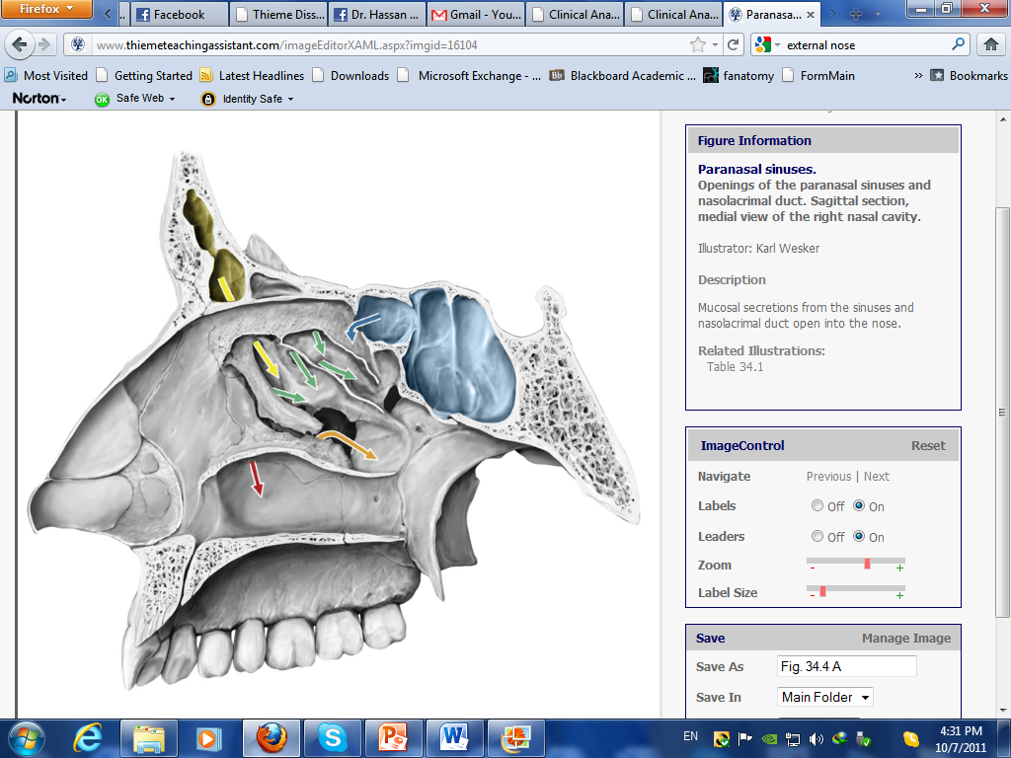

Slide 27
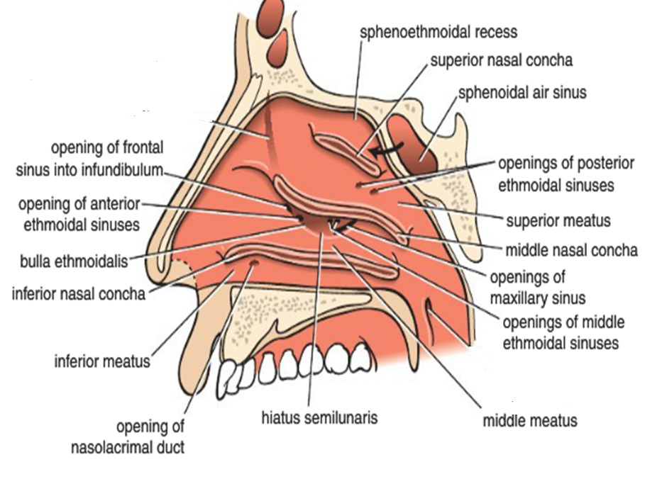

Slide 28
several paranasal sinuses have their openings in this meatus as follows:
a) Maxillary air sinus: opens into the hiatus semilunaris below the bulla ethmoidalis.
b) Anterior ethmoidal sinus: opens into the hiatus semilunaris in front of the bulla ethmoidalis.
c) Middle ethmoidal sinus: opens on the bulla ethmoidalis.
d) Frontal sinus: opens into infundibulum at the upper part of the hiatus semilunaris.
Openings of the middle meatus:

Slide 29
Middle Meatus
The middle meatus lies below the middle concha
It has a rounded swelling called the bulla ethmoidalis that is formed by the middle ethmoidal air sinuses, which open on its upper border
A curved opening, the hiatus semilunaris, lies just below the bulla
The anterior end of the hiatus leads into a funnel-shaped channel called the infundibulum, which is continuous with the frontal sinus
The maxillary sinus opens into the middle meatus through the hiatus semilunaris

Slide 30
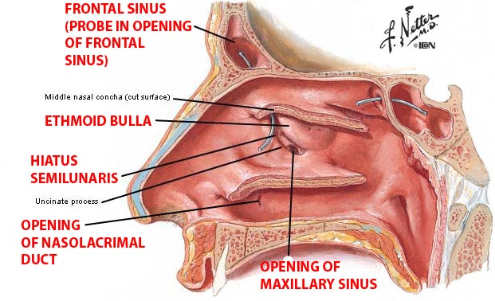
Features of the middle meatus:
presents a rounded eminence called bulla ethmoidalis which is bounded in front and below by a curved groove called hiatus semilunaris.

Slide 31
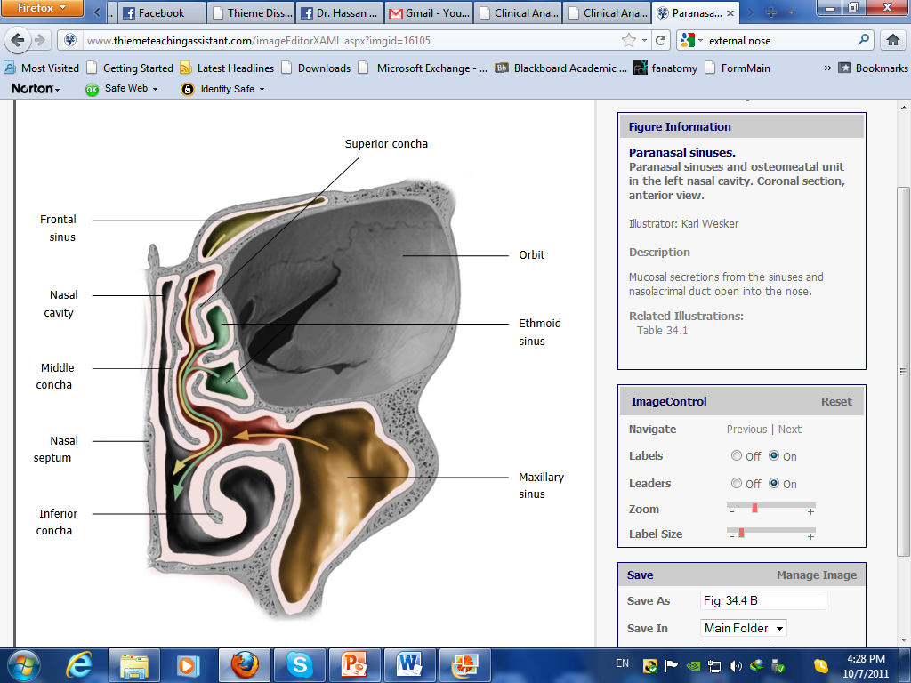

Slide 32
Other openings in the lateral wall of the nose:
a) Sphenoidal sinus: opens into the spheno-ethmoidal recess just above the superior concha.
b) Posterior ethmoidal sinus: opens into the superior meatus (below the superior concha).
c) Naso-lacrimal duct: opens into the inferior meatus.

Slide 33
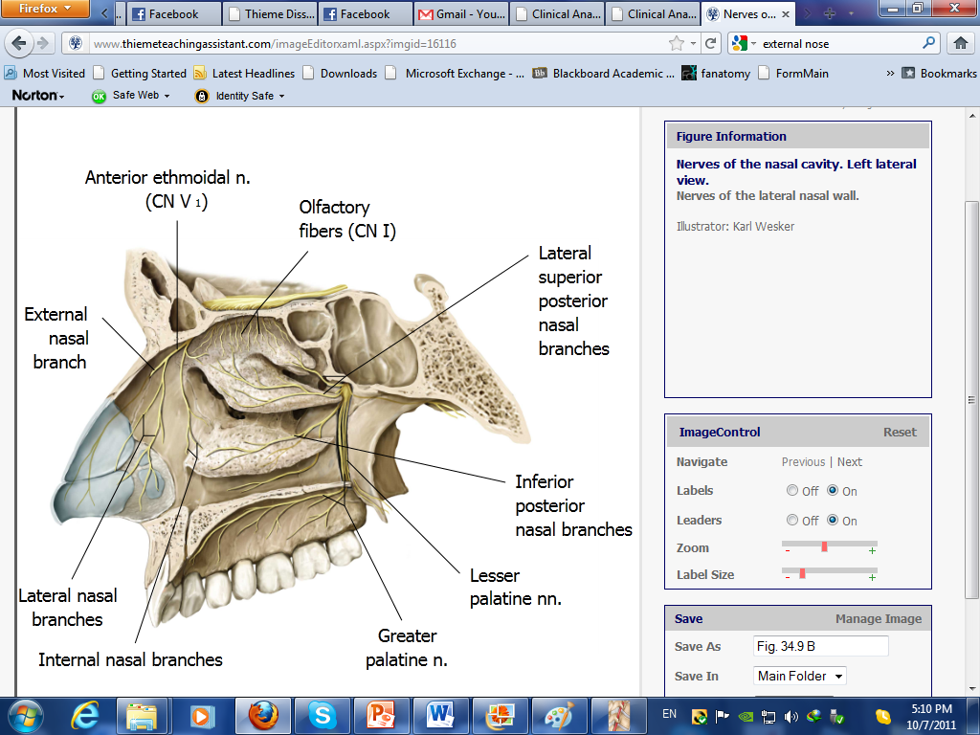
Nerves of nasal cavity:
1-Sensory: ophthalmic division (V1) and maxillary division (V2) of the trigeminal nerve
2- Olfactory nerve: It is the nerve of smell. It supplies the olfactory mucosa which is situated in the roof of the nasal cavity.

Slide 34
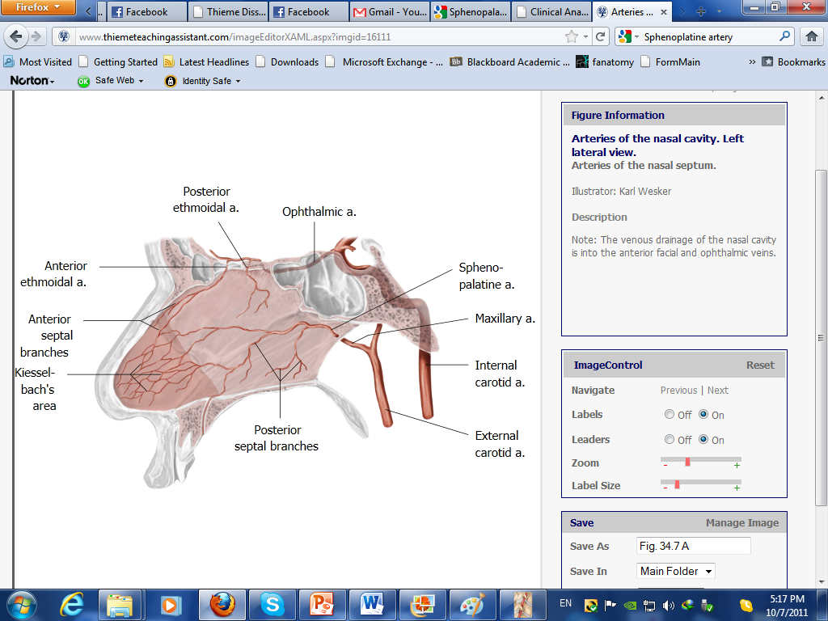
Arteries of nasal cavity:
1. Branches of maxillary artery main supply of the nose (Sphenopalatine artery).
2.Septal branch: from facial artery.
3-ethmoidal branches: from Ophthalmic artery.
bleeding from the nose (epistaxis).

Slide 35
Lymphatic drainage
(a) From the anterior part— the submandi­bular lymph nodes;
(b) From the intermediate and posterior parts— into the retropharyngeal lymph nodes;
(c) From the upper part—a few lymphatics accompany the olfactory nerves along the perineural sheaths and drain in the C.S.F. of subarachnoid spaces.
Sometimes air-borne viral infection produces rapid meningo-encephalitis following the perineural sheaths.

Slide 36
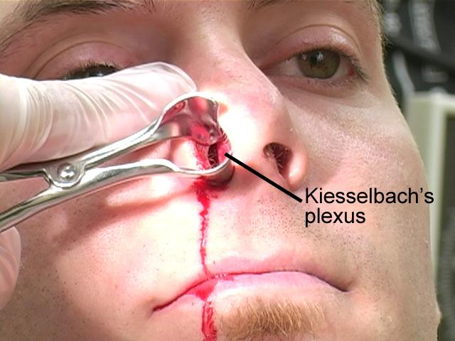

Slide 37
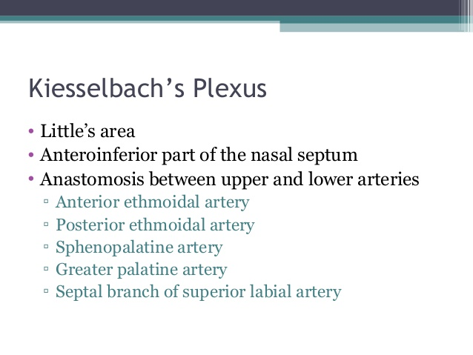
Epistaxis

Slide 38
PARANASAL AIR SINUSES

Slide 39
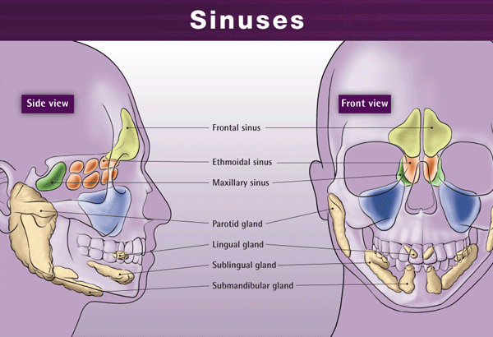

Slide 40
PARANASAL AIR SINUSES
They are cavities found in the interior of the maxilla, frontal, sphenoid, & ethmoid bones.
communicate with the nasal cavity.

Slide 41
Paranasal Sinuses
They are lined with mucoperiosteum and filled with air
They communicate with the nasal cavity through relatively small apertures
The maxillary and sphenoidal sinuses are present in a rudimentary form at birth
They enlarge appreciably after the eighth year and become fully formed in adolescence

Slide 42
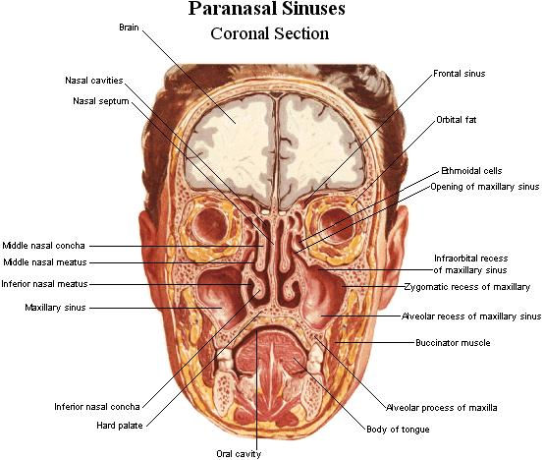

Slide 43
Drainage of Mucus
The mucus produced by the mucous membrane is moved into the nose by ciliary action of the columnar cells
Drainage of the mucus is also achieved by the siphon action created during the blowing of the nose

Slide 44
PARANASAL AIR SINUSES
Functional importance:
They have the following functions:
* They make the skull lighter (filled with air).
* They act as resonating chambers for the voice.
They increase the surface area of the nasal mucous membrane and thus help warming the air before entering the lung.

Slide 45
1) Sphenoidal air sinuses:
*These are 2 sinuses which lie inside the body of sphenoid and are separated from each other by a bony septum.
2) Ethmoidal air sinuses:
*These are large number of intercommunicating cavities present inside the ethmoid bone and open into the nose. Lies between nose and orbit.
3) Frontal air sinuses:
*These are 2 sinuses which lie in the frontal bone just above the root of the nose.
*They are separated from each other by a septum.

Slide 46
All paranasal sinuses open into the middle meatus of the nose
except 2:
1) the sphenoidal sinus (into the spheno-ethmoidal recess).
2) the posterior ethmoidal sinus (into the superior meatus).

Slide 47
MAXILLARY AIR SINUS
It is a pyramidal cavity situated inside the body of the maxilla. It is the largest paranasal air sinus.
*WALLS:
-Roof: separates the sinus from the orbit and lodges the infra-orbital
nerve and vessels.
-Floor: is formed by the alveolar process of the maxilla.
The roots of the 1st and 2nd molar teeth project into the floor.

Slide 48
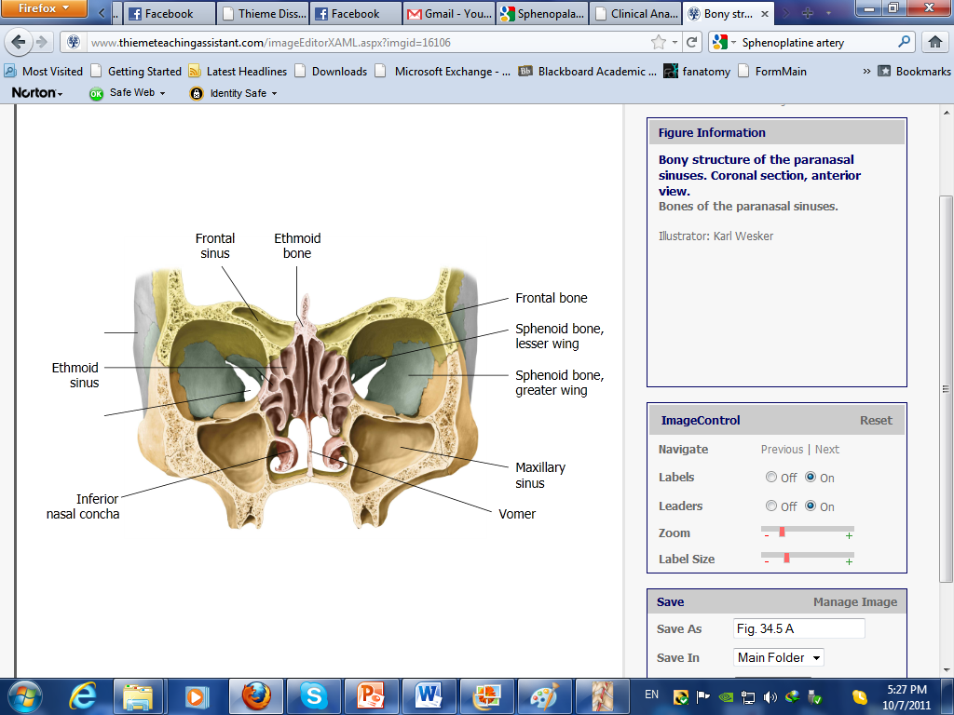
Relations:
* Medially: nasal cavity.
The sinus opens into the middle meatus of the nose.
* Above: orbit
* Below : roots of the molar and premolar teeth.

Slide 49
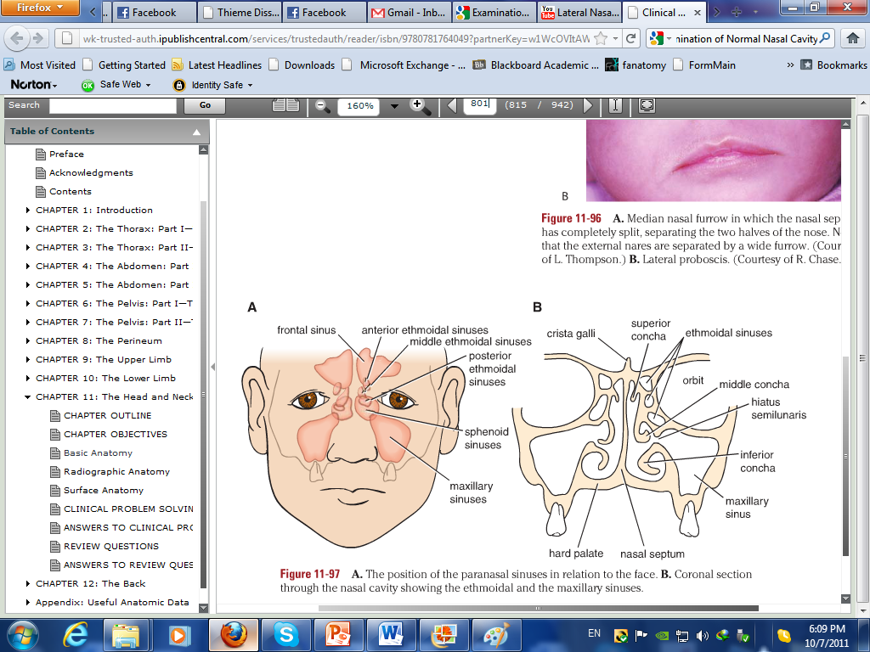

Slide 50
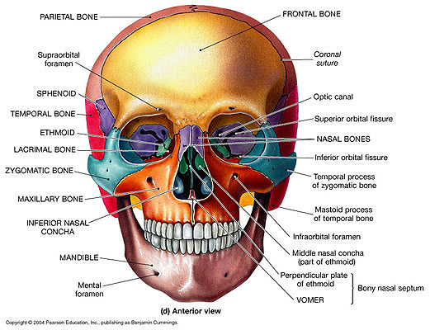

Slide 51
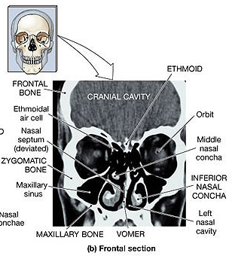

Slide 52
Thank you
Notes:
https://event.demio.com/join/q1p1PTdO0bCRUBVP

