Slide 1
Pharyngeal Arches
Dr. Duraid Hameed
M.B.Ch.B, (TUCOM)
MRCS - ENT (RCSEd, UK),
DOHNS (RCSEd, UK),
MRES Anatomy ( Liverpool, UK)

Slide 2
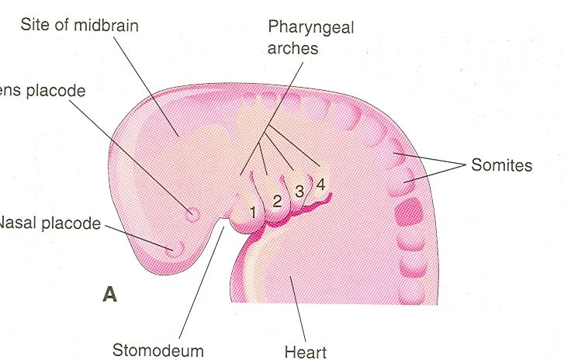

Slide 3
Pharyngeal Arches
The first pharyngeal arch (mandibular arch) develops maxillary and mandibular prominences
The first pair of pharyngeal arches plays a major role in facial development
The second pharyngeal arch (hyoid arch) contributes to the formation of hyoid bone

Slide 4
Pharyngeal Arches
By the end of the fourth week, four pairs of pharyngeal arches are visible externally
The fifth and sixth arches are rudimentary and are not visible on the surface of the embryo
The pharyngeal arches are separated from each other by fissures called pharyngeal grooves
They are numbered in craniocaudal sequence

Slide 5
