Slide 1
Pharynx.
Assistant Professor
Dr. Duraid H Abid Alkadem
M.B.Ch.B (TUCOM)
MRCS ENT (RCSEd, UK),
DOHNS (RCSEd, UK),
MRES Anatomy ( Liverpool, UK)

Slide 2
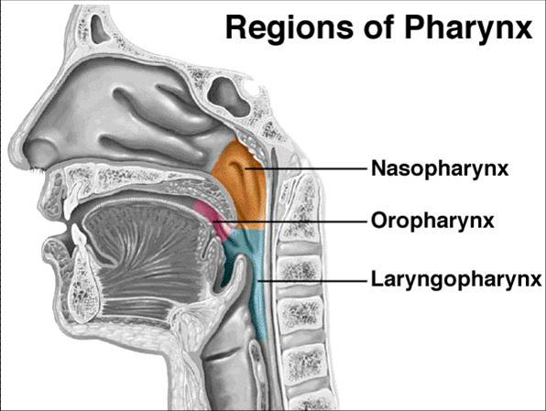
INTRODUCTION
The pharynx is a musculomembraneous tube.
Interior of the pharynx is divided into 3 parts.
Oropharynx.
Nasopharynx.
Laryngopharynx.
Length:12-14cm
width: max 3.5 cm, min 1.5cm

Slide 3
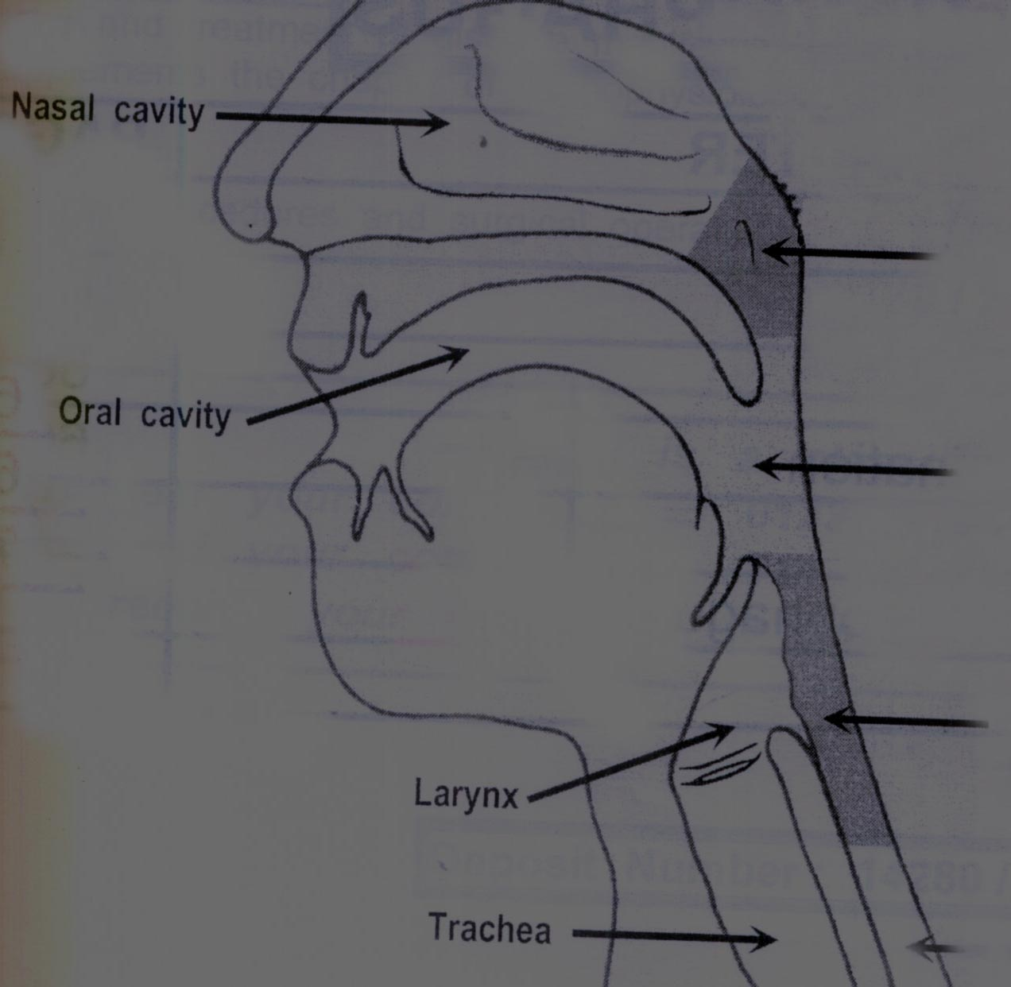
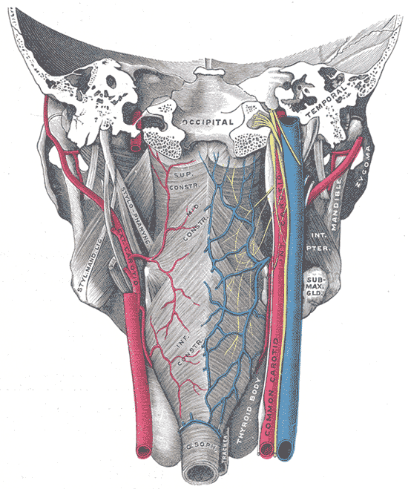
Anatomy of The pharynx
Site
Seen from behind
Midline of the neck
From skull base to esophagus
In front of upper 6 Cervical vertebra
Behind :
The Nose
The Mouth
The larynx

Slide 4
Anatomy of The pharynx
Shape
Irregular Fibromuscular tube lined by mucous membrane
Length: 15 cm

Slide 5
Anatomy
The mucosal lining of the oropharynx and hypopharynx is a nonkeratinizing stratified squamous epithelium that is tightly adherent to an underlying layer of fascia called the pharyngobasilar fascia.
The pharynx is surrounded by three constrictor muscles-the superior, middle, and inferior constrictors .
The pharyngeal muscles are enclosed by the buccopharyngeal or visceral fascia. Areas of loose connective tissue surround the visceral fascia of the pharynx and are potential spaces for infection.

Slide 6
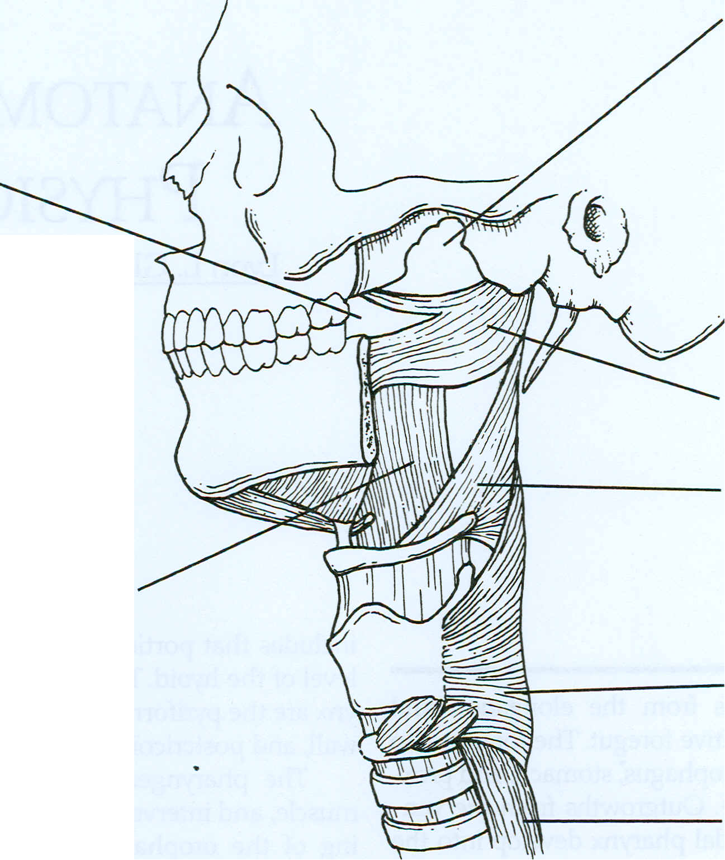
Mucous membrane of nasopharynx
Mucous membrane of oral pharynx
Superior constrictor
Middle constrictor
Mucous membrane of laryngeal pharynx
Inferior constrictor
Esophagus

Slide 7
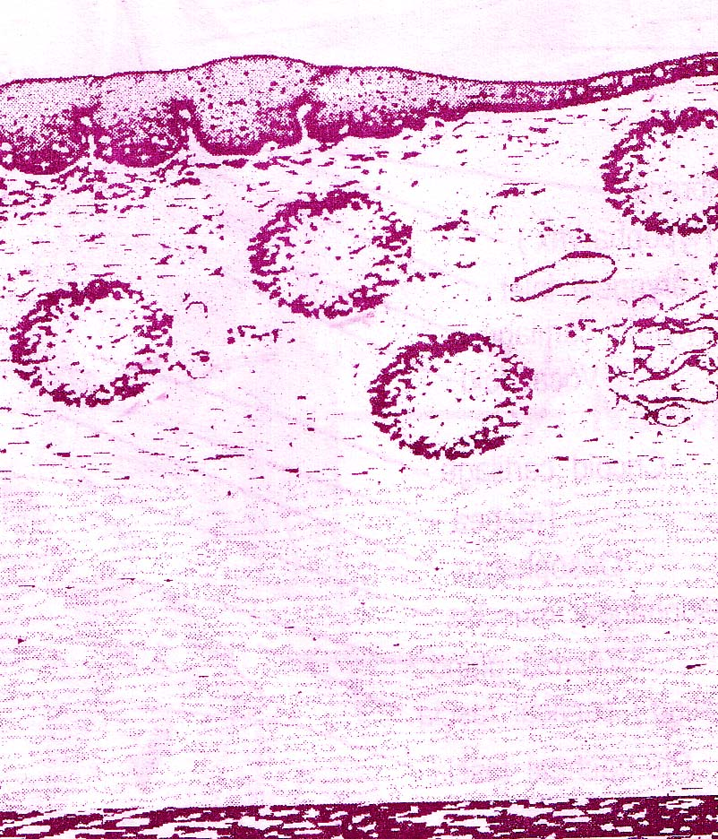
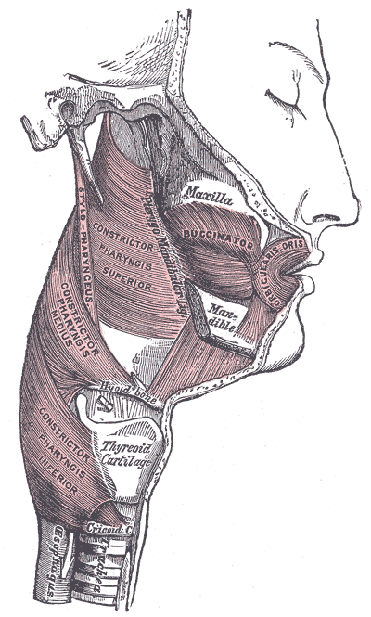
Anatomy of The pharynx
Structure
The wall is formed of 4 layers
1-Mucous membrane
2- pharyngeal aponeurosis
3-muscle layer
4-Bucco-pharyngeal fascia
Formed of 3 muscles, superior middle and inferior constrictor muscles
Loose connective tissue which contains lymphoid tissue that aggregates in some areas forming tonsils (Waldayer’s ring)
Stratified squamous epithelium except the nasopharynx, it is pseudo-stratified with goblet cells
A thin coat of connective tissue

Slide 8
Structure of pharynx.
Areolar coat .
Muscular coat .
outer circular
Superior constrictor
Middle constrictor
Inferior constrictor.
inner longitudinal
Stylopharyngeus
Palatopharyngeus
Salpingopharyngeus.
Submucous coat .
Mucous membrane.

Slide 9
pharyngobasilar fascia (pharyngeal apponeurosis)
is situated between the mucous and muscular layers.
It is thick above where the muscular fibers are wanting, and is firmly connected to the basilar portion of the occipital and the petrous portions of the temporal bones.
As it descends it diminishes in thickness, and is gradually lost.
it is corresponding to the other sub mucosal layer of the other elementary tract

Slide 10
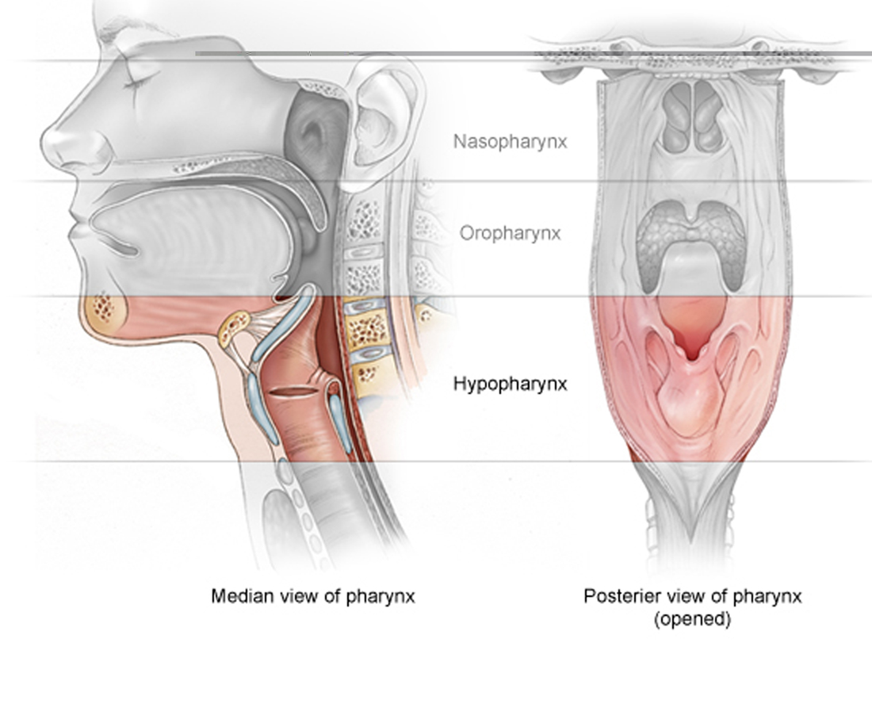
External features
Above: body of sphenoid, basilar part of occipital bone.
Below: oesophagus from level of C6.
In front: oral cavity,nasal cavity,larynx.
Behind:cervical vertebrae,muscles,fascia,space and its contents.
Lateral sides: styloid process of temporal bone,muscles,carotid sheath and contents,lateral lobe of thyroid gland and auditory tube.

Slide 11
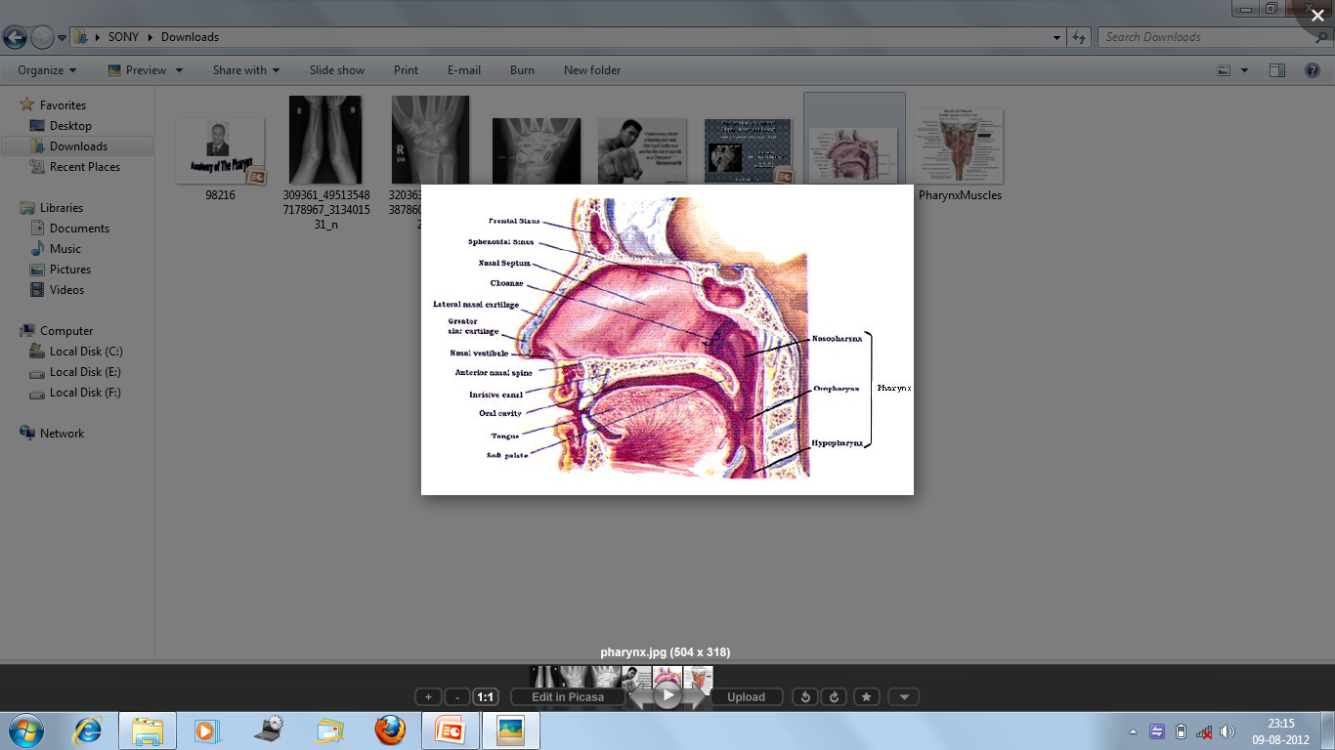
Interior of pharynx
Nasopharynx (epipharynx)
Oropharynx (mesopharynx)
Laryngopharynx (hypopharynx)

Slide 12
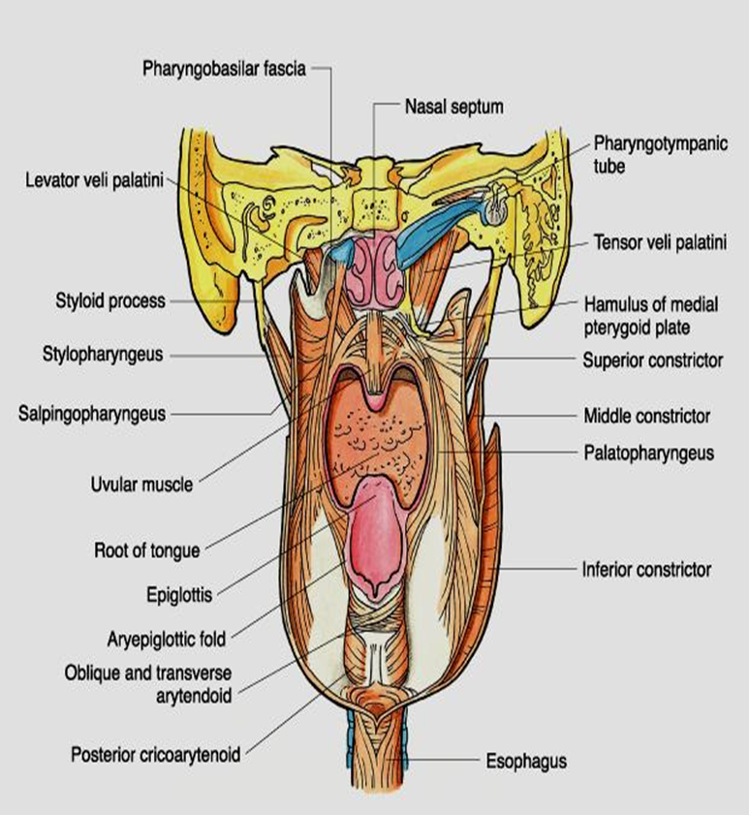

Slide 13
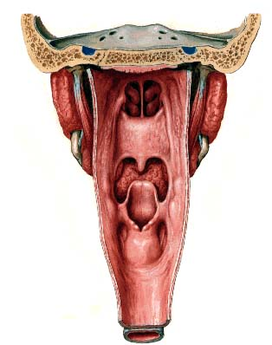
Anatomy of the pharynx
Compartments
Seen from behind
Nasopharynx
Oropharynx
Laryngopharynx
(Hypopharynx)

Slide 14
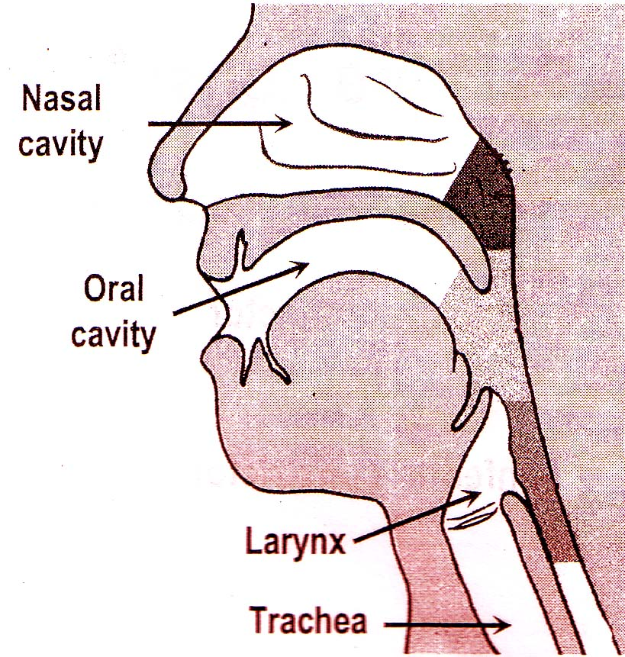
Seen from lateral
Nasopharynx
Oropharynx
Laryngopharynx
(Hypopharynx)

Slide 15
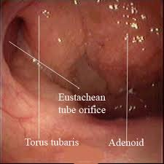
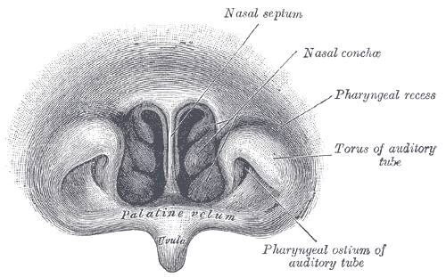
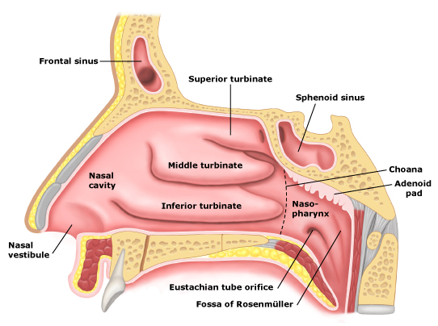
Nasopharynx
Present behind the nasal cavity and above soft palate.
Anterior wall : posterior choana and nasal septum
Posterior wall and roof supported by sphenoid (body),basilar part of occipital, anterior arch of atlas.

Slide 16
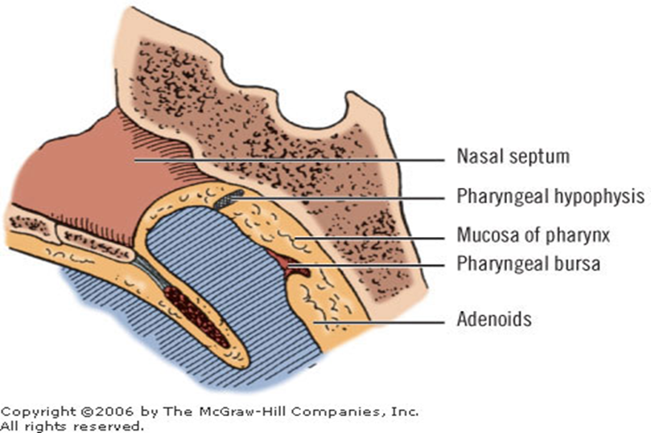
Posterior wall and roof presents following features.
The nasopharyngeal tonsils
The pharyngeal bursa
The pharyngeal hypophysis Residual tissue derived from the hypophysial diverticulum that lies in the
lamina propria of the nasopharynx.

Slide 17
Floor communicates with oropharynx through pharyngeal isthmus.
Boundaries of pharyngeal isthmus
Front :posterior part and free margin of soft palate.
Behind : posterior pharyngeal wall
On sides: palatopharyngeal arch.
During swalowing this communication closed by elevation of soft palate and forward pulling of the post. Pharyngeal wall.

Slide 18
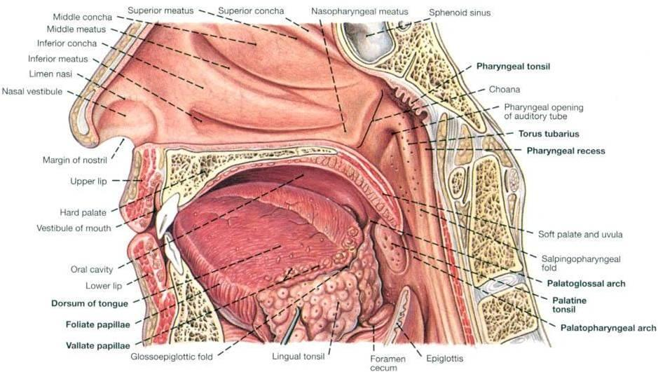
lateral wall presents the following features
Nasopharyngeal opening of Auditory tube: it is a triangular in shape, and bounded behind by a firm prominence, the torus tubarius or cushion (or tubal elevation), caused by the medial end of the cartilage of the tube that elevates the mucous membrane

Slide 19
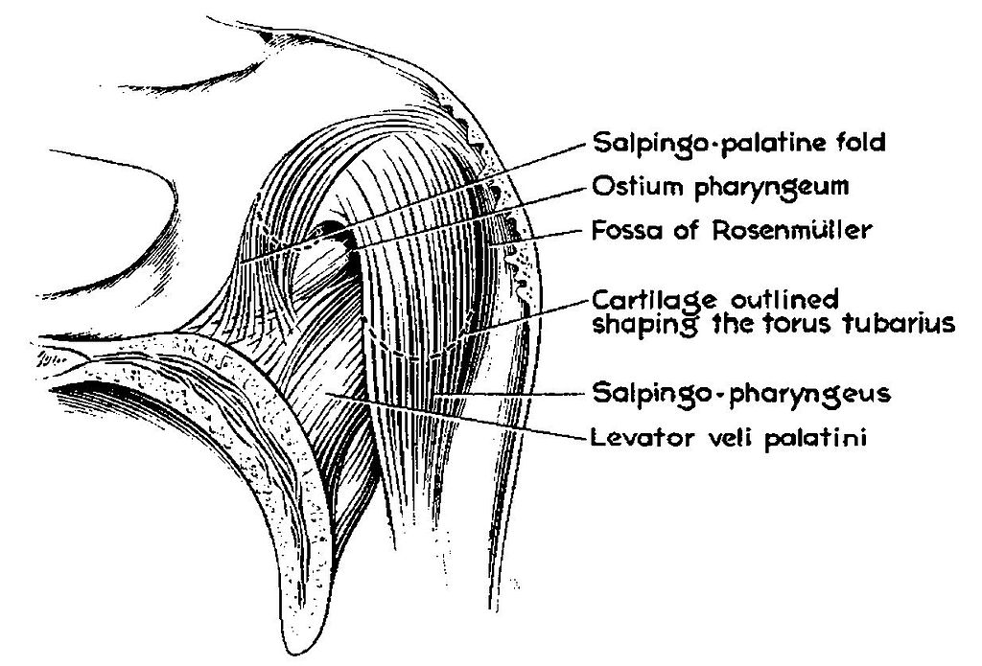
the salpingopharyngeal fold, a vertical fold of mucous membrane extending from the inferior part of the torus and containing the salpingopharyngeus muscle.
salpingopalatine fold, a smaller fold extending from the superior part of the torus to the palate and containing the levator veli palatini muscle.

Slide 20
Pharyngeal recess (Fossa of Rosenmuller)
A small depression in the lateral wall behind the tubal elevation , produced by a mass of lymphoid tissue, which is known as the pharyngeal tonsil. Superior to the pharyngeal tonsil, in the midline, an irregular flask-shaped depression of the mucous membrane sometimes extends up as far as the basilar process of the occipital bone, this is known as th pharyngeal bursa (Luschka's bursa).

Slide 21

Naso-pharyngeal tonsil
It is formed by aggregation of lymphoid tissue beneath the mucous membrane, projects downward and forward as a conical mass, which is more prominent in children and usually atrophies in adults. The naso-pharyngeal tonsil, when enlarged due to infection, is known as the adenoid which obstructs the nasal respiration and makes mouth-breathing obligatory.

Slide 22
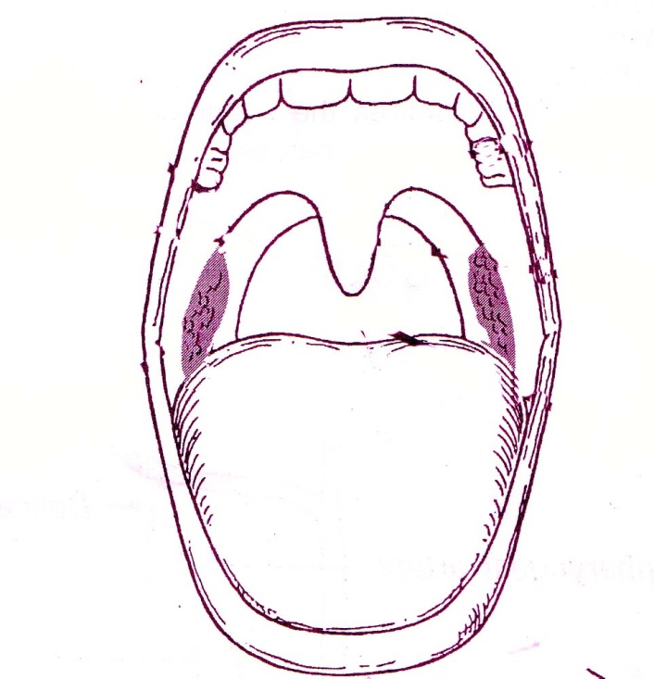
Oropharynx
Behind the oral cavity (in front of 2nd&3rd Cervical vertebra)
From the soft palate superiorly to tip of epiglottis inferiorly
Communicates:
Anteriorly with the oral cavity
Superiorly with the nasopharynx
Inferiorly with the hypopharynx
The palatine tonsils lie laterally
between the anterior and posterior
pilars

Slide 23
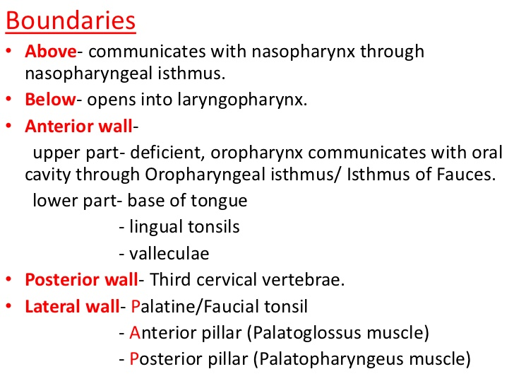

Slide 24
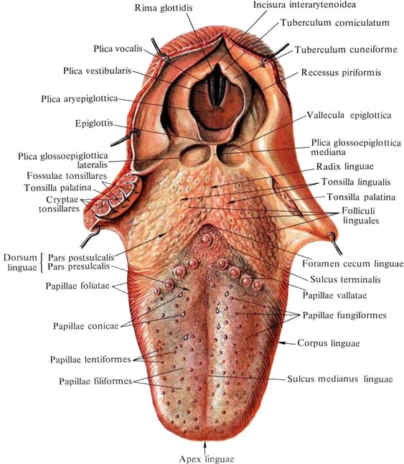
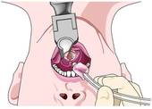
Valleculae
The epiglottic vallecula is a depression (vallecula) just behind the root of the tongue between the median glossoepiglottic fold and the 2 lateral glossoepiglottic folds.
The vallecula is an important reference landmark used during intubation of the trachea

Slide 25
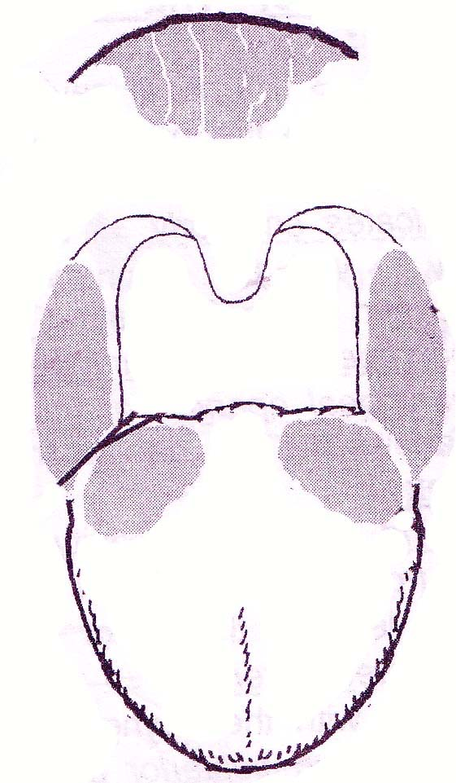
What is Waldeyer’s ring?
The lymphoid tissue in the
pharyngeal aponeurosis
aggregates in some areas
forming tonsils:
1-one nasopharyngeal tonsil
2- two palatine tonsils
3- two lingual tonsils

Slide 26
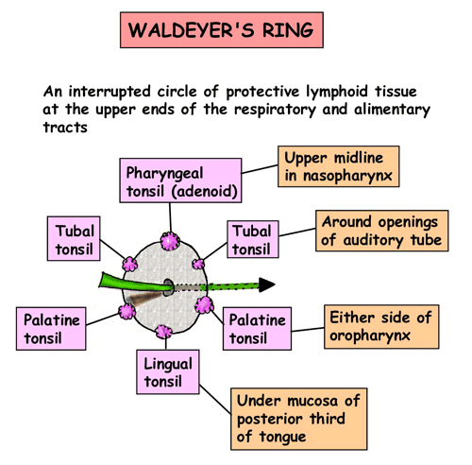
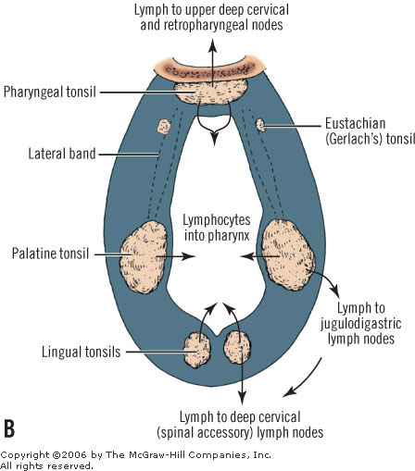
What is Waldeyer’s Ring

Slide 27
Structure of pharyngeal lymphatic ring
Pharyngeal submucous lymph tissue
(inner ring)
Lymph node of neck（outer ring）
adenoid tonsil
tubal tonsils
tonsilla palatina
lateral pharyngeal bands
folliculus lymphaticus of pharyngeal posterior wall
lingual tonsil
retropharyngeal lymph nodes
lymph nodes of
mandibular angle
submandibular lymph nodes
submental lymph nodes
drain to

Slide 28

The anterior pillar formed by
palatoglossus muscle
The posterior pillar formed
By palatopharyngeus m
The tonsils lie between the
Two pillars

Slide 29
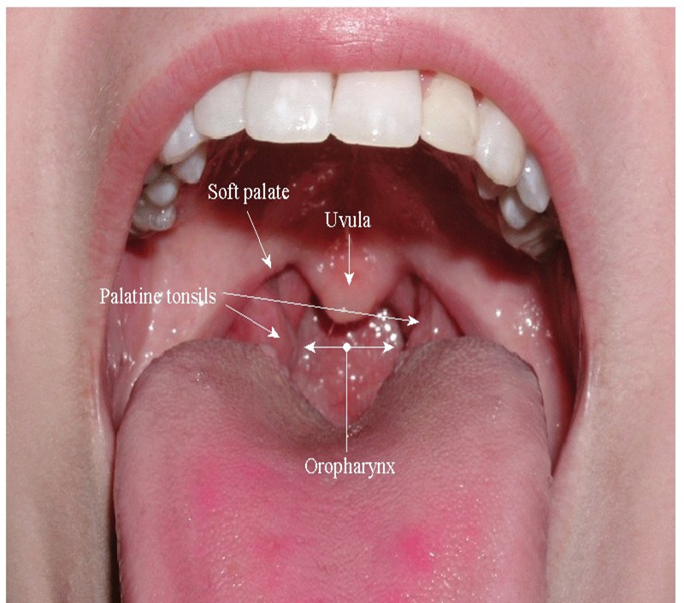
Palatine Tonsils
(1) anatomy feature
a、location
b、appearance: it is covered by m.m. and projected into the cavity of the pharynx. The surface is pitted by tonsillar crypts.
c、construction features: the lateral aspect of is covered by tonsillar capsule.

Slide 30
Palatine tonsils
Superiorly: soft palate
Inferiorly: tongue.
Anteriorly: palatoglossal arch.
Posteriorly: palatopharyngeal arch.
Medially : oropharynx
Laterally: capsule , loss areollar tissue, Sup. Constrictor muscle, descending palatine vein---from the soft palate to join the pharyngeal venous plexus.
Lateral to the sup. Const. m. ---stylopharyngus m. and facial artery.
Lateral and behind: (2.5 cm)– int. carotid artery.

Slide 31
Tonsilla palatina
blood vessel：
①descending palatine artery
②ascending palatine artery
③tonsillar artery . A branch of facial artery
④tonsillar branch of ascending
pharyngeal artery
⑤dorsal artery of tongue
Veins: external palatine, pharyngeal, or facial vein
Lymphatic : jugulodigastric LN. (below and behind the angel of mandible)
nerves： ① pharyngeal plexus
② superior maxillary nerve (Ⅴ2)
③ branches glossopharyngeal nerve.

Slide 32
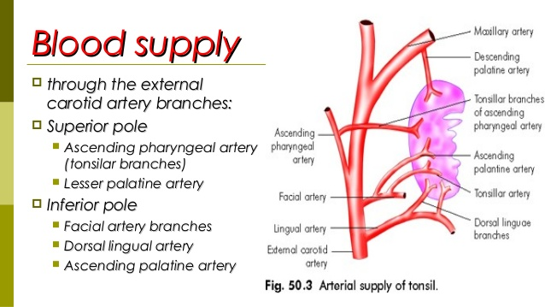
Arterial supply of the tonsils

Slide 33
Laryngopharynx (Hypopharynx)
Behind the Larynx (in front of 3rd to 6th Cervical vertebra)
From the tip of epiglottis superiorly to
the lower border of cricoid cartilage
Inferiorly
Communicates:
Anteriorly with the Larynx
Superiorly with the oropharynx
Inferiorly with the esophagus

Slide 34
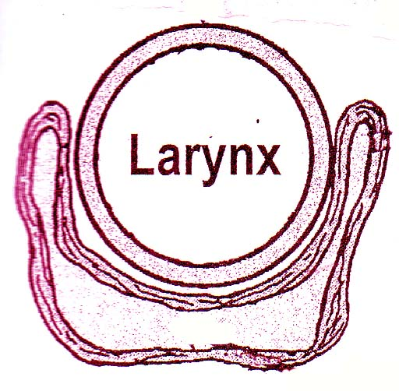
Seen from
behind
The hypopharynx does not only
lie behind the larynx BUT also
Projects laterally on each side of the larynx
So it is formed of :
Postcricoid region ( behind the larynx)
Two pyriform fossa (on each side of the larynx
Cross section

Slide 35
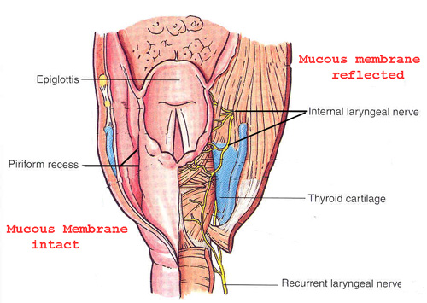
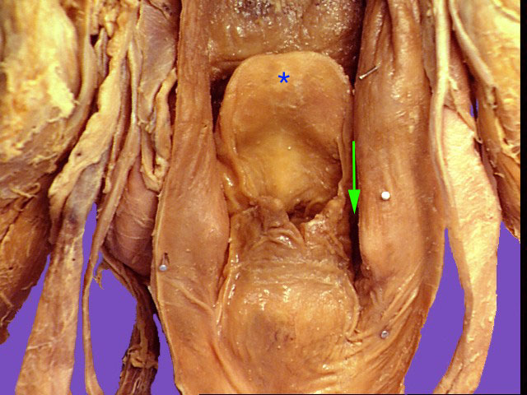
Piriform fossa
Is a potential space that lie on either side of the larynx. They are two in number. It is shaped like a pyramid with the base pointint above and the apex below.
laterally by the mucosa covering the lamina of the thyroid cartilage.
Medially the aryepiglottic fold and arytenoid cartilages above and the cricoid cartilage below.
Superiorly it is bounded by the lateral glosso epilglottic fold.
Inferiorly it continues with the oesophagus.

Slide 36
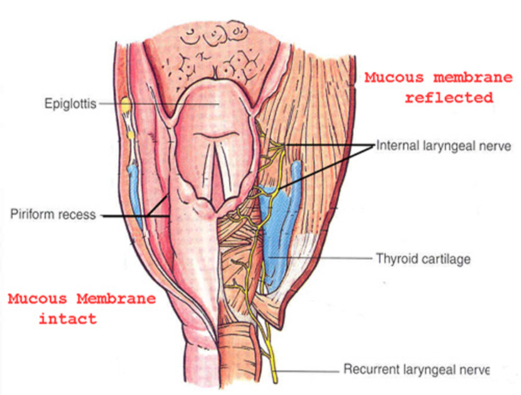
Piriform fossa
Internal laryngeal nerve and superior laryngeal vessels pierce the thyrohyoid membrane and traverse outside the mucous lining of the fossa from lateral to medial walls.

Slide 37
Piriform fossa
Clinical Importance of piriform fossa:
1. Anatomically it is a hidden area. Any malignancy in this area will initially cause fewer symptoms and has a tendency to present very late.
2. This area is richly endowed with lymphatics. They drain into the upper deep cervical group of lymph nodes. Any malignancy in this area has a tendency for nodal metastasis.
3. Foreign bodies in the throat commonly gets lodged here.
4. Since superior laryngeal nerve lies superficially in this area, it can be topically blocked by placing cotton pledgets soaked in 4% xylocaine in this area. This is known as the piriform fossa block.

Slide 38
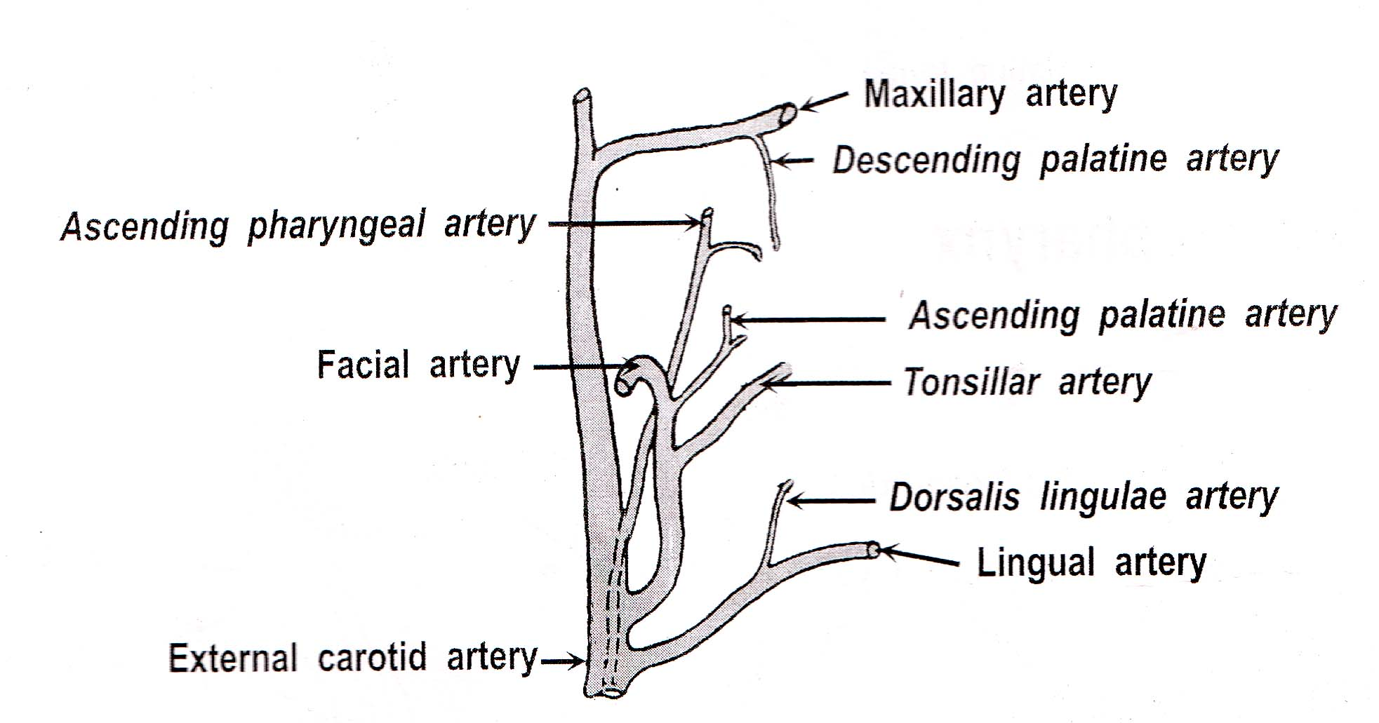
Blood supply of pharynx
From the External Carotid Artery & its branches
1- Tonsillar artery (from Facial Artery)
2-Ascending palatine artery (from Facial Artery)
3-Ascending pharyngeal Artery (from external carotid)
4-Descending palatine artery ( from Maxillary artery.
5-Dorsalis lingulae artery (from Lingual artery)

Slide 39
Lymph Drainage
Nasopharynx ---►Retropharyngeal ----►UDCLN
Oropharynx ---► UDCLN
Hypopharynx ---► UDCLN

Slide 40
Nerve Supply
Motor ---► X Except :
Stylopharyngeus --►IX
Tensor palati --► V3
In addition the inferior constrictor receives branches from external laryngeal and recurrent laryngeal nerve.
Sensory --►
Nasopharynx: V :pharyngeal branches of pterygopalatine ganglion, conveying fibres of Maxillary nerve
Oropharynx: IX
Laryngopharynx: X

Slide 41
Constrictors of the pharynx.
Constrictor muscles (Circular layer):
The constrictors take limited origin from the front (from bones, ligaments or cartilages) and possess expanded insertion behind in a median fibrous raphe which extends from of the pharyngeal tubercle at the basi-occiput to the pharyngo-oesophageal junction. Close to the insertion, the constrictors overlap one another from below upwards like the placing of three flower pots one within the other :
Superior, middle and inferior constrictor (Have 2 parts.
Thyropharyngeus and Cricopharyngeus.) muscles

Slide 42
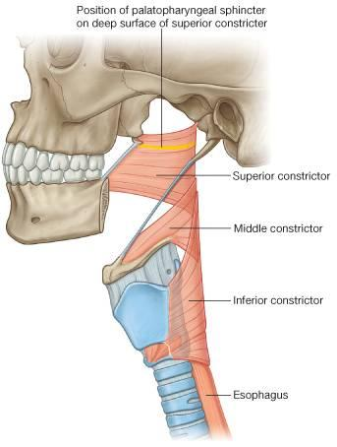
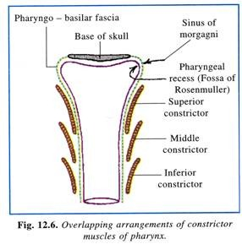

Slide 43
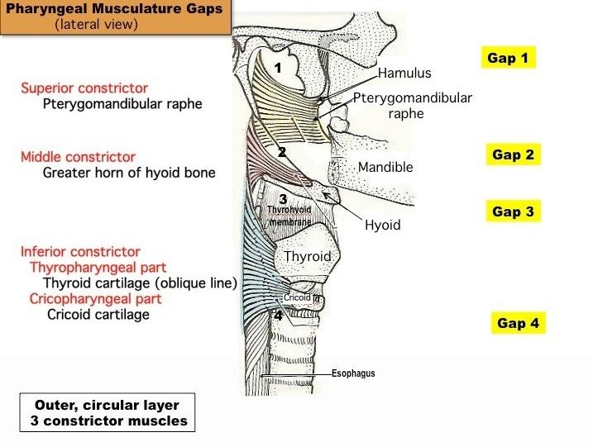

Slide 44
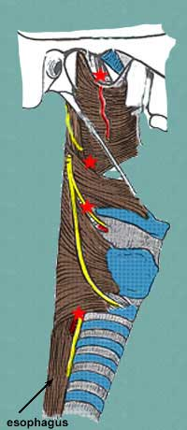
Structures passing between the constrictors.
Gap between the superior constrictor and base of the skull:
  Eustachian tube
  Tensor veli palatini m.
  Levator veli palatini m.
  Ascending pharyngeal artery (tonsillar br.)

Slide 45
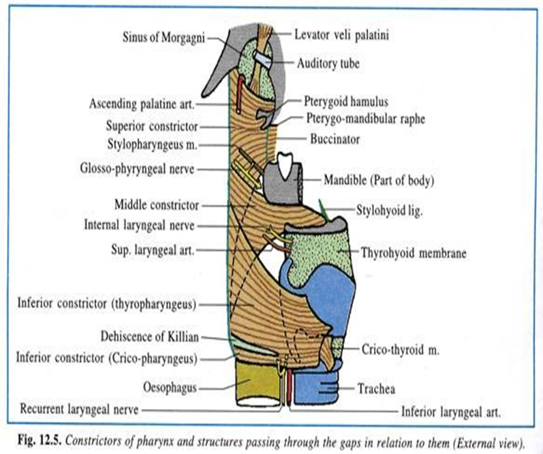
Structures passing between the constrictors.
Gap between superior and middle constrictor:
  Tonsillar Br of the Facial a.
  Styloglossus m.
  Stylohyoid Ligament
  Hyoglossus m.
  CN XII
  Stylopharyngeus
  CN IX
  Cervical N #1
  Lingual a.

Slide 46
Structures passing between the constrictors.
Gap below the origin of the middle constrictor is covered by the thyrohyoid membrane
  Internal laryngeal nerve (from Superior laryngeal n.)
  Superior laryngeal artery (from Superior Thyroid a.) into the larynx.

Slide 47
Structures passing between the constrictors.
Gap below the inferior constrictor piercing the pharyngeal wall to enter the larynx
  Recurrent laryngeal nerve (CN X)
  Inferior laryngeal artery (from inferior thyroid a.)

Slide 48
Actions of the constrictors
1. All constrictors contract reflexly during deglutition and induce a wave of peristalsis which passes in caudal direction.
2. The thyropharyngeus is propulsive in function, whereas the cricopharyngeus acts as a sphincter and is normally kept closed except in deglutition. When the thyropharyngeus contracts, the cricopharyngeus relaxes and vice versa.
In neuro-muscular in-coordination when both parts contract simultaneously, the intrapharyngeal pressure rises and the mucous membrane of the pharynx bulges through the dehiscence forming a pharyngeal diverticulum. (Zenker’s diverticulum)

Slide 49
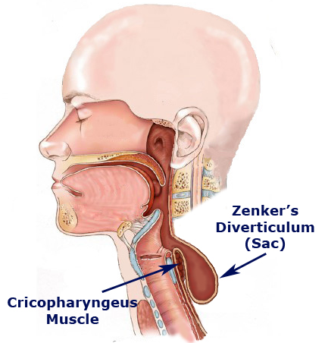
Zenker’s diverticulum

Slide 50
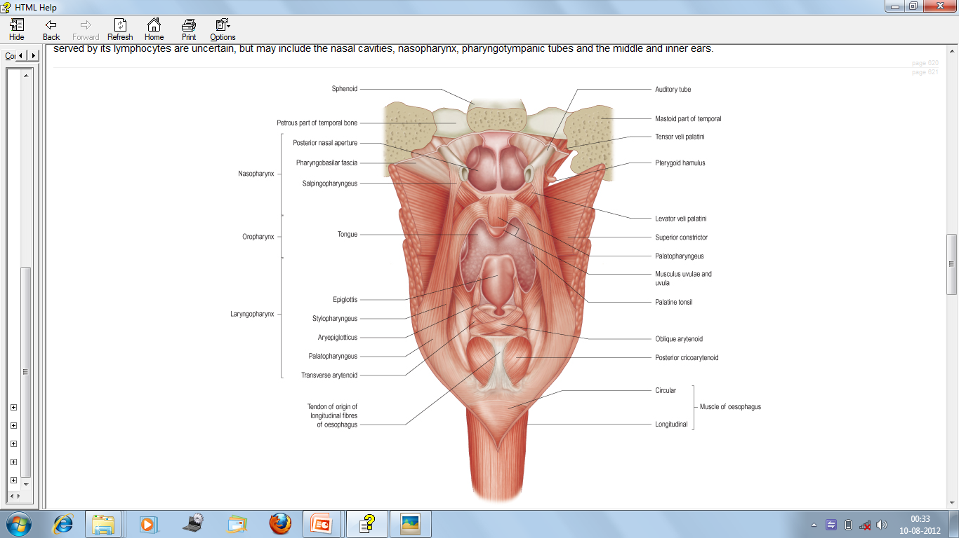
Longitudinal muscles.
Stylopharyngeus.
Palatopharyngeus.
Salpingopharyngeus.

Slide 51
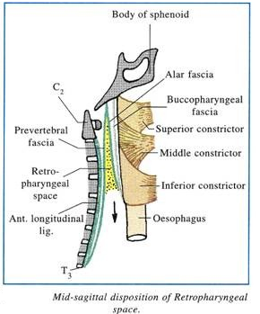
Buccopharyngeal fascia
Covers the constrictor muscles and is continued forward from the constrictor m. onto the buccinator.
It is attached to the prevertebral layer by loose connective tissue only, and thus an easily distended space, the retropharyngeal space, is found between them.
containing the pharyngeal plexus of nerves and venous plexus.

Slide 52
Pharyngeal plexus
It is formed by
Pharyngeal branch of Vagus carrying fibres from cranial part of accessory nerve.
Pharyngeal branche of Glossopharyngeal nerve.
A branch from the superior cervical ganglion of the sympathetic trunk.
Sometimes a branch by the external laryngeal nerve.

Slide 53
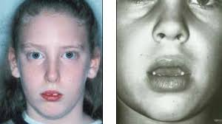
Applied anatomy of pharynx.
Adenoids
Adenoid facies- long face, pinched nose, open mouth, high arched palate, shortened upper lip, vacant expression and crowded upper teeth.

Slide 54
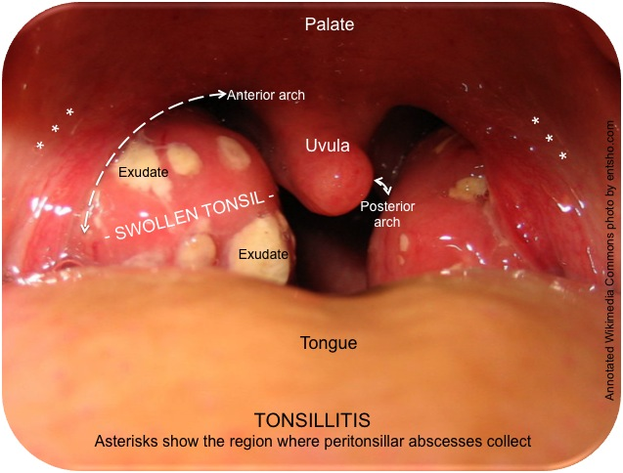
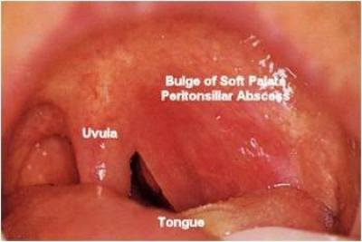
Tonsillitis- inflammation of the tonsils.
Peritonsilar abscess(quinsy)-collection of pus in peritonsillar space. Characterised by sore throat, fever, malaise, oodynophagia, and swelling of jugulo digastric lymph nodes.
treatement is by Incision and drainage of pus followed by antibiotics.

Slide 55
Thank you.

