Slide 1
THYROID & PARATHYROID Gland
Assistant Professor
Dr. Duraid H Abid Alkadem
M.B.Ch.B (TUCOM)
MRCS ENT (RCSEd, UK),
DOHNS (RCSEd, UK),
MRES Anatomy ( Liverpool, UK)

Slide 2
Objectives of the lectures
Explain the anatomy and blood supply of the thyroid gland
2. Describe the embryology of the thyroid gland.
Explain the function of the thyroid and parathyroid gland.
Identify the important structures that related to the thyroid gland which are significant surgically.
Explain briefly the common thyroid and parathyroid diseases

Slide 3
      Introduction
A. Thyroid
1. Endocrine gland
a. Lobes are cone shaped
b. Apex extends to oblique line of thyroid cartilage
2. Highly vascular
      Introduction
A. Thyroid
1. Endocrine gland
a. Lobes are cone shaped
b. Apex extends to oblique line of thyroid cartilage
2. Highly vascular

Slide 4
Thyroid
1. Largest endocrine gland in adult
2. Normally extends from ~ C-5 through ~ T-1
3. Highly vascular
Weights ~20 - 30 grams
Surrounded by pretracheal layer of deep fascia.

Slide 5
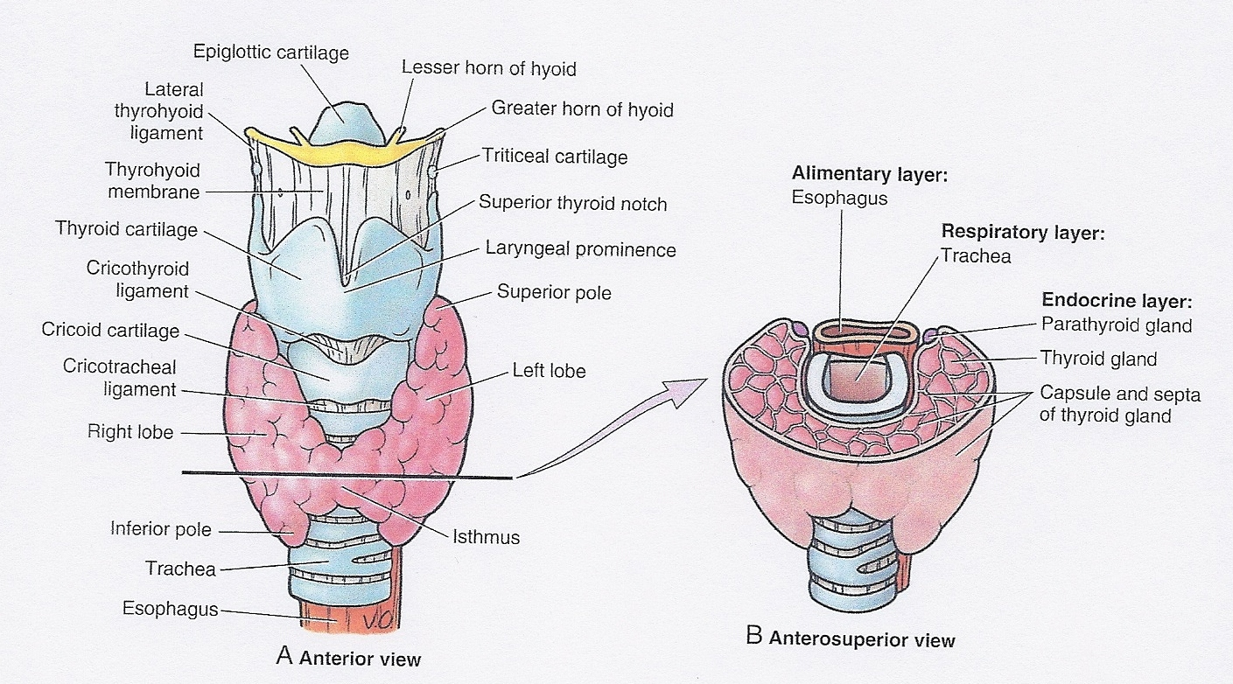
3. Anterior & lateral to larynx, trachea
4. Lobes connected by an isthmus
5. Pyramidal lobe may be present
6. Normally not palpable

Slide 6
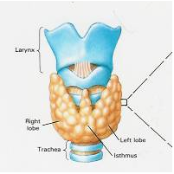
Thyroid Gland
Located in the anterior region of the neck
This gland has an accessory (pyramidal) lobe

Slide 7
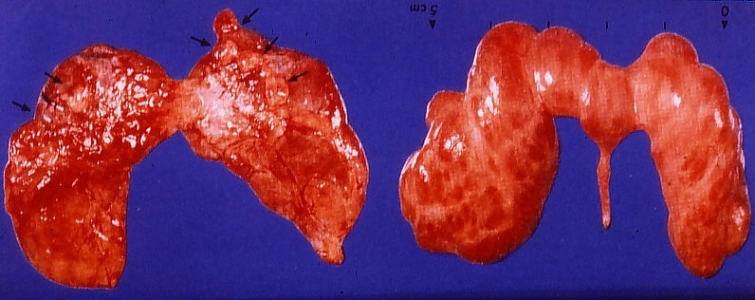
Anterior and Posterior Views of Thyroid Gland

Slide 8
8. Isthmus crosses tracheal cartilages 2-4
9. Base located ~4-5th tracheal cartilage
10. Thyroxin function: regulates basic metabolism in all cells

Slide 9
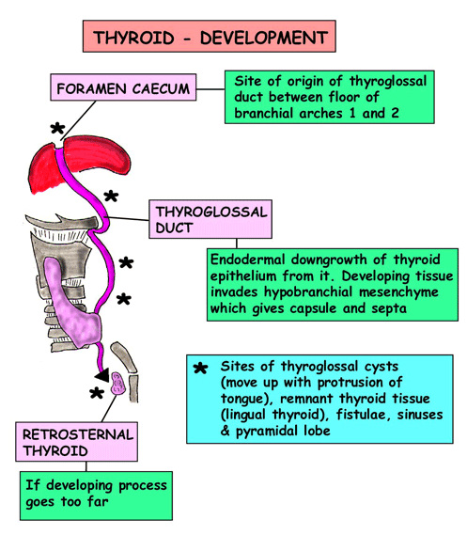
7the week
The bilobed terminal swelling
Of the thyroglossal duct expand to form thyroid gland.

Slide 10
Pyramidal lobe
a. present in ~ 40% of population.
b. Extends upward from isthmus
c. anterior to thyroid cartilage

Slide 11
d. Embryologic remnant of thyroglossal duct
e. formerly connected cecum of tongue to thyroid diverticulum

Slide 12
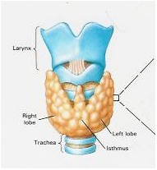
Pyramidal Lobe of the Thyroid Gland
Approximately 40% of patients have a pyramidal lobe that arises from either lobe or the midline isthmus it is connected to the hyoid bone by fibrous or muscular band called levator glandulae thyroideae
Pyramidal Lobe
Thyroid Gland, Anterior View

Slide 13
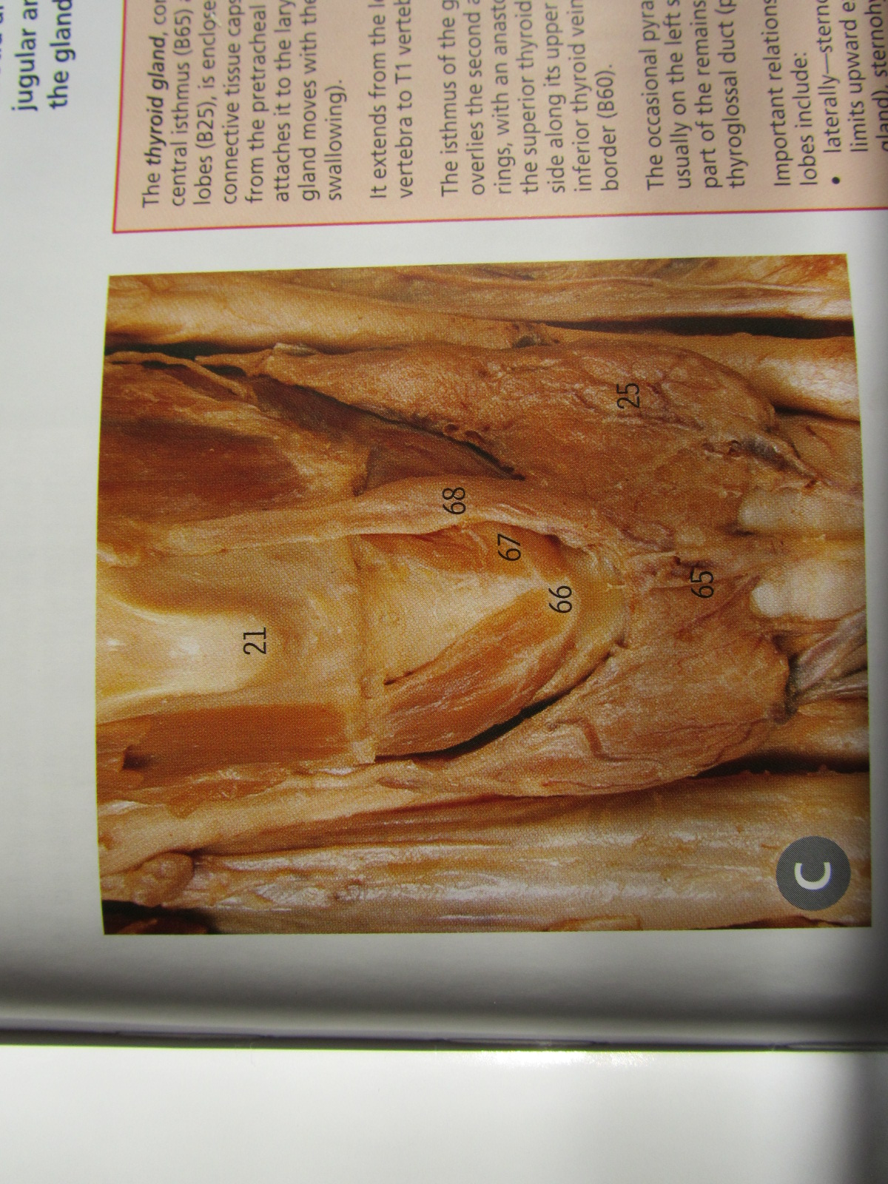
40% present

Slide 14
c. Lobes:
1. Attached to cricoid cartilage by ligaments
2. Medial surface adapted to larynx and trachea

Slide 15
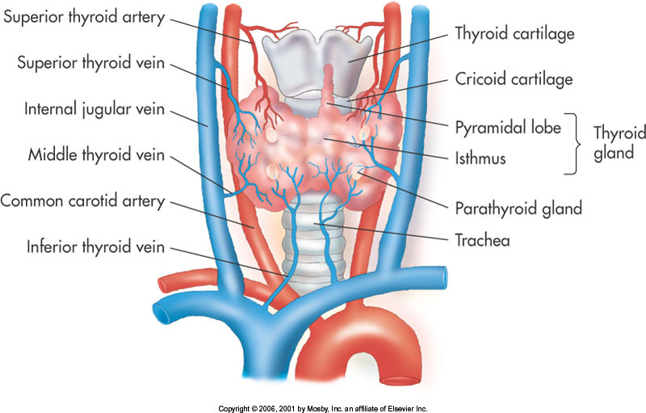
d. Isthmus
1. 1.25 cm x 1.25 cm
2. Crosses the tracheal rings ~2-4
3. Occasionally absent

Slide 16
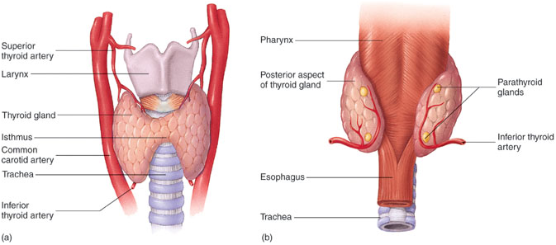
Thyroid gland vascular,
6. Highly vascular gland supplied by four large arteries
R & L inferior thyroid artery a branch of thyrocervical trunk
b. R & L superior thyroid artery a branch of ext. carotid a.
c. Thyroid ima if present a branck of aorta.

Slide 17
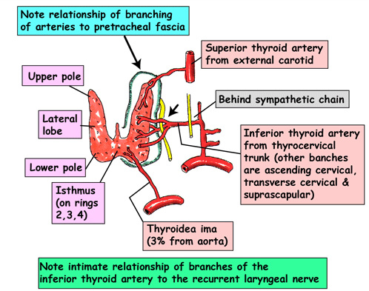
Thyroid gland vascular,
Drained by R & L superior, middle and inferior thyroid veins
They drain into int. jugular vein.
Veins arise from plexus
b. on anterior surface of gland
c. Extend over anterior surface of trachea

Slide 18
Thyroid gland, continued …
d. Lymph vessel
1. In interlobular connective tissue between lobes
2. Connect with network in wall of gland
3. drain into deep cervical LN. terminate in thoracic and right lymphatic ducts
4. Few lymph vessels drain into paratracheal LN.

Slide 19
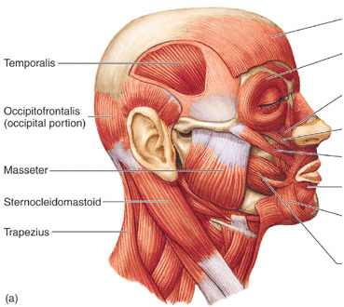
8. Muscular landmarks
a. Sternocleidomastoid muscles lie laterally
b. Longus colli (prevertebral) muscles lie posteriorly
c. “Strap” muscles lie anteriorly
Strap Muscles

Slide 20
9. Autonomic innervation via
a. Cervical portion of sympathetic trunk
b. Parasympathetic fibers arise from Vagus X

Slide 21
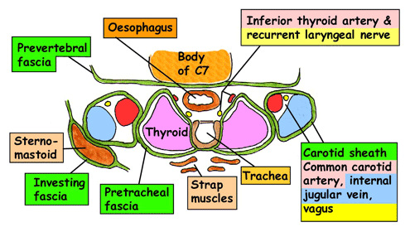

Slide 22
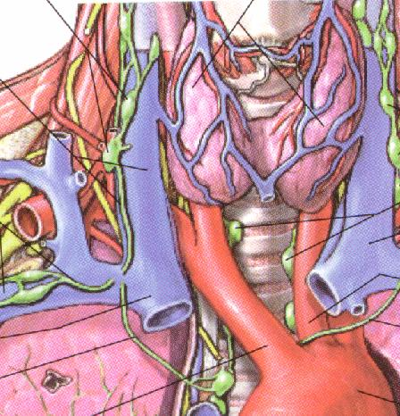
Gross Anatomy
Located in neck
  lobes
  isthmus
Relations
  Larynx
  Trachea
  Recurrent laryngeal nerves
  Parathyroid glands
  Carotid sheath
Blood supply
  Sup. thyroidal a.
  Inf. thyroidal a.

Slide 23
9. Treatment considerations
a. Superior thyroid artery is accompanied by superior laryngeal nerve
b. Inferior thyroid artery is accompanied by recurrent laryngeal nerve

Slide 24
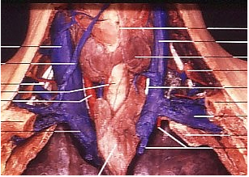
c. Damaging nerves results in partial or total paralysis of larynx
d. Bordered by neurovascular structures contained in carotid sheath

Slide 25
Thyroid gland, continued …
Pretracheal fascia:
a. surrounds thyroid
b. Extends from hyoid bone to fibrous pericardium
c. Encloses trachea, larynx, pharynx, thyroid
d. Parathyroids and venous plexus lie between layers

Slide 26
Pretracheal fascia,
d. Fascia more dense anteriorly
1. Thyroid enlargement often occurs posteriorly
2. May compress trachea, esophagus
3. 1st symptom may be hoarseness, difficulty swallowing

Slide 27
Parathyroid glands
Two pairs: Superior and Inferior
Weight is about 50 to 70 ^{mg}
Size 5 x 3 x 1 ^{mm}
Color of normal parathyroid glands ranges from yellowish brown to reddish brown
87% there are four glands.
Their Arterial supply is usually from Sup. And Inferior Thyroid artery.

Slide 28
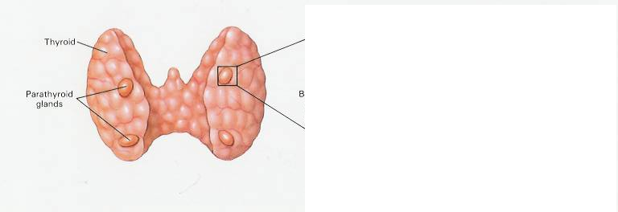
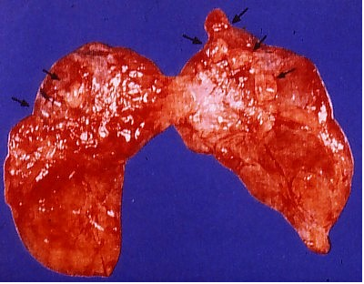
Parathyroid Glands (Posterior view)
Parathyroid Glands are located on the posterior aspect of the thyroid; sometimes the tissue is embedded within thyroid tissue.

Slide 29
Surgical Localization
Superior Parathyroid Glands
  80% they are at the cricothyroid junction approximately 1 cm cranial to the juxtaposition of the recurrent laryngeal nerve and the inferior thyroid artery.
  Ectopic glands: it could be intrathyroid, paraesophageal, retroesophageal and mediastinal (posterior superior compartment)

Slide 30
...Surgical Localization
Inferior Parathyroid Glands:
  More variable location
  More than 50% of the inferior parathyroid glands are situated near the lower pole of the thyroid gland
  Ectopic glands: it could be situated in thyrothymic ligament (28%) or mediastinum (Anterior superior compartment)

Slide 31
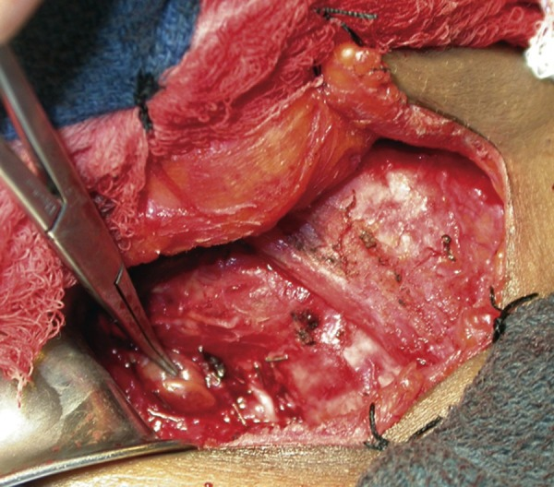

Slide 32
…
Parathyroids are difficult to see
1. Size and location are variable
2. Usually:
a. moderately echogenic b. well-circumscribed c. capsule around d. anterior to longus colli e. medial to common carotid a.

Slide 33
  III. Thyroid/Parathyroid Diseases
  A. Ultrasound useful in differentiating cystic from complex or solid masses
  B. Thyroid Cysts
  1. Typical cystic appearance
  2. Colloid cysts
  3. Thyroglossal duct cysts

Slide 34
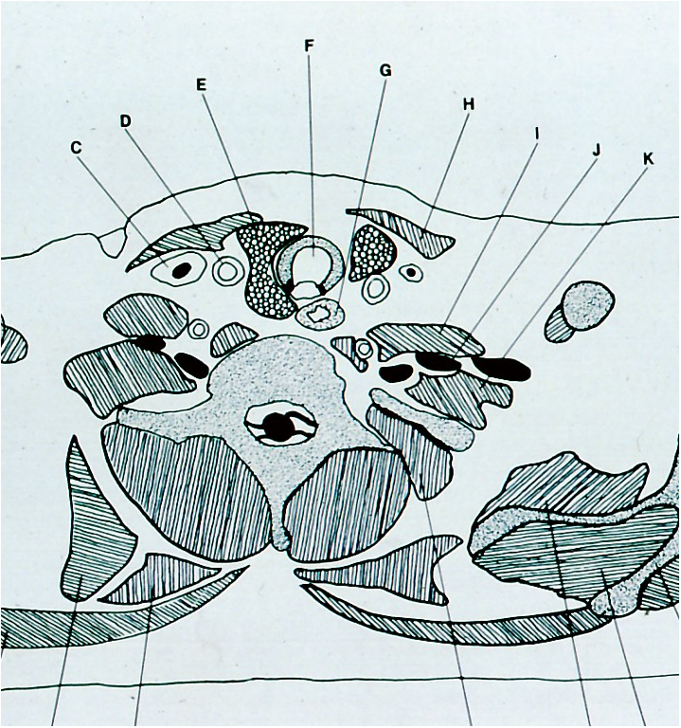
Transverse Section of Thyroid Gland
Trachea
Thyroid Gland, Left Lobe
Sternocleidomastoid Muscle
Internal Jugular Vein
Common Carotid Artery
Brachial Plexus
Esophagus

Slide 35
C. Thyroid is more homogeneous and echogenic than surrounding muscle
1. Sternocleidomastoid (lateral)
2. Longus colli (posterior)
D. US is less helpful w/ complex masses or diffuse parenchymal disorders

Slide 36
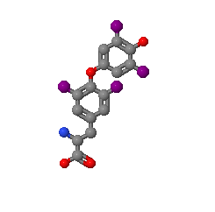
Function and Physiology
Maintains body metabolism, growth, and development
  synthesis, storage, & secretion of thyroid hormones
        Thyroid gland traps iodine (used for synthesis)
        Produces triiodothyronine (T3) & thyroxine (T4)
        Thyroid hormone released into bloodstream via action of thyrotopin (TSH) produced by the pituitary gland
Notes:
36

Slide 37
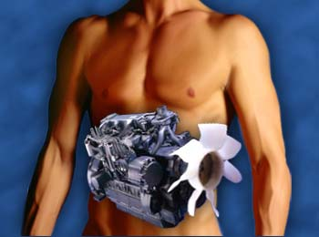
Thyroxine (T4)
Iodine + Tyrosine (amino acid)
Combines with protein thyroglobulin & stored.
  Increases carbohydrate burn
  Breaks down proteins for energy
  Regulates fat metabolism
  Accelerates body growth (especially nervous tissue)
  Increases nervous system reactivity
Notes:
37

Slide 38
Calcitonin
Produced by parafollicular cells (C cells of thyroid gland) in response to high calcium levels
Decreases the concentration of calcium in the blood by inhibiting bone break down (less Ca absorbed).
Parathyroid hormone (PTH), parathormone or parathyrin
is secreted by the chief cells of the parathyroid glands.It acts to increase the concentration of calcium (Ca²⁺) in the blood
Notes:
38

Slide 39
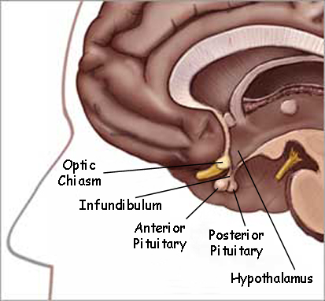
Thyroid Stimulating Hormone (TSH)
Produced by the anterior pituitary gland
Regulated by the thyrotropin-releasing factor (TRF) produced by the hypothalmus
TRF regulated by the basal metabolic rate.
Notes:
39

Slide 40
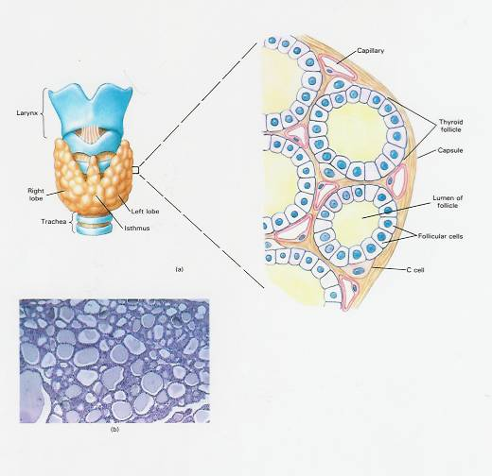
Thyroid Follicles showing Colloid
Thyroid Follicles with colloid containing Thyroid hormones

Slide 41
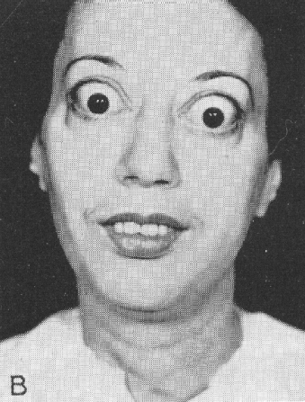
Hyperthyroidism
Thyrotoxicosis
Graves’ disease
Toxic Adenoma
Toxic Multinodular Goiter
Chronic Thyroiditis

Slide 42
Hyperthyroidism Symptoms
Tachycardia/arrhythmia
Muscle tremors
Hyperreflexia
Increased core & skin temp./ Heat Intolerant
Exophthalmos
Muscle wasting
Loose stool
Osteoporosis
Hair loss
Oligo-/amenorrhea
Irritability, Restlessness

Slide 43
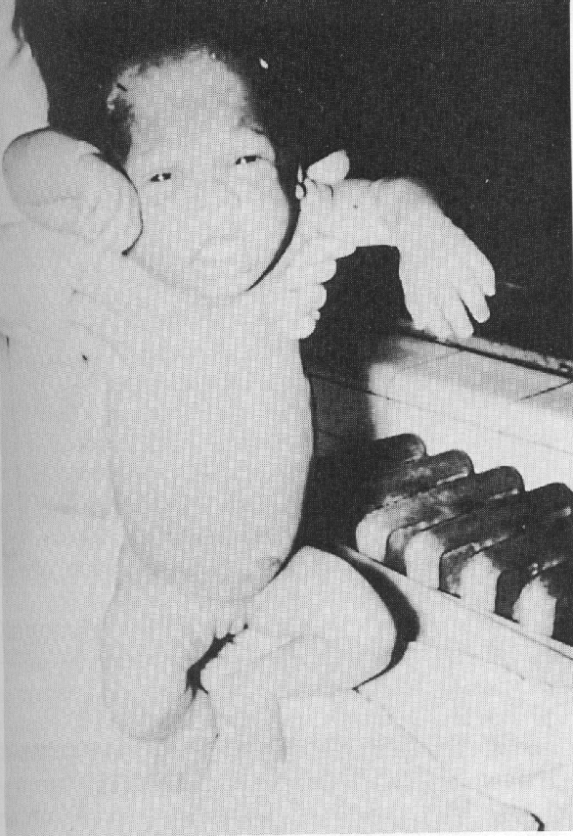
Hypothyroidism
Newborn
  Cretinism
  Lack of myelination
Children
  Retarded Growth
  Disproportionate

Slide 44
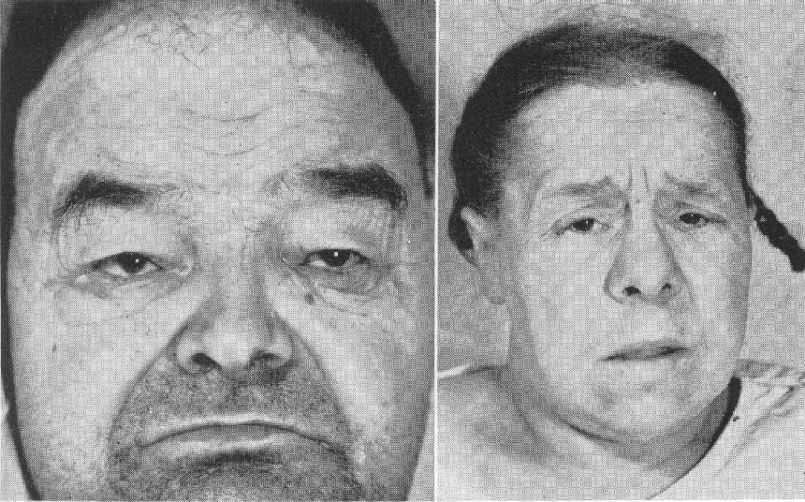
Hypothyroidism
Adult
  Muscle weakness
  Mental slowness
  Tired/fatigued
  Cold
  Slowed intestinal peristalsis
  Impaired renal function
  Anemia
  Myxedema

Slide 45
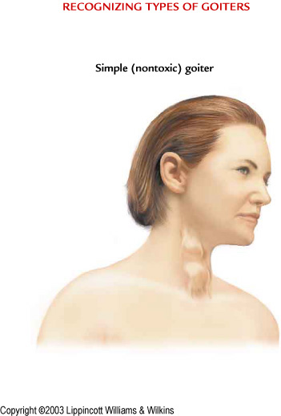
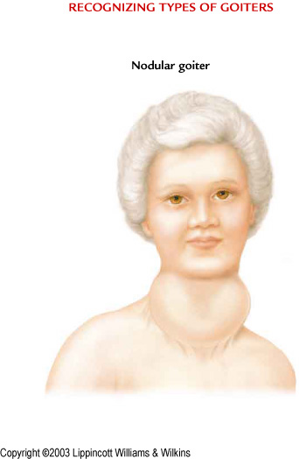
Types of Goiters
Simple Goiter (L) and Nodular (Toxic) Goiter (R)

Slide 46
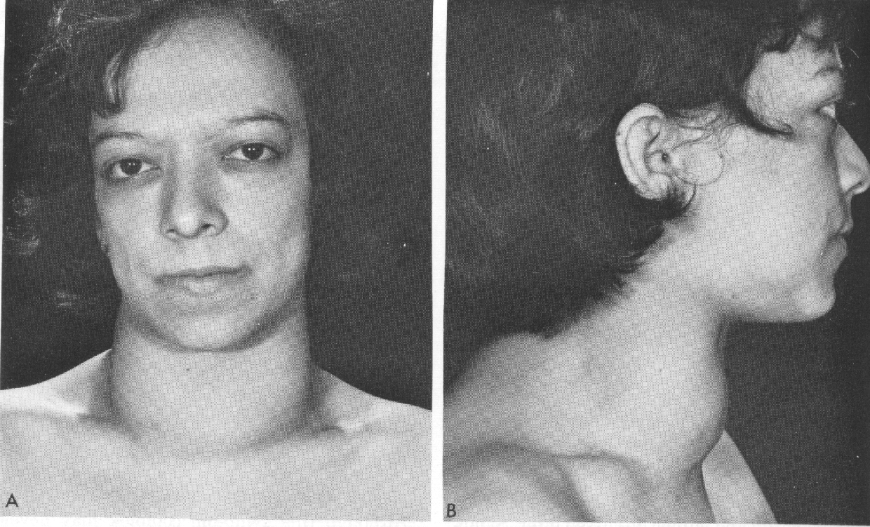
Non-toxic goiter
Iodine deficiency

Slide 47

Thank You!

