Slide 1
Anatomy of the face
Dr. Duraid Hameed
M.B.Ch.B, (TUCOM)
MRCS - ENT (RCSEd, UK),
DOHNS (RCSEd, UK),
MRES Anatomy ( Liverpool, UK)

Slide 2
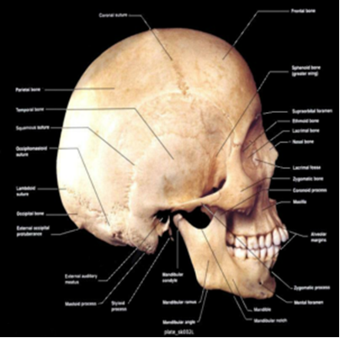
Bones of the Skull
Mandible
Occiput
Temporal bones
Parietal bones
Frontal bones
Maxilla bones

Slide 3
Structures
Orbits
Mastoid processes
Supraorbital foramen
Temporomandibular joint

Slide 4
Skin & Fascia of the Face
Skin of face has numerous sweat & sebaceous glands.
It is connected to the underlying bones by loose connective tissue (superficial fascia), in which are embedded muscles of facial expression.
No deep fascia in the face.

Slide 5
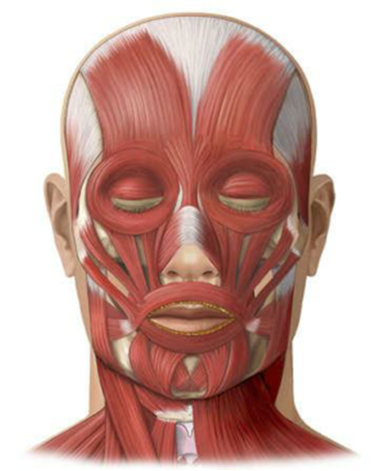
Muscles of Facial Expression

Slide 6
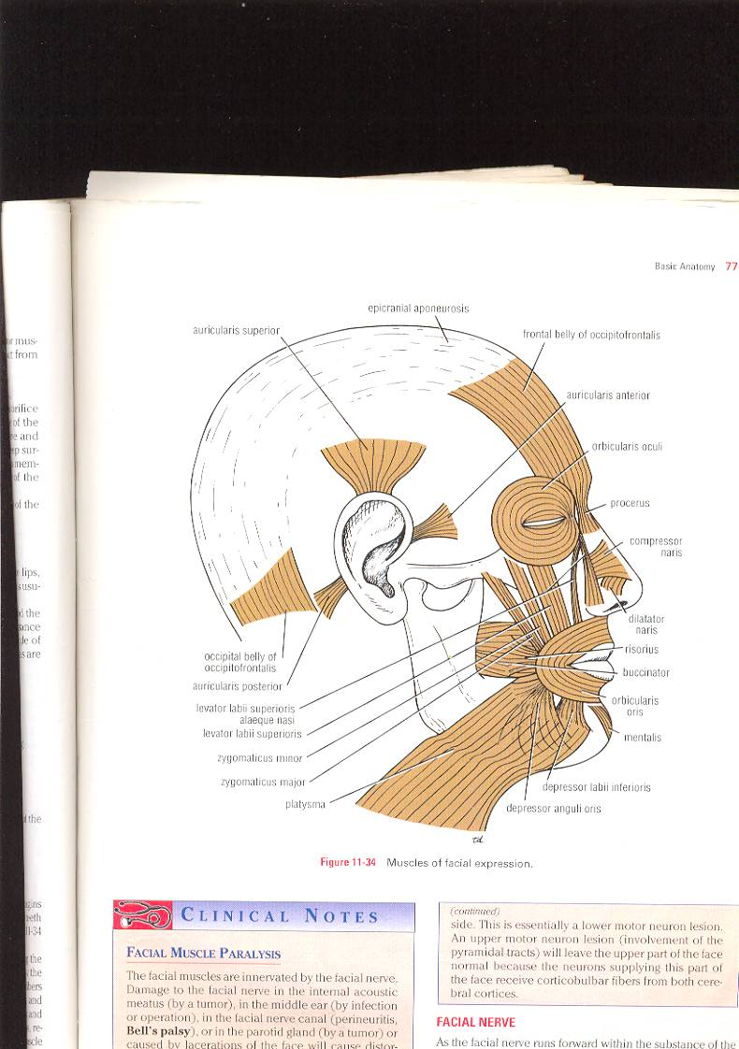
Muscles of Face (muscles of facial expression)
They are called ms. Of expression because they pull skin of face to produce various expressions.
They are arranged in groups around the eye, nose & mouth.
They have bony origin.
They are inserted into skin of face (no deep fascia in face).
They are supplied by branches of facial N., Except levator P.S. by occulomotor N. (striated ms.) + sympathetic N. (smooth ms.).which is superior tarsal m.

Slide 7
Muscles of Face
A) Muscles of eyelids :
1- levator palpebrae superioris (the dilator ms. of eyelids, lying in the orbital cavity).
2-Orbicularis oculi (the sphincter ms of eyelids).
3-Corrugator supercilii (deep to orbicularis oculi). 4-Occipitofrontalis (ms. of scalp).
B) Muscles of Nose :
1-Procerus.
2-Compressor & dilator naris.

Slide 8
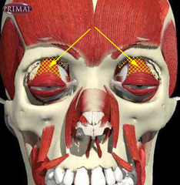
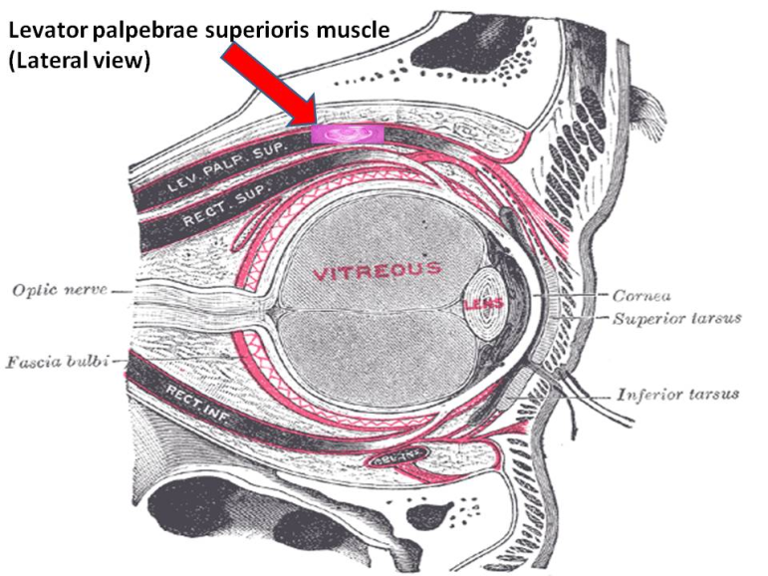
The levator palpebrae superioris M.
It originates on the lesser wing of the sphenoid bone, just above the optic foramen
It elevates and retracts the upper eyelid.
It is innervated by the superior division of the oculomotor nerve (Cranial Nerve III).
Damage to this muscle, or its innervation, can cause ptosis, the drooping of the eyelid. Ptosis can also be caused by damage to the adjoining superior tarsal muscle, or its sympathetic innervation. Such damage to the sympathetic supply occurs in Horner's syndrome.

Slide 9
Muscles of Face
C) Muscles of Lips :
Sphincter muscle of the lips :
“ Orbicularis Oris”.
Dilator muscles of the lips :
1-Levator labii superioris alaeque nasi. 2-Levator labii superioris. 3-Depressor labii inferioris. 4-Zygomaticus minor. 5-Zygomaticus major. 6-Levator anguli Oris (deep to zygomatic ms.). 7-Depressor anguli Oris. 8-Risorius. 9-Mentalis.
D) Muscles of Cheek :
“Buccinator”

Slide 10
Muscles of Face (muscles of facial expression)
3 large muscles : 1- Buccinator m. (ms. of cheek). 2- Orbicularis oculi m. 3- Orbicularis oris m.
Many small muscles : 1- Dilator ms. of lips (separate lips) : -Levator labii superioris alaeque nasi, -Levator labii superioris. -Zygomaticus minor & major. -Levator anguli oris, risorius & depressor anguli oris. -Depressor labii inferioris & mentalis. origin : bones & fascia around oral aperature. Insertion : into substance of lips.

Slide 11
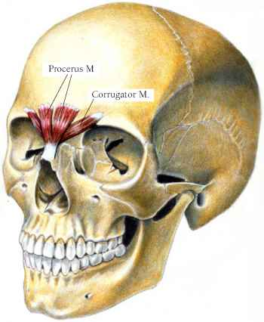
2- Corrugator supercilli : -It lies deep to orbicularis oculi. origin : superciliary arch (bone). Insertion : skin of eyebrow. Action : vertical wrinkles of forehead, as in frowning. 3- Compressor naris & dilator naris : origin : maxilla. Insertion : the fibres are continuous with those of opposite side in front of the bridge of nose to form aponeurosis of bridge of nose. Action : compesses & widens nasal cartilages and aperature. 4- Procerus : - It is continuous with the medial part of occipito-frontalis ms. Origin : nasal bone. Insertion : medial part of skin of eyebrow. Action : wrinkles skin of nose.

Slide 12
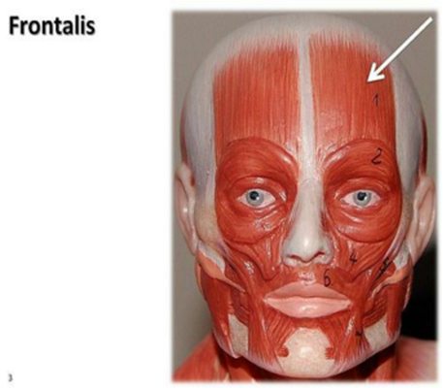
Muscles of Facial Expression
Frontalis
Elevates eyebrows
Wrinkles forehead
Innervation
Temporal branch of
Facial nerve

Slide 13
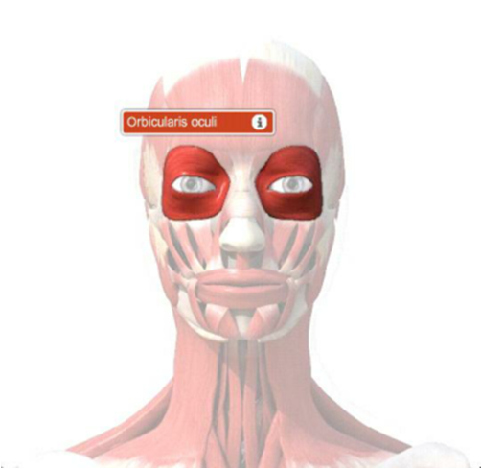
Muscles of Facial Expression
Orbicularis Oculi
Closes and squints
Eyes
1- Orbital part
2- Palpebral part :
Innervation
Temporal and
Zygomatic branch
of Facial nerve

Slide 14
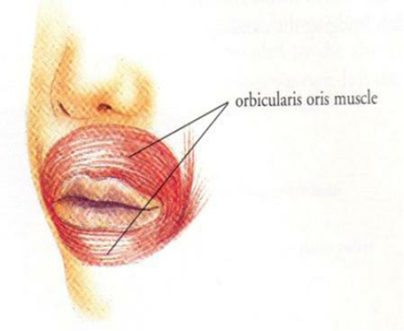
Muscles of Facial Expression
Orbicularis Oris
: compresses the lips together to close the mouth (sphincter muscle of lips).
(kissing muscle)
Innervation
Mandibular branch
Of facial nerve

Slide 15
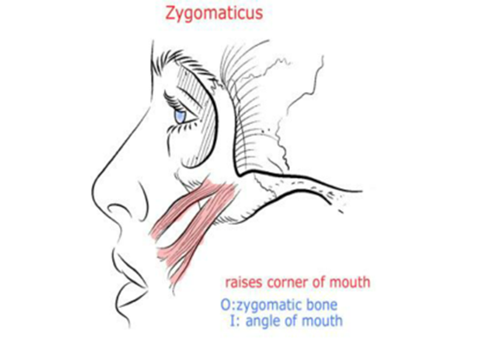
Muscles of Facial Expression
Zygomaticus Muscles
Elevates corners of
mouth; (smiling muscle)
Innervation
Buccal branches of
Facial nerve

Slide 16
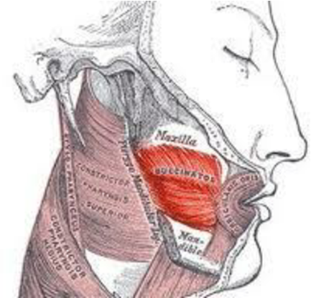
Muscle of Cheek : Buccinator Muscle :
Origin : from outer surface of maxilla & mandible opposite the molar teeth + from pterygomandibular ligament.
Insertion : 1-upper fibres : into upper lip. 2-lower fibres : into lower lip. 3-middle fibres : decussate at the angle of mouth.
N.supply : buccal branch of facial N.
Action : 1- it compresses the cheeks & lips against the teeth to prevent accumulation of food in vestibule of mouth. 2- it is used in wistling, when cheeks are distended with air.

Slide 17
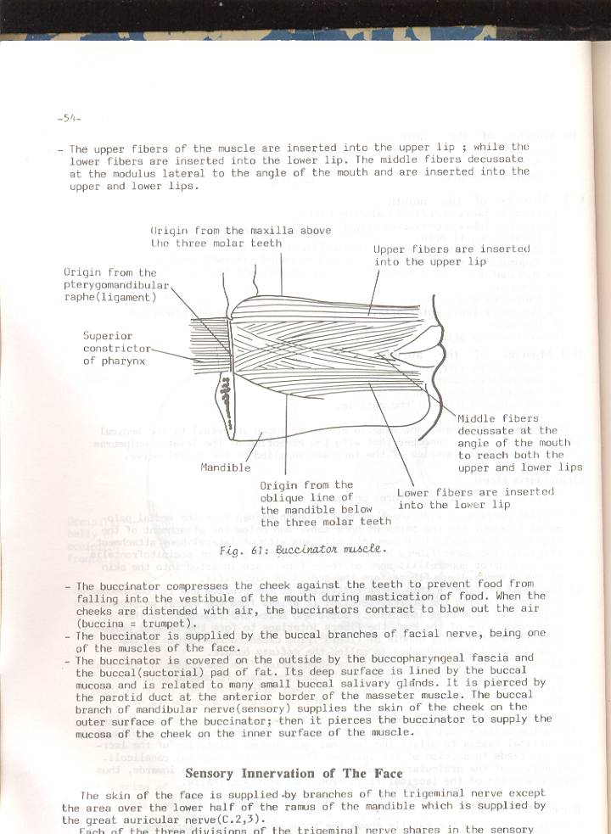
It is covered on outside by buccopharyngeal fascia & buccal pad of fat.
Its deep surface is lined by buccal mucosa.
It is pierced by : 1-parotid duct , opposite upper 2nd molar tooth. 2-Buccal branch of mandibular nerve (sensory) to supply m.m of cheek on the inner surface of buccinator muscle.

Slide 18
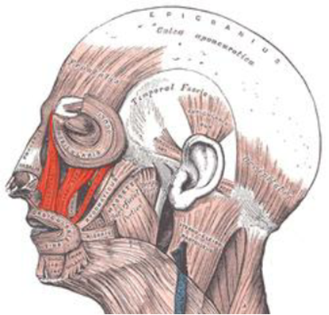
Muscles of Facial Expression
Levator Labii Superioris
Elevates upper lip
Innervation
Buccal branches of
Facial nerve

Slide 19
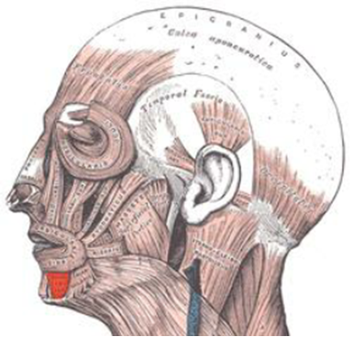
Muscles of Facial Expression
Depressor Labii Inferioris
Depresses lower lip
Innervation
Buccal branches of
Facial nerve

Slide 20
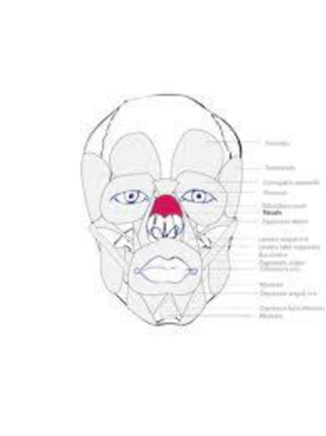
Muscles of Facial Expression
Nasalis
Open and close
nostrils
Innervation
Buccal branch of facial
nerve

Slide 21
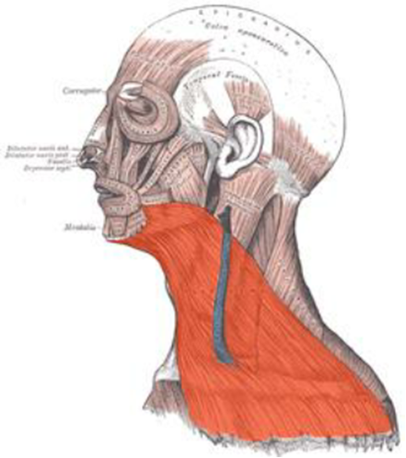
Muscles of Facial Expression
Platysma
Draws mouth
downward
(pouting)
Innervation
Cervical branch of
Facial nerve

Slide 22
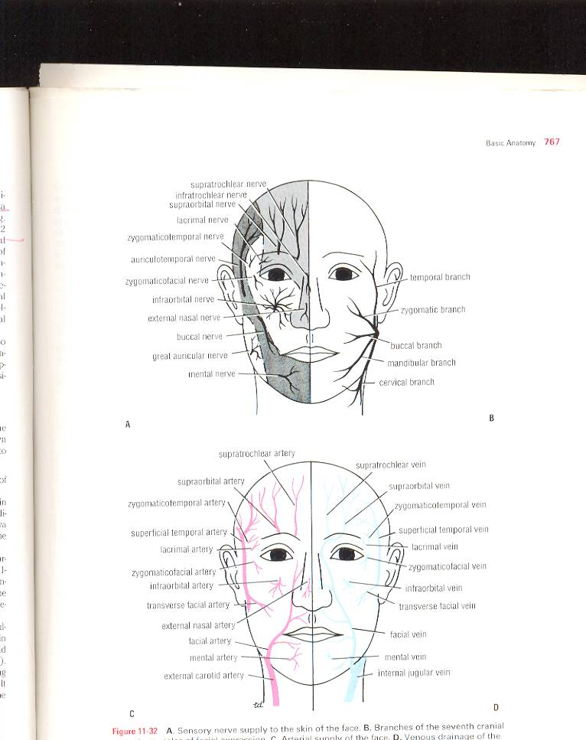
Skin innervation of the face
Skin of the face is supplied by branches of trigeminal nerve except the area over the angle of mandible & parotid gland, which is supplied by great auricular nerve..
Ophthalmic nerve supplies the region developed from the frontonasal process.
The maxillary nerve supplies the region developed from the maxillary process of 1st pharyngeal arch.
The mandibular nerve supplies the region developed from the mandibular process of 1st pharyngeal arch.
Skin of face has numerous sweat & sebaceous glands. It is connected to underlying bones by loose C.T, in which are embedded the muscles of facial expression.
No deep fascia is present in the face.

Slide 23
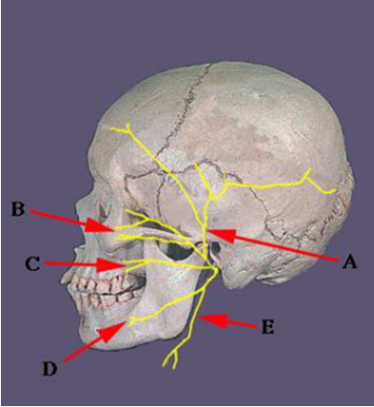
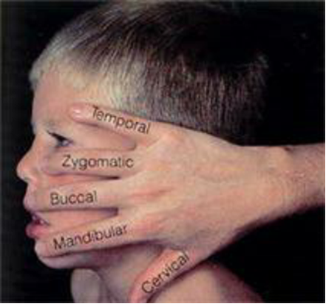
Innervation

Slide 24
Ophthalmic Nerve
It supplies skin of forehead, upper eyelid, conjunctiva, & side of the nose, it has 5 branches :
1-Lacrimal N. : supplies skin & conjunctiva of lateral part of upper eyelid.
2-Supraorbital N.: winds at supraorbital notch,it supplies skin & conjunctiva on the central part of upper eyelid + skin of forehead.
3-Supratrochlear N. : it lies medial to supraorbital N. it supplies skin & conjunctiva on medial part of upper eyelid + skin of forehead.
4-Infratrochlear N. : leaves orbit to supply skin & conjunctiva on the medial part of upper eyelid + skin of adjoining part of the side of the nose.
5-External nasal N. : leaves nose to supply skin on the side of the nose down as far as the tip.

Slide 25
Maxillary Nerve
It supplies the skin of posterior part of the side of nose, lower eyelid, cheek, upper lip, lateral side of the orbit. It has 3 branches :
1-Infraorbital N. : is a direct continuation of maxillary N. it leveas orbit via infraorbital foramen. It gives numerous small branches to supply skin of lower eyelid & cheek, side of nose, & the upper lip.
2-Zygomaticofacial N. : passes onto face via a small foramen on lateral side of zygomatic bone to supply skin over the cheek.
3-Zygomaticotemporal N. : passes through a small foramen on the posterior part of zygomatic bone to supply skin of temple.

Slide 26
Mandibular Nerve
It supplies skin of lower lip, lower part of face, temporal region & part of the auricle + side of scalp. It has 3 branches
1-Mental N. : emerges from the mental foramen of mandible to supply skin of lower lip & chin.
2-Buccal N. : enters the face from under cover of the masseter. It passes over the buccinator. It supplies skin & m.m of cheek.
3-Auriculotemporal N. : leaves upper border of parotid gland , between superficial temporal vessels & auricle to supply skin of auricle, external auditory meatus, outer surface of tympanic membrane & skin of scalp above auricle.

Slide 27
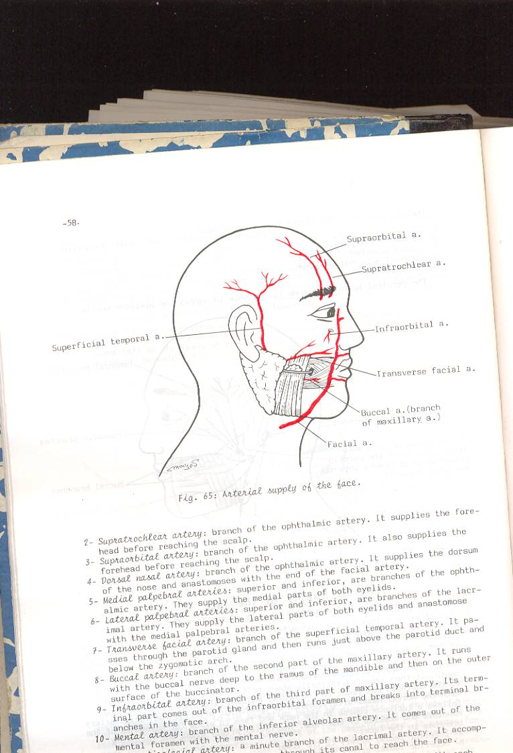
Arterial Supply of the Face
Facial artery : arises from external carotid artery. -it reaches face by piercing deep fascia at the lower border of the mandible and then curving up to the face close to anteroior border of masseter, here its pulse can be easily felt. -it then passes upwards in a tortuous course over the mandible and buccinator towards the angle of mouth. -it then ascends along side of nose to the medial angle of eye, where it anastomoses with the terminal branches of the ophthalmic artery.
Superficial temporal artery : the smaller terminal branch of external carotid artery within the parotid gland.It ascends in front of auricle to supply the scalp.

Slide 28
Arterial Supply of the Face
Transverse facial artery : a branch of superficial temporal artery of external carotid artery, within the parotid gland.It runs forward across the cheek just above parotid duct.
Infraorbital artery : it is the terminal part of maxillary artery (one of terminal branches of external carotid artery), it enters face via infraorbital foramen.
Mental artery : branch of inferior alveolar from maxillary from ext.c.artery, ,it enters face via mental foramen of mandible.
Zygomaticofacial & zygomaticotemporal arteries, from superficial temporal artery.
Lacrimal artery : from ophthalmic artery, of internal carotid artery.
Supraorbital & Supratrochlear arteries : branches of ophthalmic artery, of internal carotid artery , supply skin of forehead.

Slide 29
Branches of Facial artery
1- Submental artery : arises at the lower border of the body of mandible to supply skin of chin + lowe lip. 2- Inferior labial artery : arises near angle of mouth to run medially in the lower lip and anastomoses with its fellow of opposite side. 3- Superior labial artery : runs medially in the upper lip and gives branches to the septum + ala of nose. 4- Lateral nasal artery : supplies skin on the side & dorsum of nose.

Slide 30
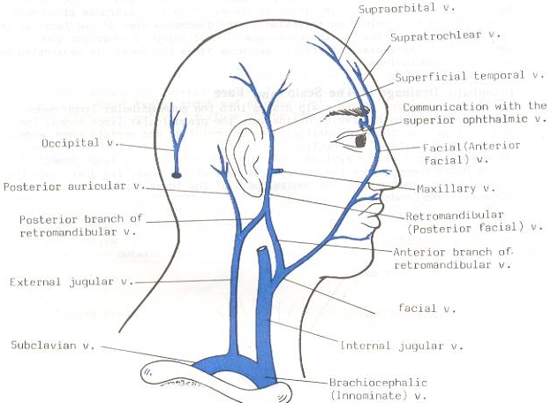
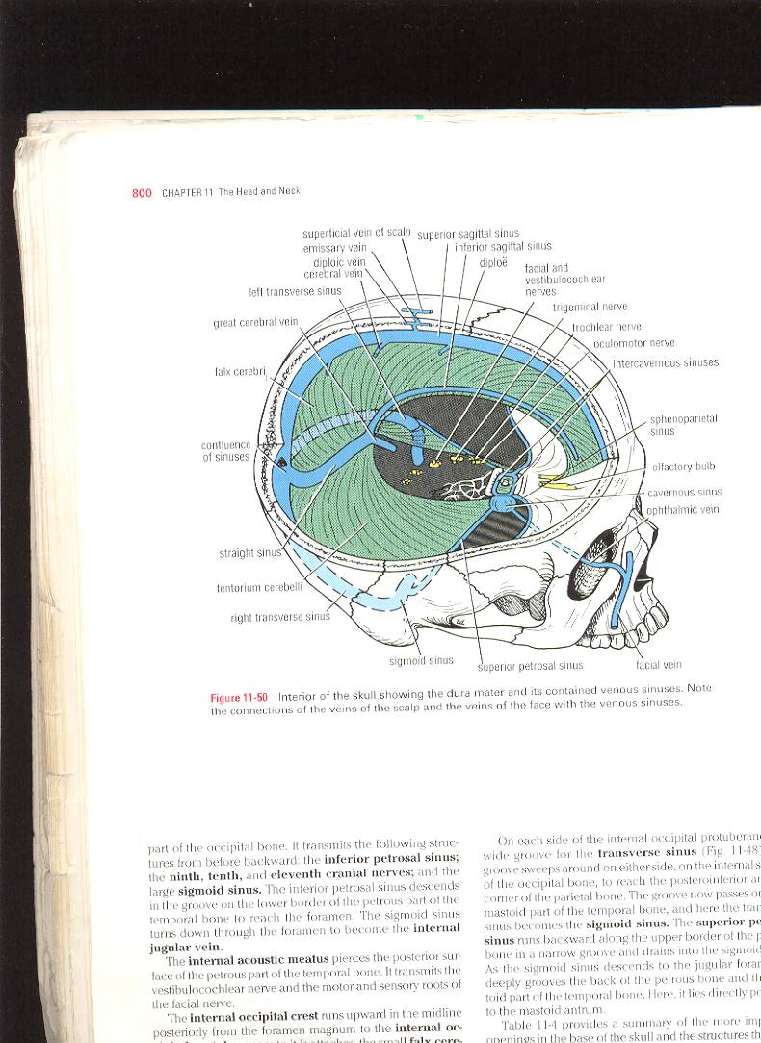
Venous Drainage of Face
Facial vein : -is formed at the medial angle of eye by union of supraorbital & supratrochlear veins. -it is connected to cavernous sinus through superior ophthalmic vein. This connection is of great clinical importance because it provides a pathway for spread of infection from face to cavernous sinus. -It descends behind the facial artery to the lower border of body of mandible. -It crosses with the facial artery superficial to submandibular gland. –It is joined by anterior division of retromandibular vein to form common facial vein to end into the internal jugular vein.

Slide 31
Tributaries of Facial vein
It recevies tributaries that correspond to the branches of facial artery.
It is joined to pterygoid venous plexus ( a venous network lying around pterygoid muscles) by deep facial vein and to the cavernous sinus by superior ophthalmic vein.
Transverse facial vein joins superficial temporal vein within the parotid gland.

Slide 32
Venous drainage of scalp and face
Maxillary V Sup. Temporal V +
Supratrochlear V + Supraorbital V
Retromandibular V
Anterior facial V
Anterior division
Posterior division
+
Post. Auricular V
Common facial vein
EJV
IJV
Subclavian V
* Occipital veins drain into suboccipital plexus of veins

Slide 33
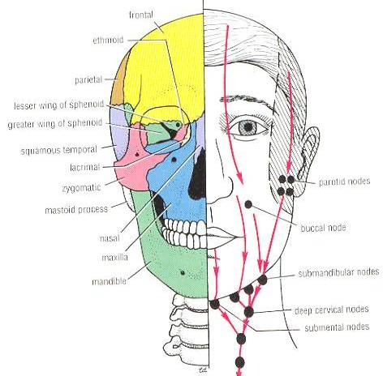
Lymph Drainage of the Face
Lymph from forehead + anterior part of face drains into submandibular L.Ns., a few buccal lymph nodes may be present along course of these lymph vessels.
Lateral part of face + lateral parts of eyelids drin into parotid L.Ns.
Lower lip + chin are drained into submental L.Ns.

Slide 34
Facial Nerve
It emerges from stylomastoid foramen to enter the parotid gland , it supplies all muscles of facial expression. it does not supply the skin ,It runs within substance of parotid gland, it divides into 5 terminal branches : 1- Temporal branch : emerges from upper border of gland to supply anterior + superior auricular muscles, frontal belly of occipitofrontalis, orbicularis oculi and corrugator supercillii. 2- Zygomatic branch : emerges from anterior border of parotid gland to supply orbicularis oculi.

Slide 35
Facial Nerve
3- Buccal branch : emerges from anterior border of parotid gland below parotid duct to supply buccinator +ms.of upper lip & nostril.
4- Mandibular branch : emerges from anterior border of parotid gland to supply ms. of lower lip. 5- Cervical branch : emerges from lower border of parotid gland , it descends in the neck to supply platysma muscle + depressor anguli oris muscle.

Slide 36
Nerve supply of the face
sensory
motor
By branches of trigeminal nerve except the skin covering the angle of mandible (supplied by great auricular nerve)
By facial N. which supplies all muscles of the face except lev. Palp. Sup. (by oculomotor)
Ophthalmic div.
Maxillary div.
Mandibular div.
1-supratrrochlear
2-supraorbital
3-palpebral br. of lacrimal
4-infratrochlear
5-external nasal
1-zygomaticofacial
2-zygomaticotemporal
3-infraorbital
1-mental
2-buccal
3-auriculotemporal

Slide 37
Facial muscle Paralysis
The facial ms. Are innervated by facial N.
Cause : Damage to facial N. (by a tumor in internal acoustic meatus or parotid galnd) /or operation or infection in middle ear / or perineuritis, Bell’s palsy in facial nerve canal.
Results : Lower motor neuron lesion which involves distortion of face+ drooping of lower eyelid + angle of mouth will sag on the affected side. /But Upper motor neuron lesion is due to lesion of pyramidal tract and here the upper face is normal because the neurons supplying this part receive corticobulbar fibres from both cerebral cortices.

Slide 38
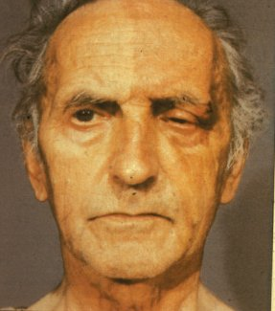
Bell’s Palsy
Lower motor neurone of facial nerve
Forehead and all the
muscles on the side of lesion are affected

Slide 39
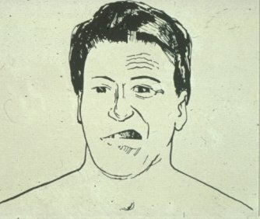
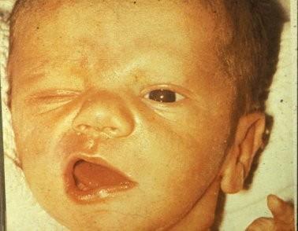
Facial Palsy

Slide 40
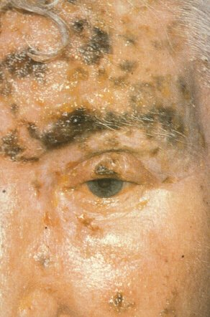
Corneal Reflex
Afferent (sensory) cilary branches nasocilary of ophthalmic of 5th
Efferent (motor)
Zygomatic branch of facial 7th
Last reflex to go

Slide 41
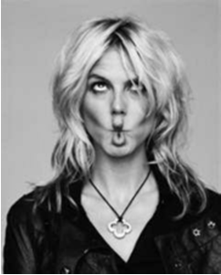
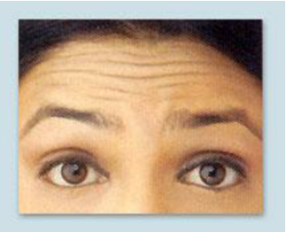
what muscles are being used?

Slide 42
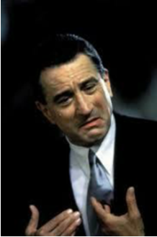
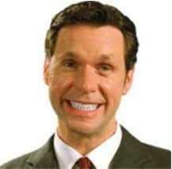
what muscles are being used?

Slide 43

what muscles are being used?

Slide 44
Special Expressions
How many of you have “special skills”
Can you wiggle your nose?
–Can you move your ears?
–Can you move your hairline?
All of these motions require the use of muscles
that you do have, but may not know how to
activate.

