Slide 1
Base of The Skull
Dr. Duraid Hameed
M.B.Ch.B, (TUCOM)
MRCS - ENT (RCSEd, UK),
DOHNS (RCSEd, UK),
MRES Anatomy ( Liverpool, UK)

Slide 2
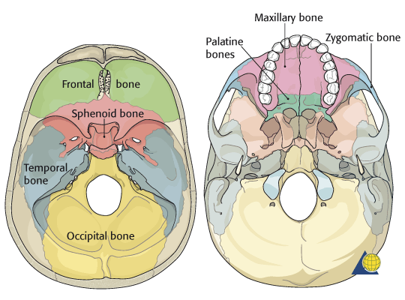

Slide 3
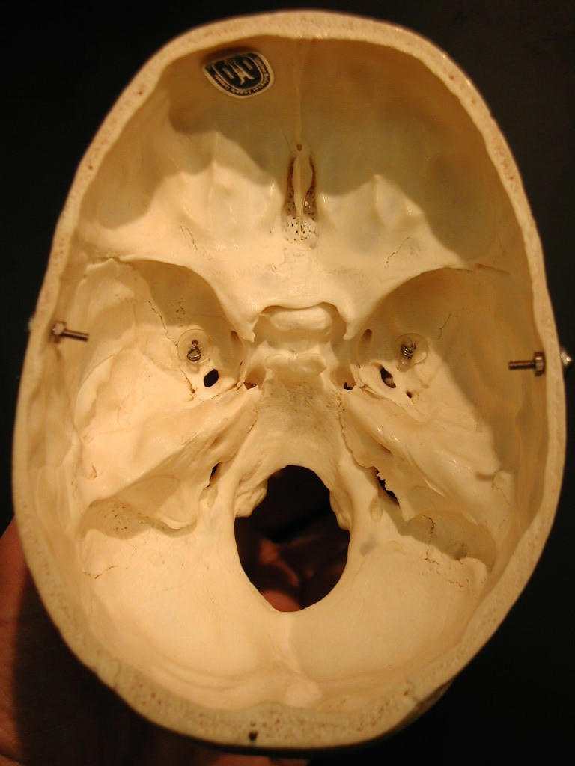

Slide 4
Anterior Cranial Fossa
Contains the frontal lobes.
Anteriorly : Inner surface of the frontal bone.
Midline: Frontal crest for attachment of falx cerebri.
Posteriorly: A. lesser wing of sphenoid which articulate with frontal bone and meets the ant. Inf. Angle of parietal bone or Pterion.
B. The medial end of sphenoid bone forms ant. Clenoid process which gives attachment of tentoriun cerebelli.
Floor:
A. Laterally, Orbital plate of frontal bone.
B. medially, cribriform plate of ethmoid bone supports the olfactory bulbs, and oflactory nerves.
Crista galli, is a sharp projection of the ethmoid bone for attachment of falx cerebri.

Slide 5
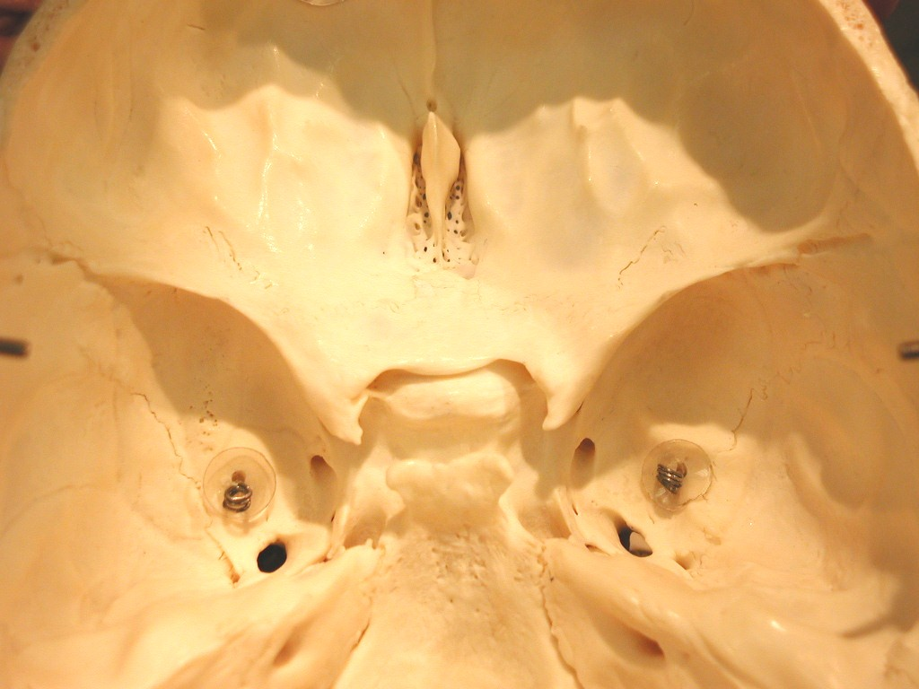

Slide 6
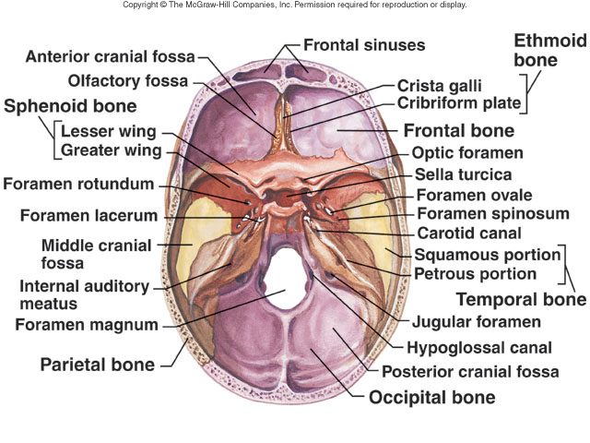

Slide 7
Middle Cranial Fossa
Consists of small median part (body of sphenoid) and large lateral parts (contains the temporal lobes of the cerebral hemisphere).
Anteriorly: lesser wing of sphenoid
Posteriorly: superior border of the petrous part of the temporal bone.
Laterally:
A. squamous part of the temporal bone
B. The greater wing of sphenoid
C. The parietal bone
Floor
A. The greater wing of sphenoid.
B. Squamous and petrous parts of temporal bone.
Medially is formed by the body of the sphenoid.

Slide 8
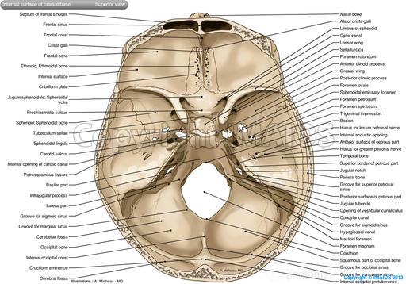

Slide 9
Posterior Cranial Fossa
It lodges cerebellum, pons, and medulla oblongata(hindbrain).
Anteriorly Superior border of petrous part of temporal bone.
Posteriorly: Internal surface of the squamous part of the occipital bone.
Floor: basilar, condylar and squamous part of the occipital bone.
Roof: Fold of dura, the tentorium cerebelli, which intervenes between the cerebellum below and occipital lobes of the cerebral hemispheres above.

Slide 10
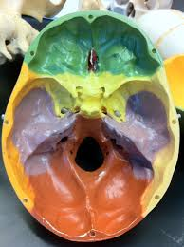

Slide 11
Major Skull Base foramina
Anterior cranial fossa:
A. Cribriform plate of ethmoid bone which transmits olfactory nerve bundles (I).
B. Foramen cecum, located between the crista galli and frontal crest, for transmission of small veins from the nose to the superior sagittal sinus.

Slide 12
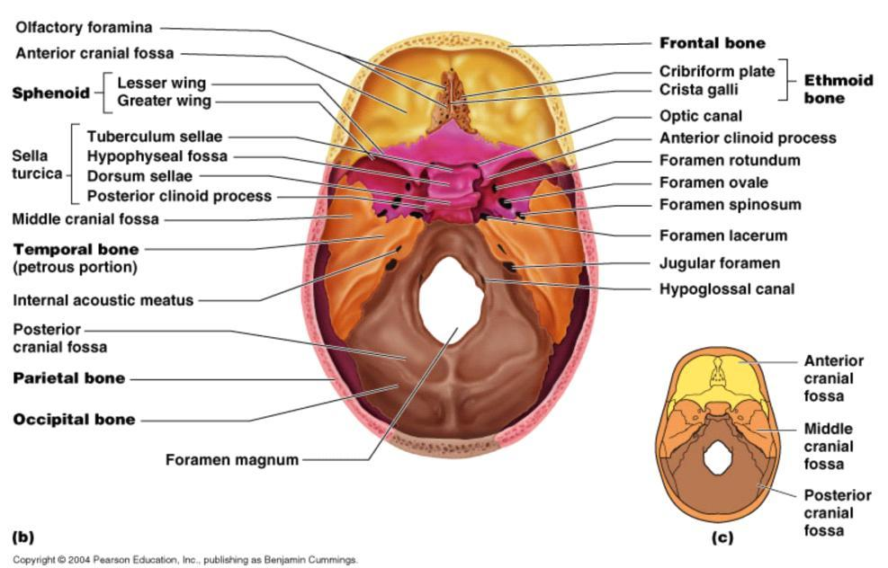

Slide 13
Middle Cranial Fossa Foramina
Optic canal: which transmits ophthalmic artery and optic nerve (II).
superior orbital fissure: which transmits the following structures:
superior ophthalmic vein.
oculomotor nerve (III).
trochlear nerve (IV).
lacrimal, frontal and nasociliary branches of ophthalmic nerve (V1).
abducent nerve (VI).
3. Inferior orbital fissure: Transmits mainly the maxillary nerve (Vb). Also it transmits the following structures
A. Inferior ophthalmic veins
B. Infraorbital artery.
C. Infraorbital vein.
D. zygomatic nerve.
E. Orbital branches of pterygopalatine ganglion

Slide 14
4. Foramen rotundum: located in the shenoid bone. It transmits maxillary nerve (Vb).
5. Foramen Ovale: transmits
Mandibular nerve: (Vc) (Mainly).
Lesser petrosal nerve.
Accessory meningeal artery.
6. Foramen Lacerum:
Artery of the pterygoid canal.
Greater petrosal nerve.
Internal carotid artery traverse the upper third.
7. Foramen Spinosum:
A. Middle meningeal artery (mainly).
B. Meningeal branch of the mandibular nerve (V3).

Slide 15
Posterior Cranial Fossa Foramina
1. Internal acoustic meatus, transmits the following structures.
A. Labyrinthine artery branch of basilar art.
B. Facial nerve (VII).
C. Vestibulocochlear nerve (VIII).
2. Jugular foramen, transmits:
Internal jugular vein.
Inferior petrosal sinus.
Large sigmoid sinus, turns down to the foramen to become Internal jugular vein.
glossopharyngeal nerve (IX).
vagus nerve (X).
accessory nerve (XI).

Slide 16
  3. Hypoglossal canal transmits hypoglossal nerve (XII).
  4. Foramen magnum, transmits:
  Anterior and posterior spinal arteries.
  Vertebral arteries.
  Medulla oblongata.
  Ascending spinal fibers of accessory nerve (XI).
  5. Stylomastoid foramen, transmits stylomastoid artery and facial nerve (VII).

Slide 17
Thank you

